Slide 1
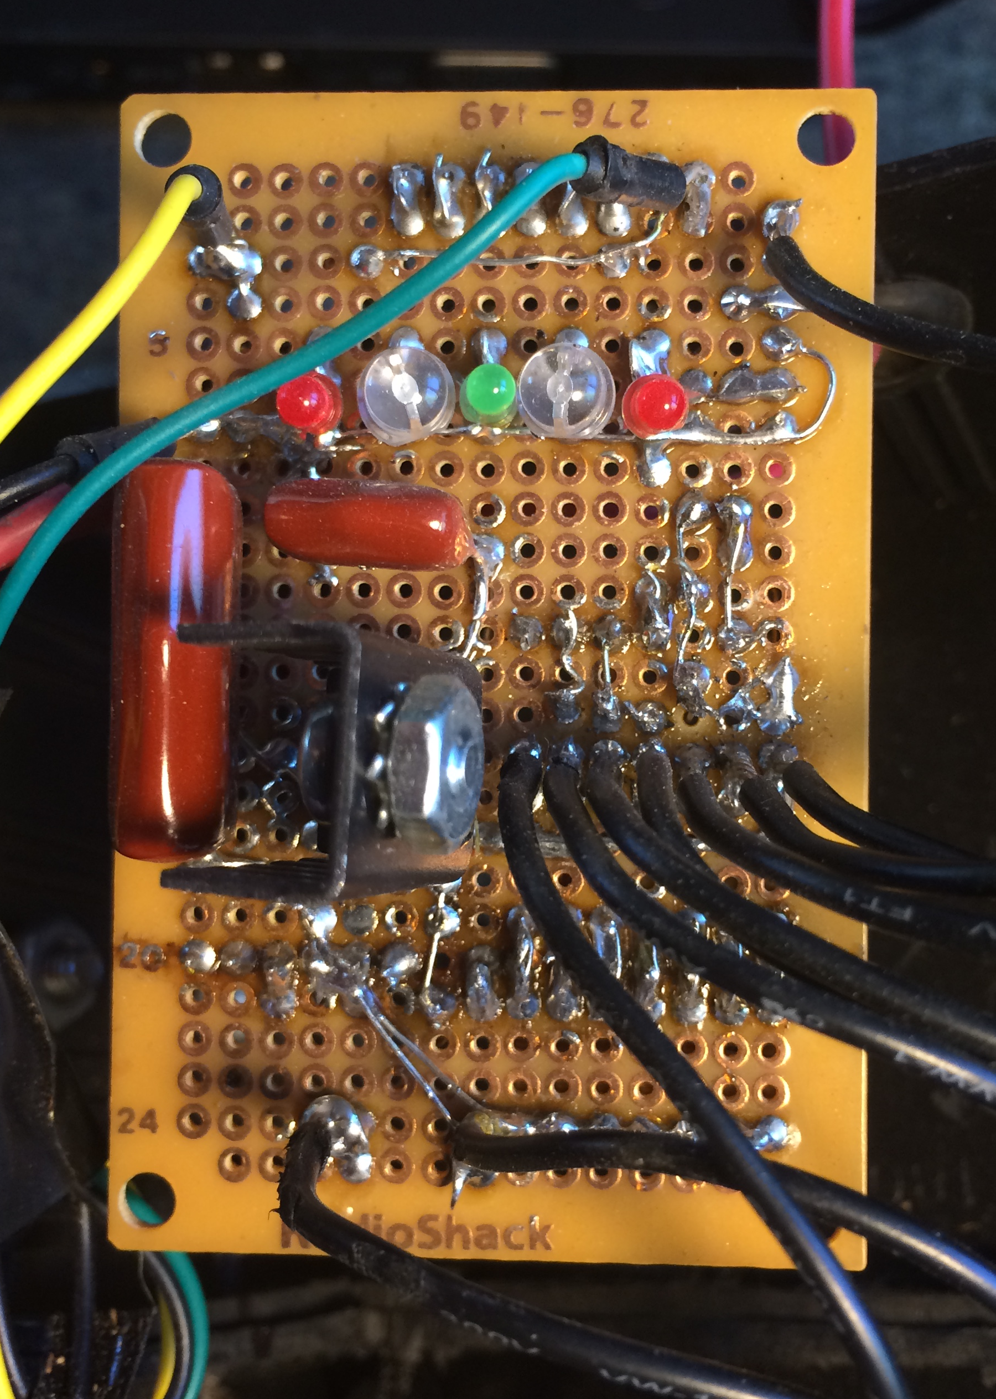
BOKn
Cell 8
Cell 7
Cell 6
Cell 5
Cell 4
Cell 3
Cell 2
GND
Cell 1

