Slide 1
Landscaping Ideas
Plants: not too big, low water usage or drought tolerant once established, fire resistant, including some that are good for pollinators
Hardscapes: attractive, durable, rakable or blowable
Fencing materials: attractive, fire resistant, durable, affordable
Using https://identify.plantnet.org/k-world-flora/identify for identification
Category | Item | Page
Smaller Trees | Crape Myrtle | 2
 | Japanese Maple | 3
 | Tulip Tree | 4
Taller Bushes | Lycianthes | 5
Shorter Bushes | Boxwood | 6
 | Ceanothus | 7
 | Indian Hawthorn | 8
 | Japanese Barberry | 9
 | Japanese Holly RETAKE PICTURE | 10
 | Mexican Bush Sage | 11
 | Pittosporum | 12
 | Small Rose | 13
 | Verbena | 14
Flowers | Autumn Sage | 15
 | Periwinkle | 16
Hardscapes | TBD
Fencing Materials | TBD

Slide 2
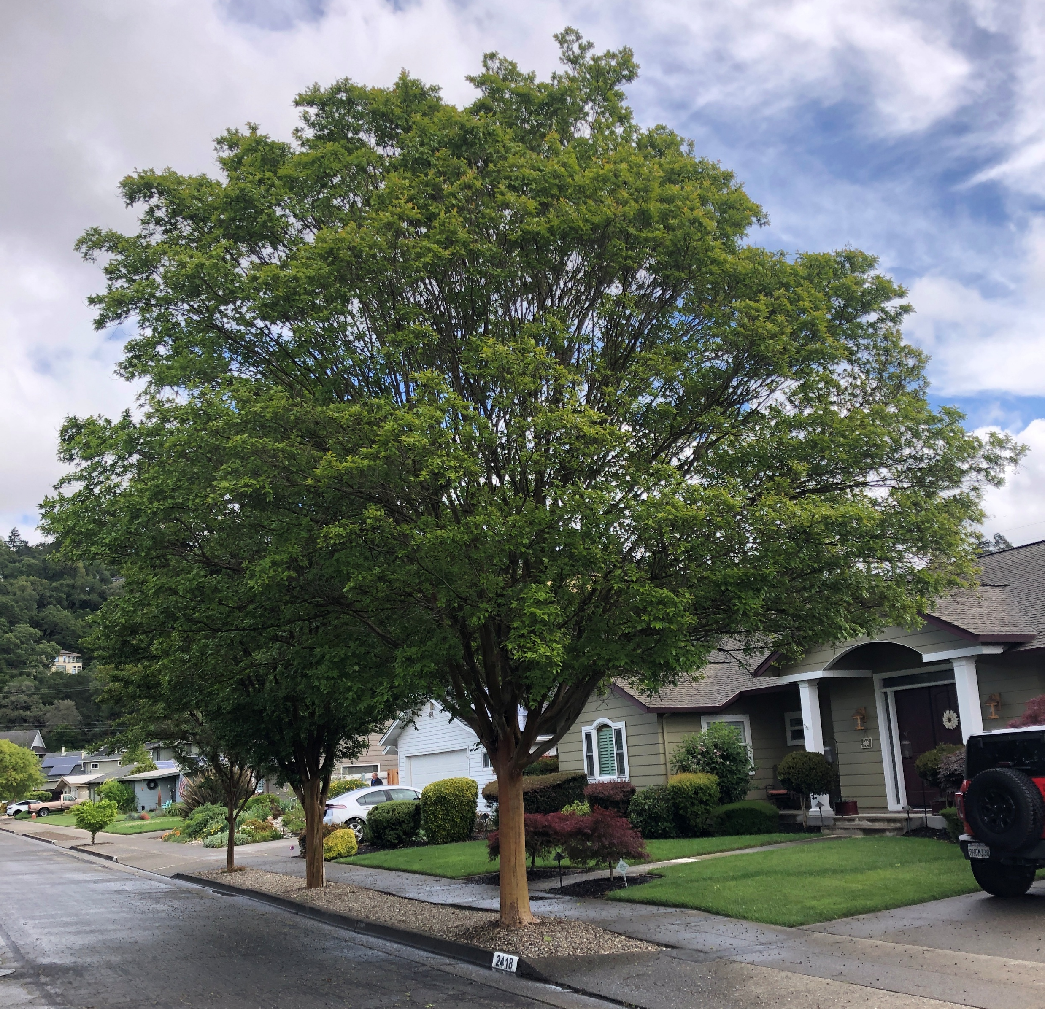
Smaller Trees
Crape Myrtle
Up to 25’ high and 15’ wide
Drought tolerant
Fire resistant
Native to East Asia

Slide 3
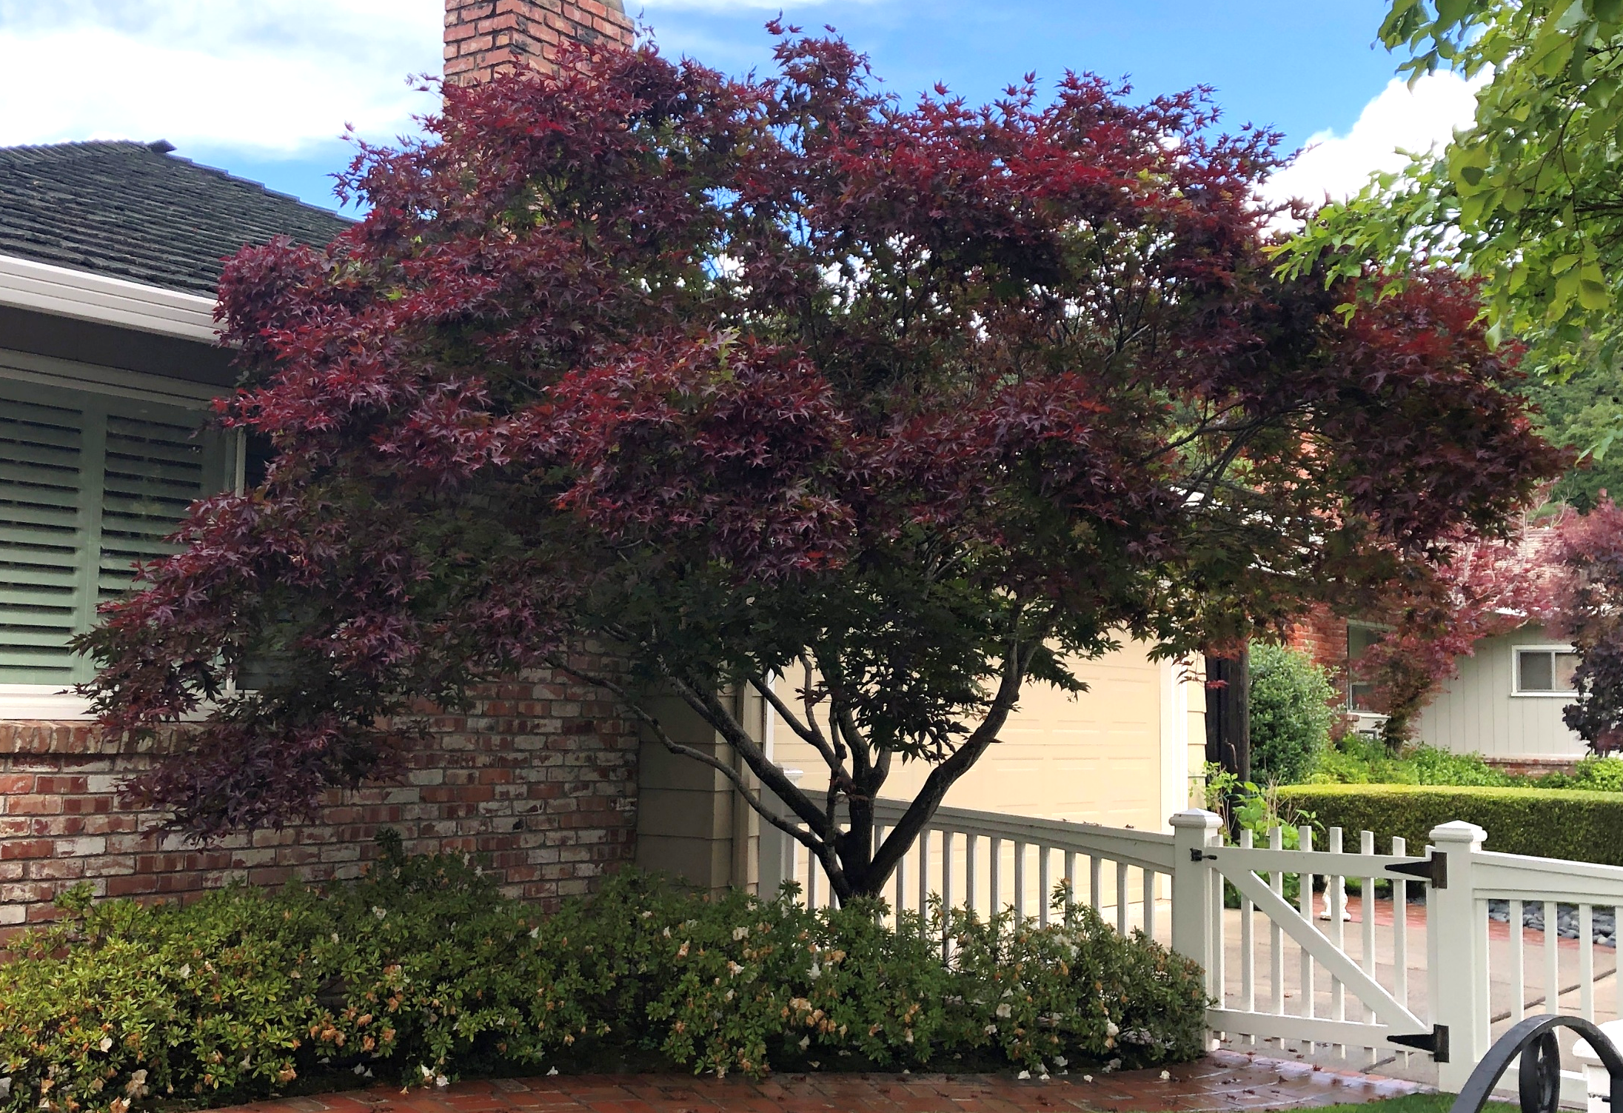
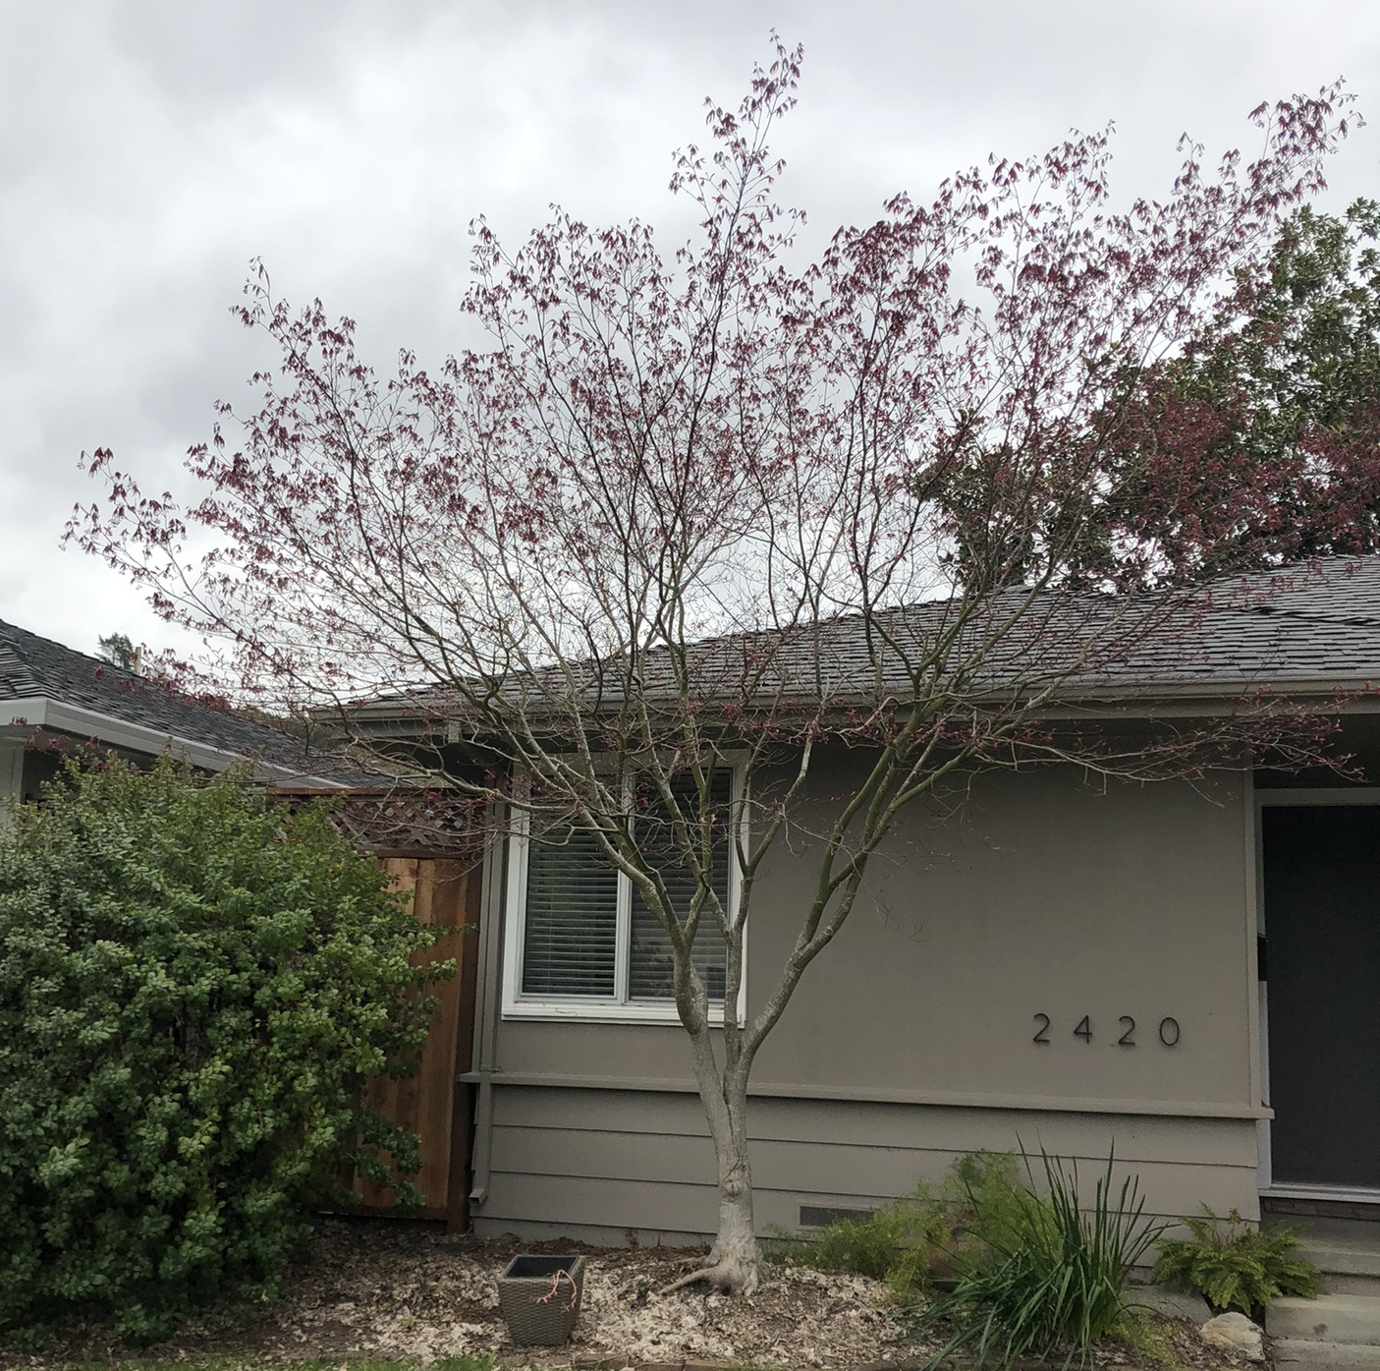
Japanese Maple
Up to 25’ tall and wide
Drought tolerant varietals available
Fire resistant
Native to East Asia

Slide 4
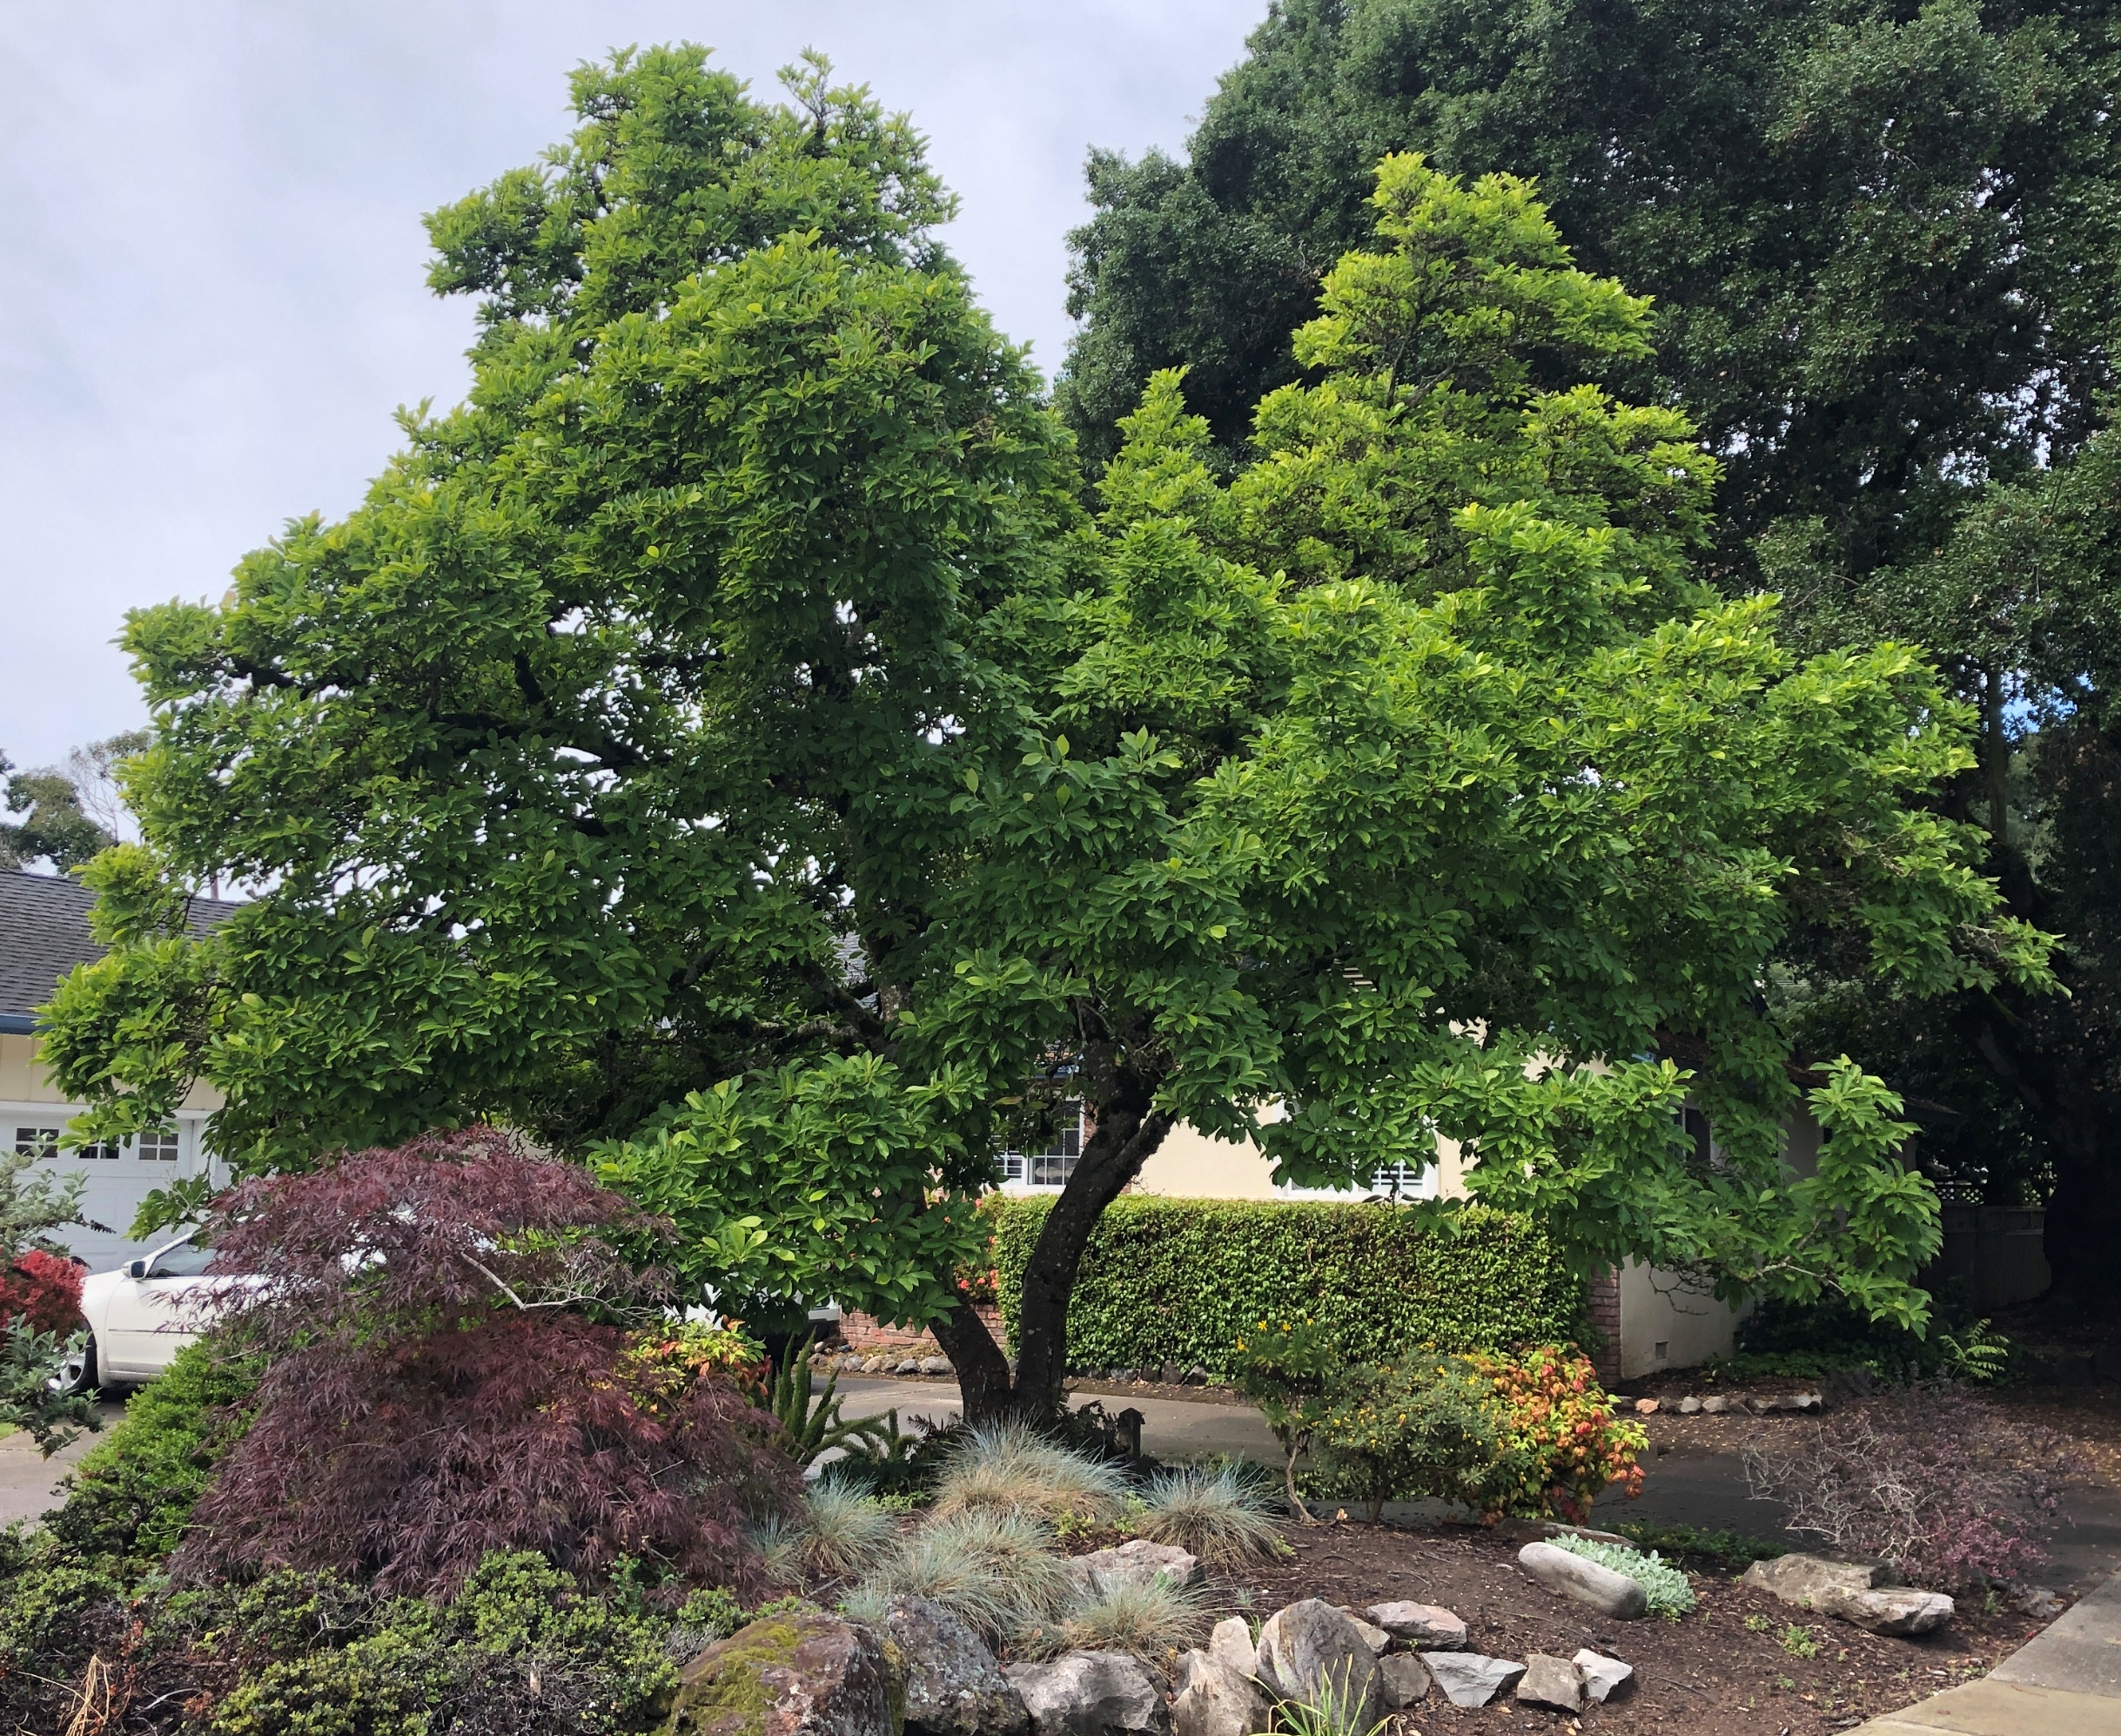
Tulip Tree
Up to 70’ high and 50’ wide, but not in Santa Rosa?
Only moderately drought tolerant
Fire resistant
Native to Eastern North America

Slide 5
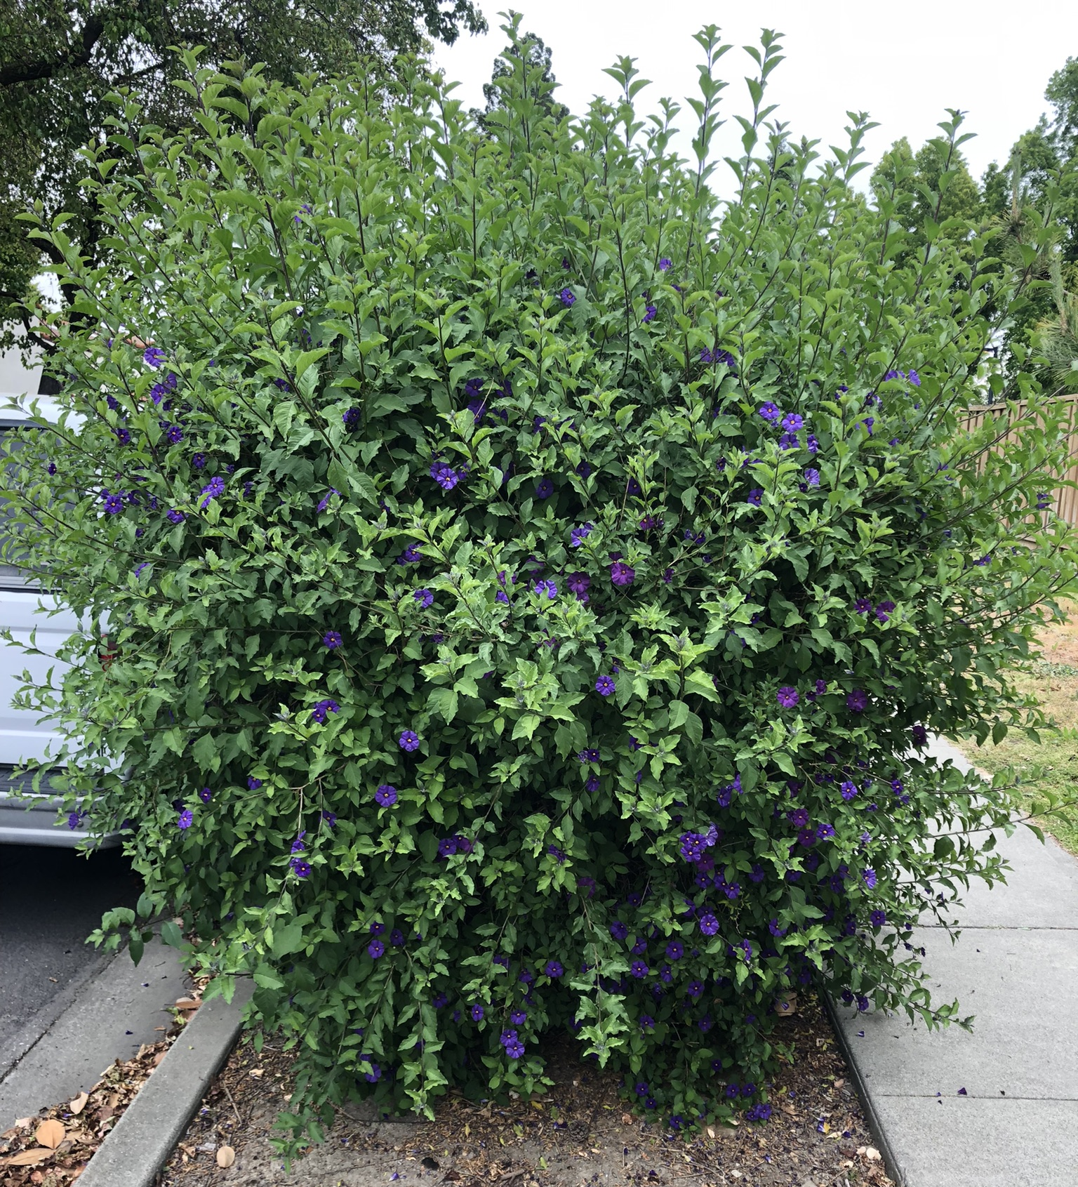
Taller Bushes
Blue Potato Bush
Up to 12’ high and 10’ wide
Only moderately drought tolerant
Fire resistant
Native to Paraguay and Argentina

Slide 6
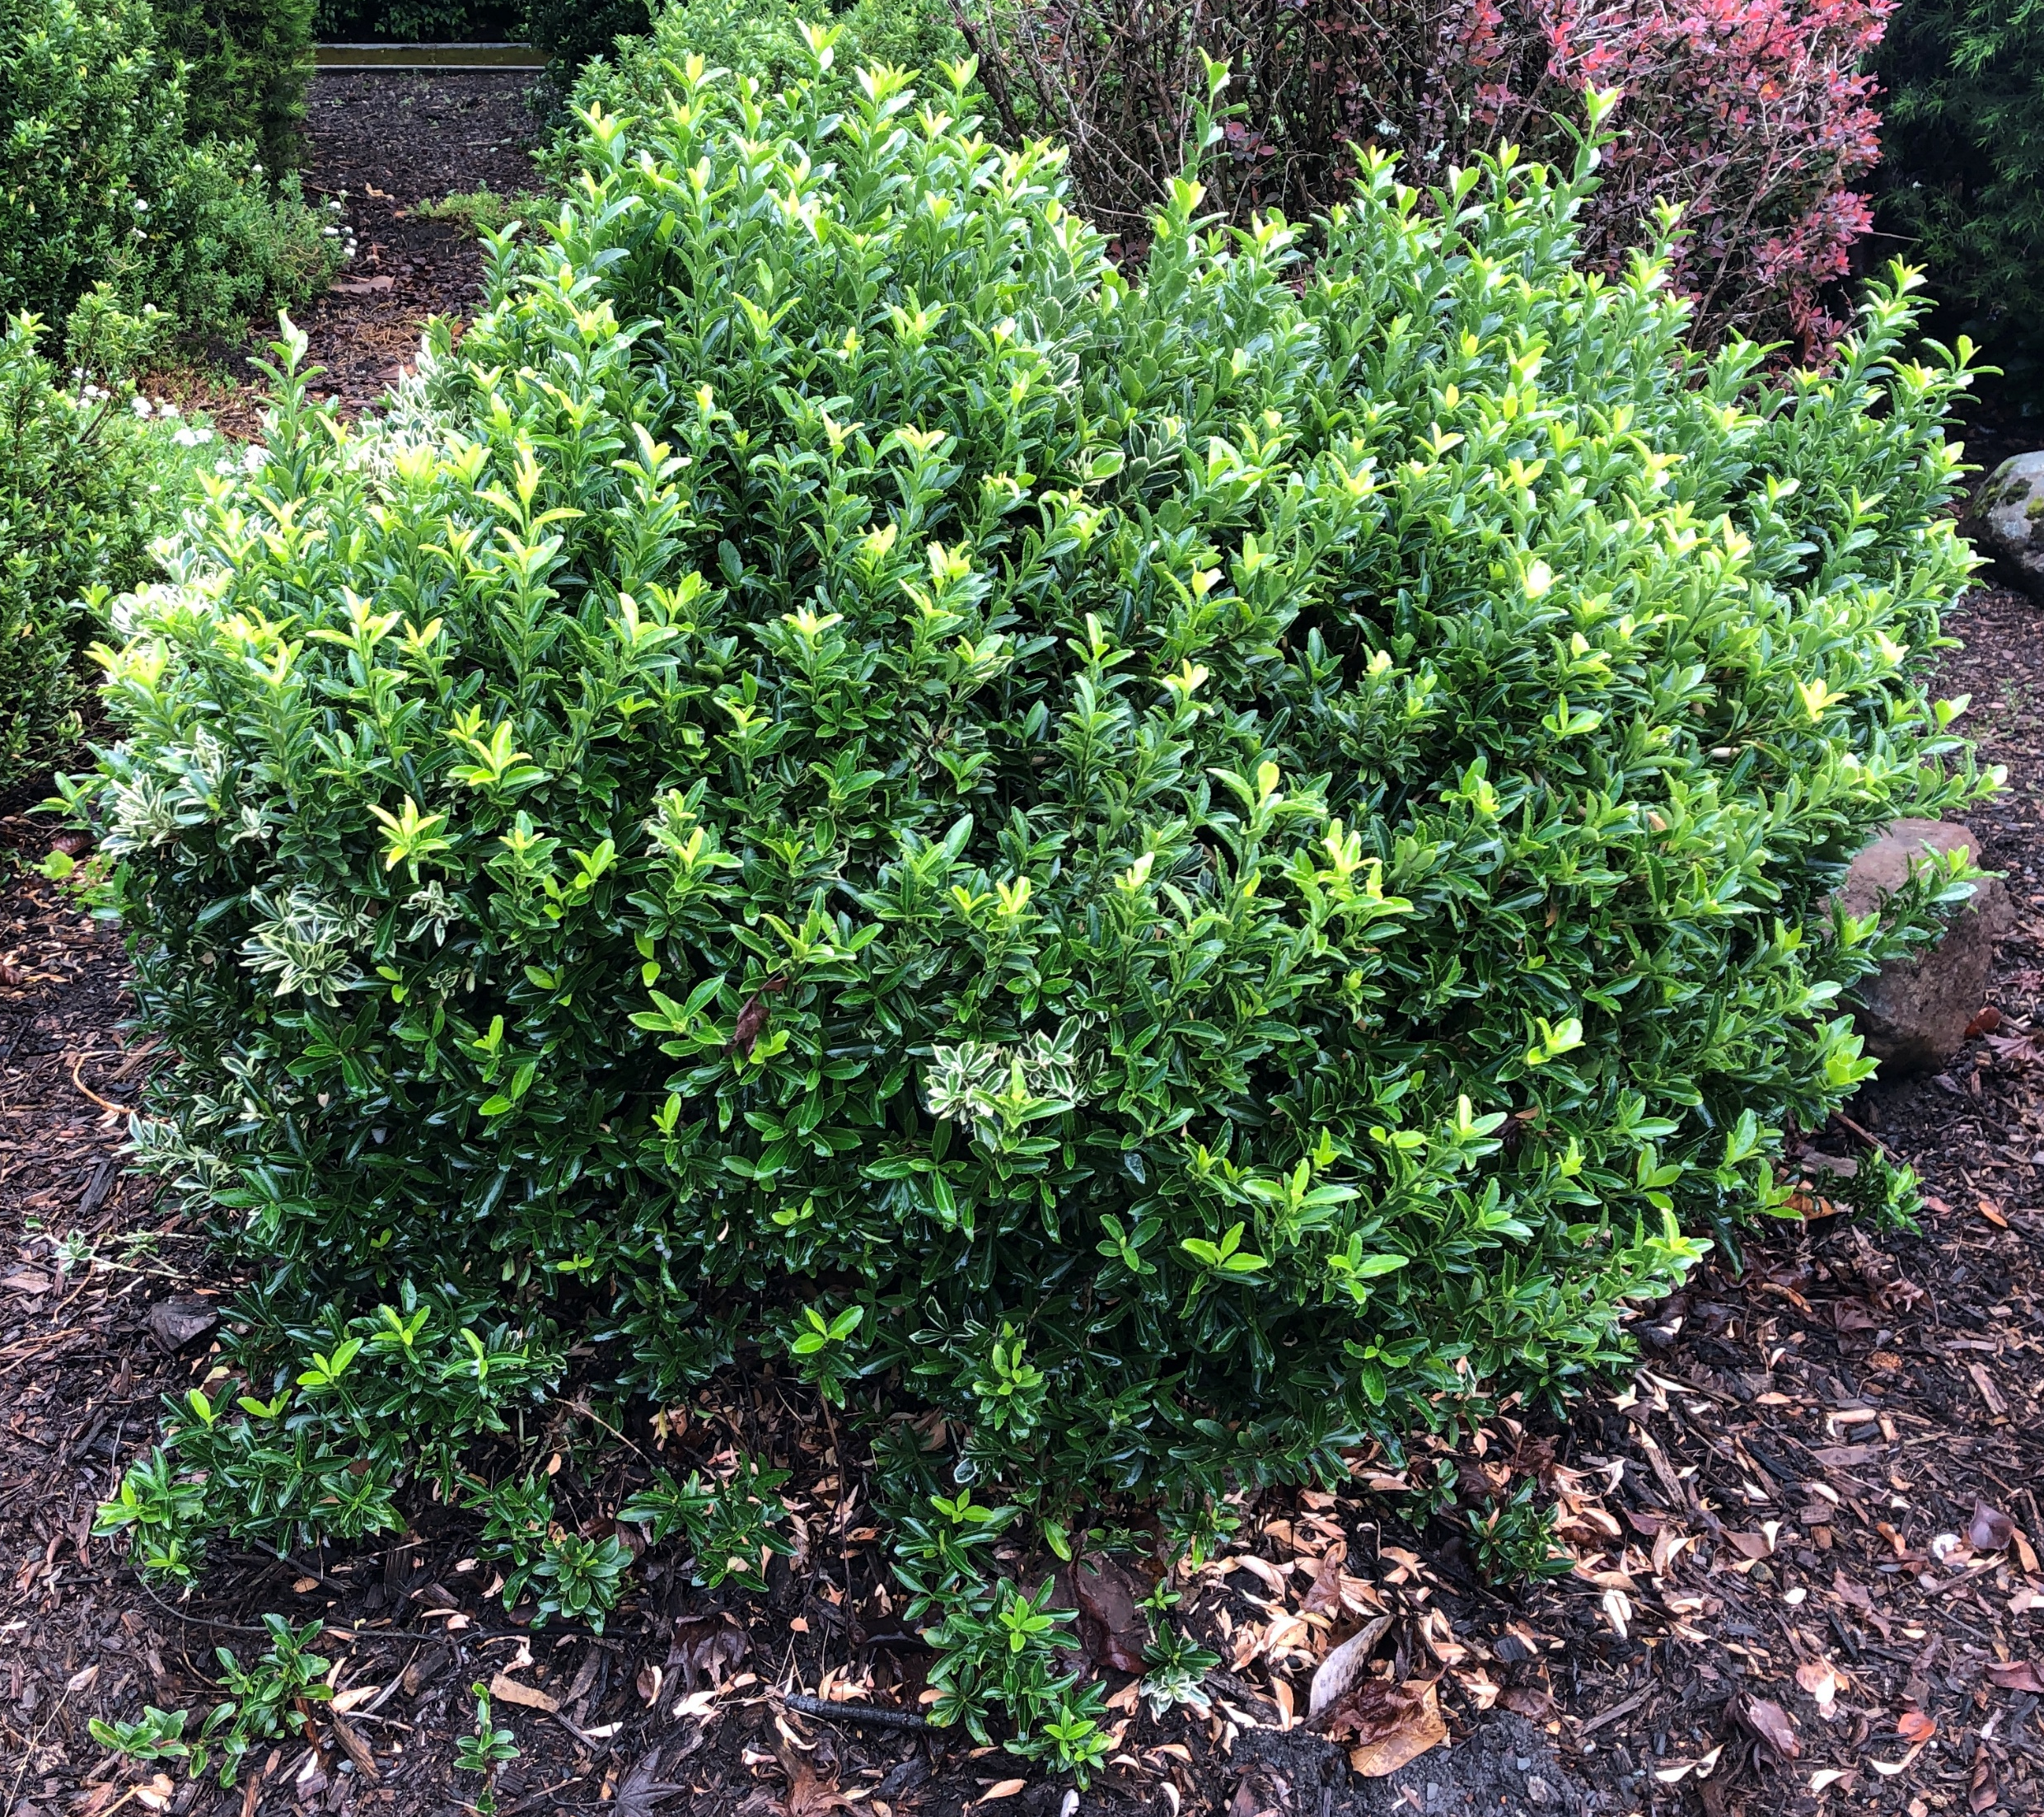
Shorter Bushes
Boxwood
Up to 20’ high and 8’ wide
Drought tolerant
Fire resistant
Native to Europe, Asia and Africa

Slide 7
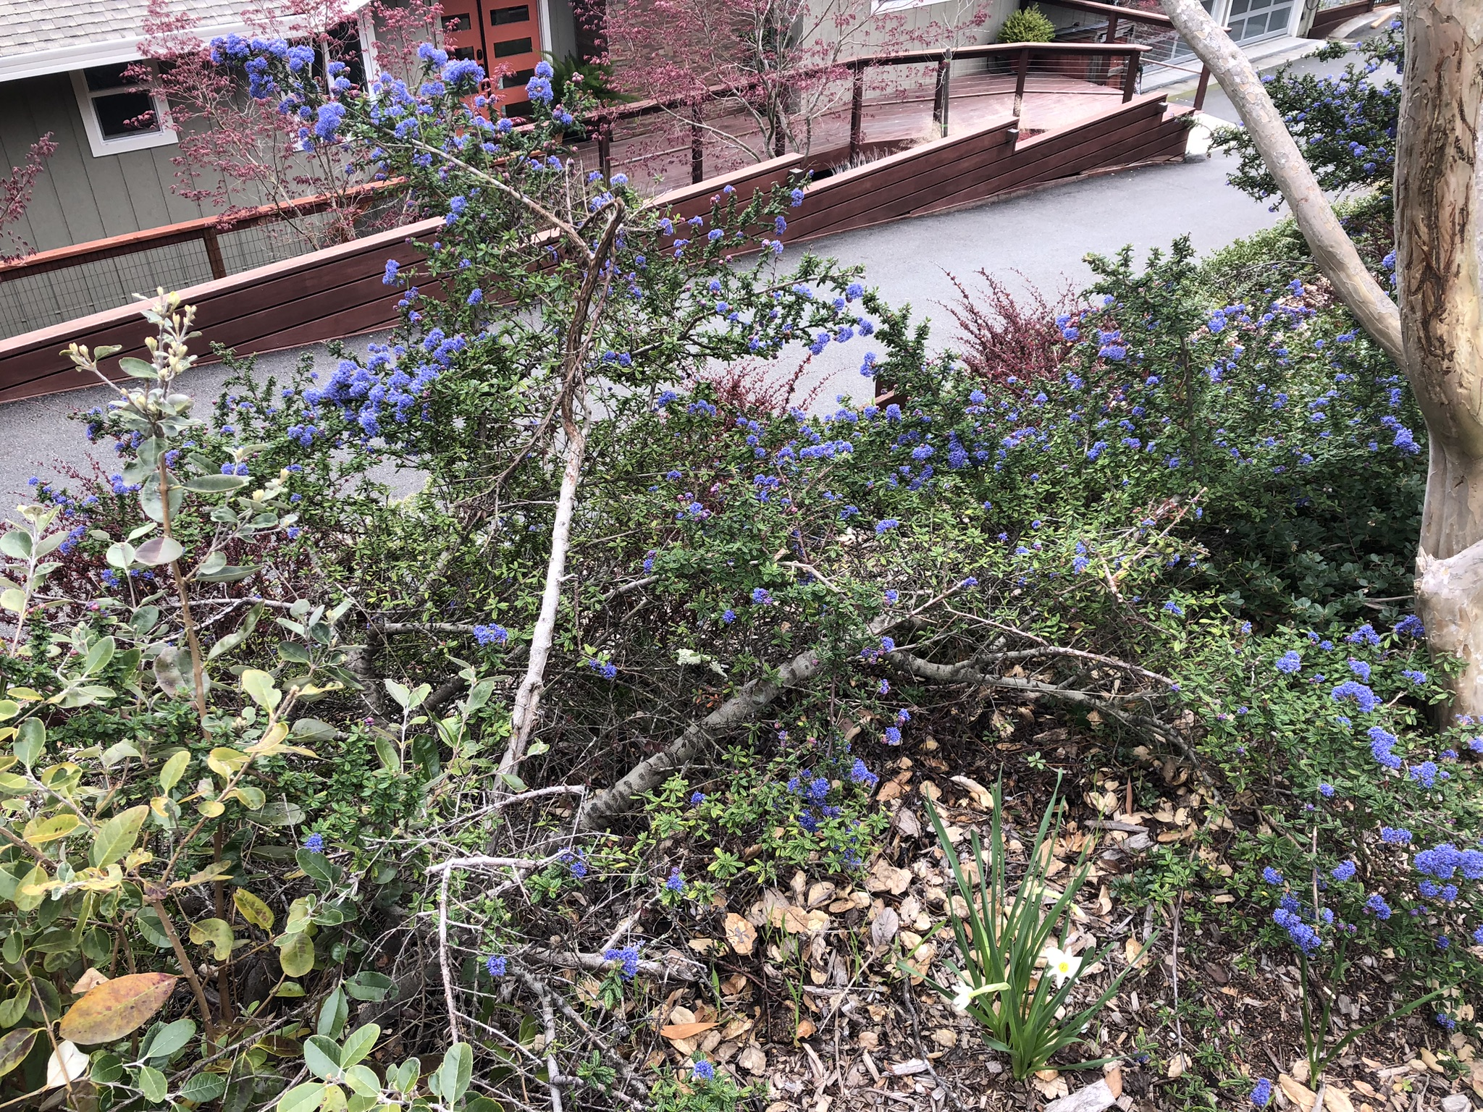
California Lilac
Up to 10’ high
Drought tolerant
Fire resistant
Native to California

Slide 8
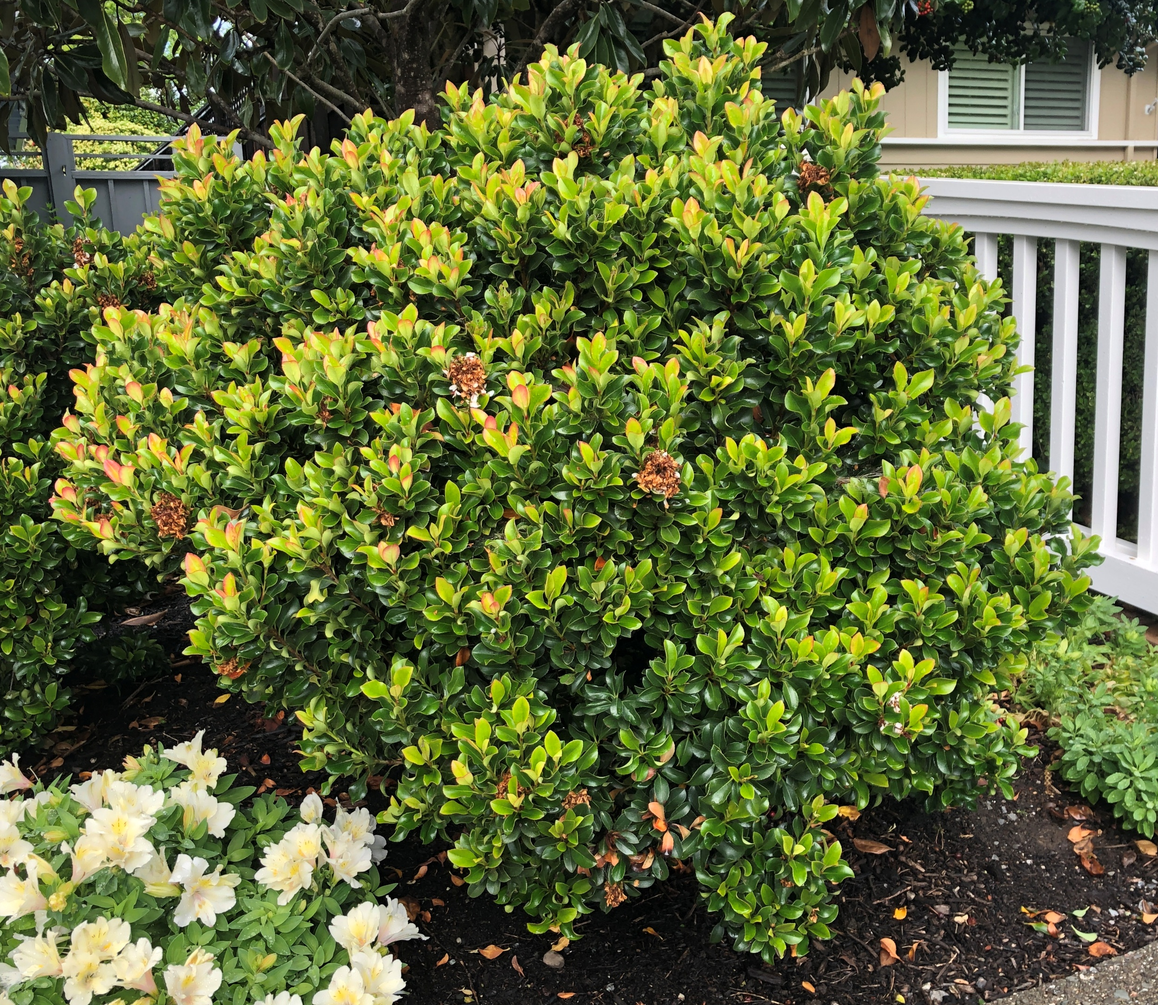
Indian Hawthorn
Up to 6’ tall and wide
Drought tolerant
Fire resistant
Native to Southeast Asia

Slide 9
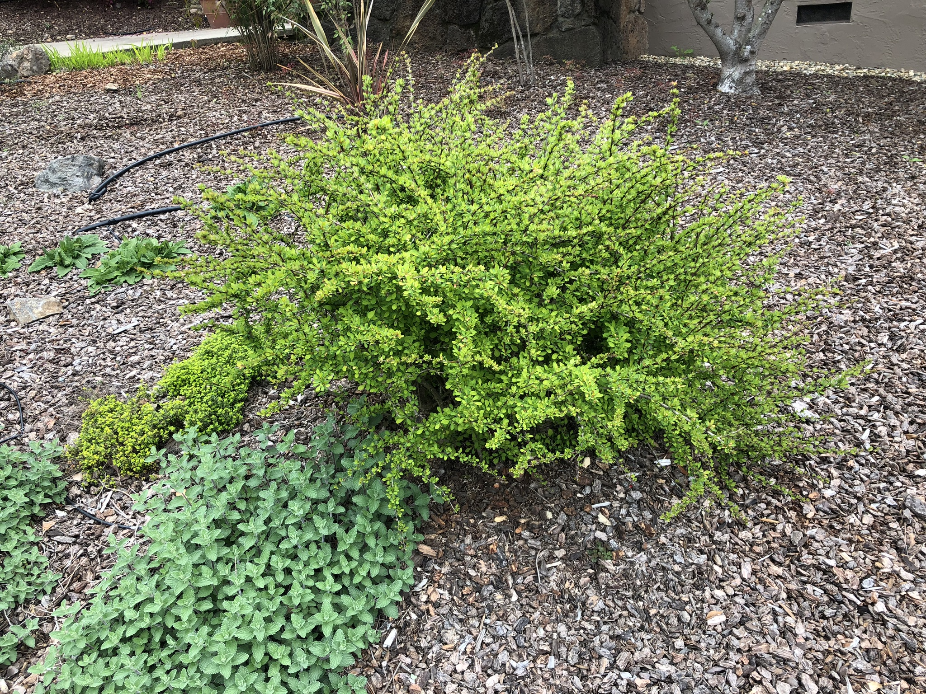
Japanese Barberry
Up to 6’ tall and 7’ wide
Highly drought tolerant
Fire resistant
Native to Japan and Asia

Slide 10
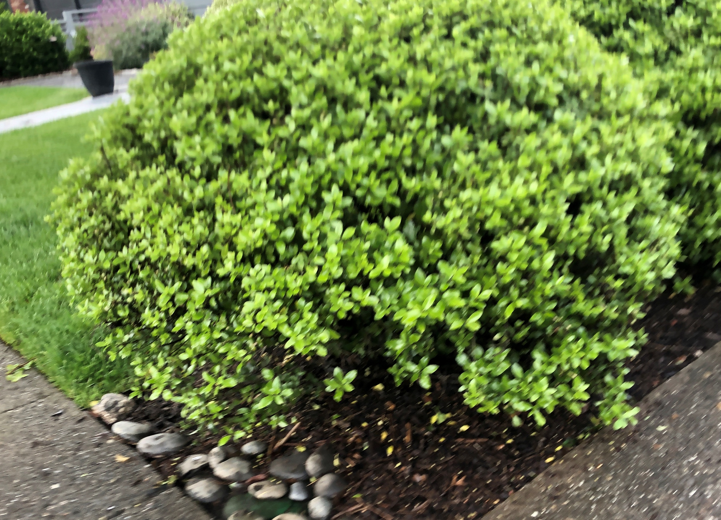
Japanese Holly RETAKE PICTURE
Up to 10’ tall
Only moderately drought tolerant
Fire resistant
Native to East Asia

Slide 11
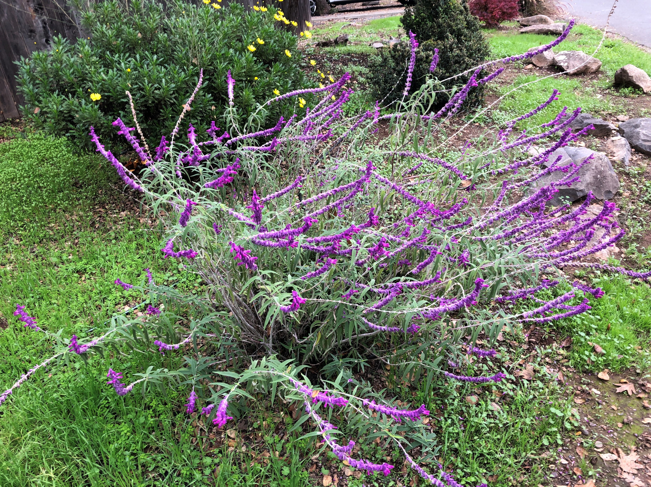
Mexican Bush Sage
Up to 5’ high and 6’ wide
Highly drought tolerant
Fire resistant
Native to Mexico and Central America

Slide 12
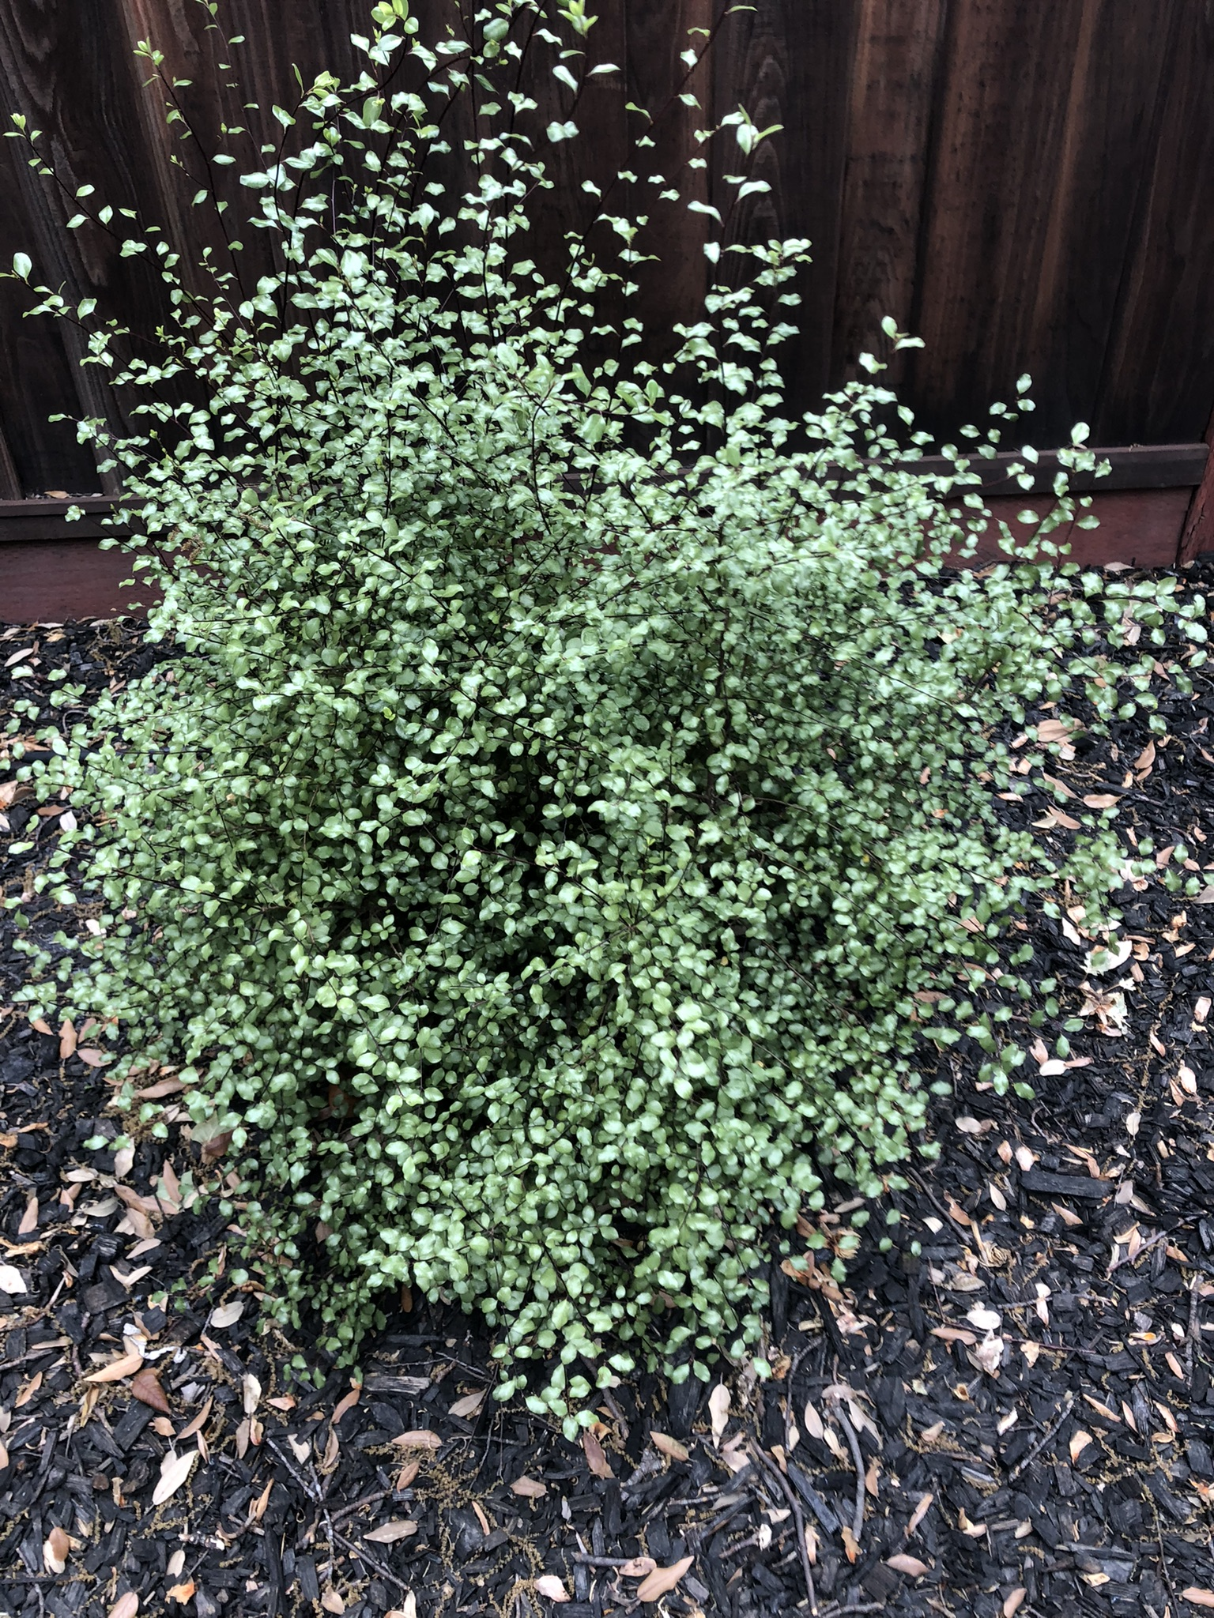
Pittosporum
2’ high dwarf to 15’ high varietals
Highly drought tolerant
Fire resistant
Native to Australia, Asia and Africa

Slide 13
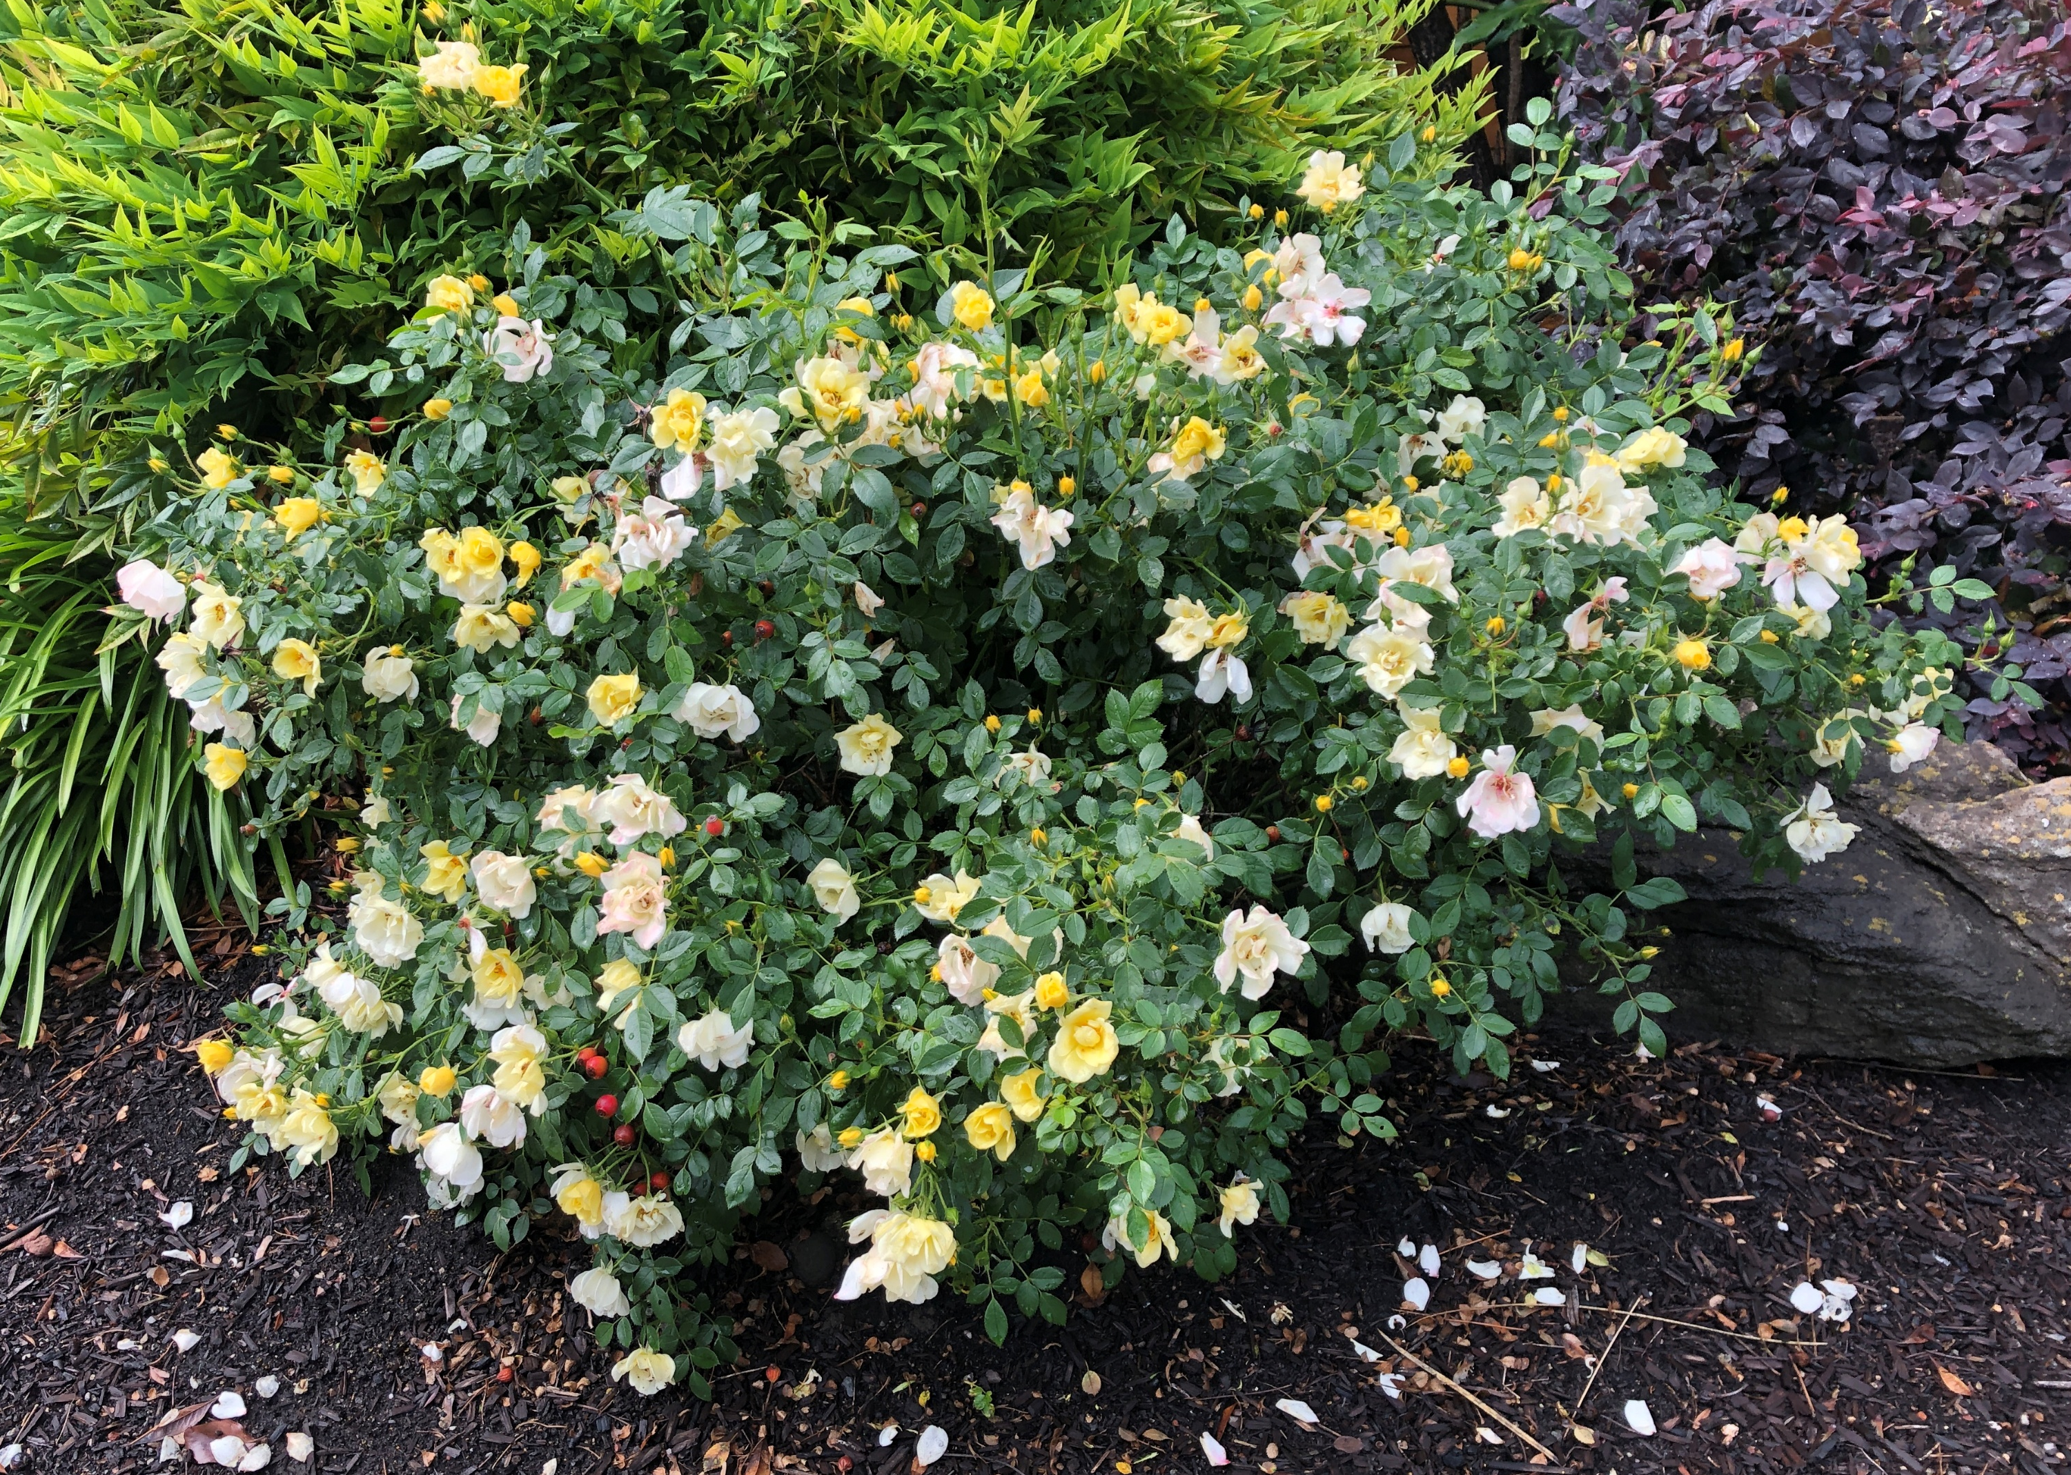
California Wildrose
2’ high
Low water usage
Fire resistant
Native to California

Slide 14
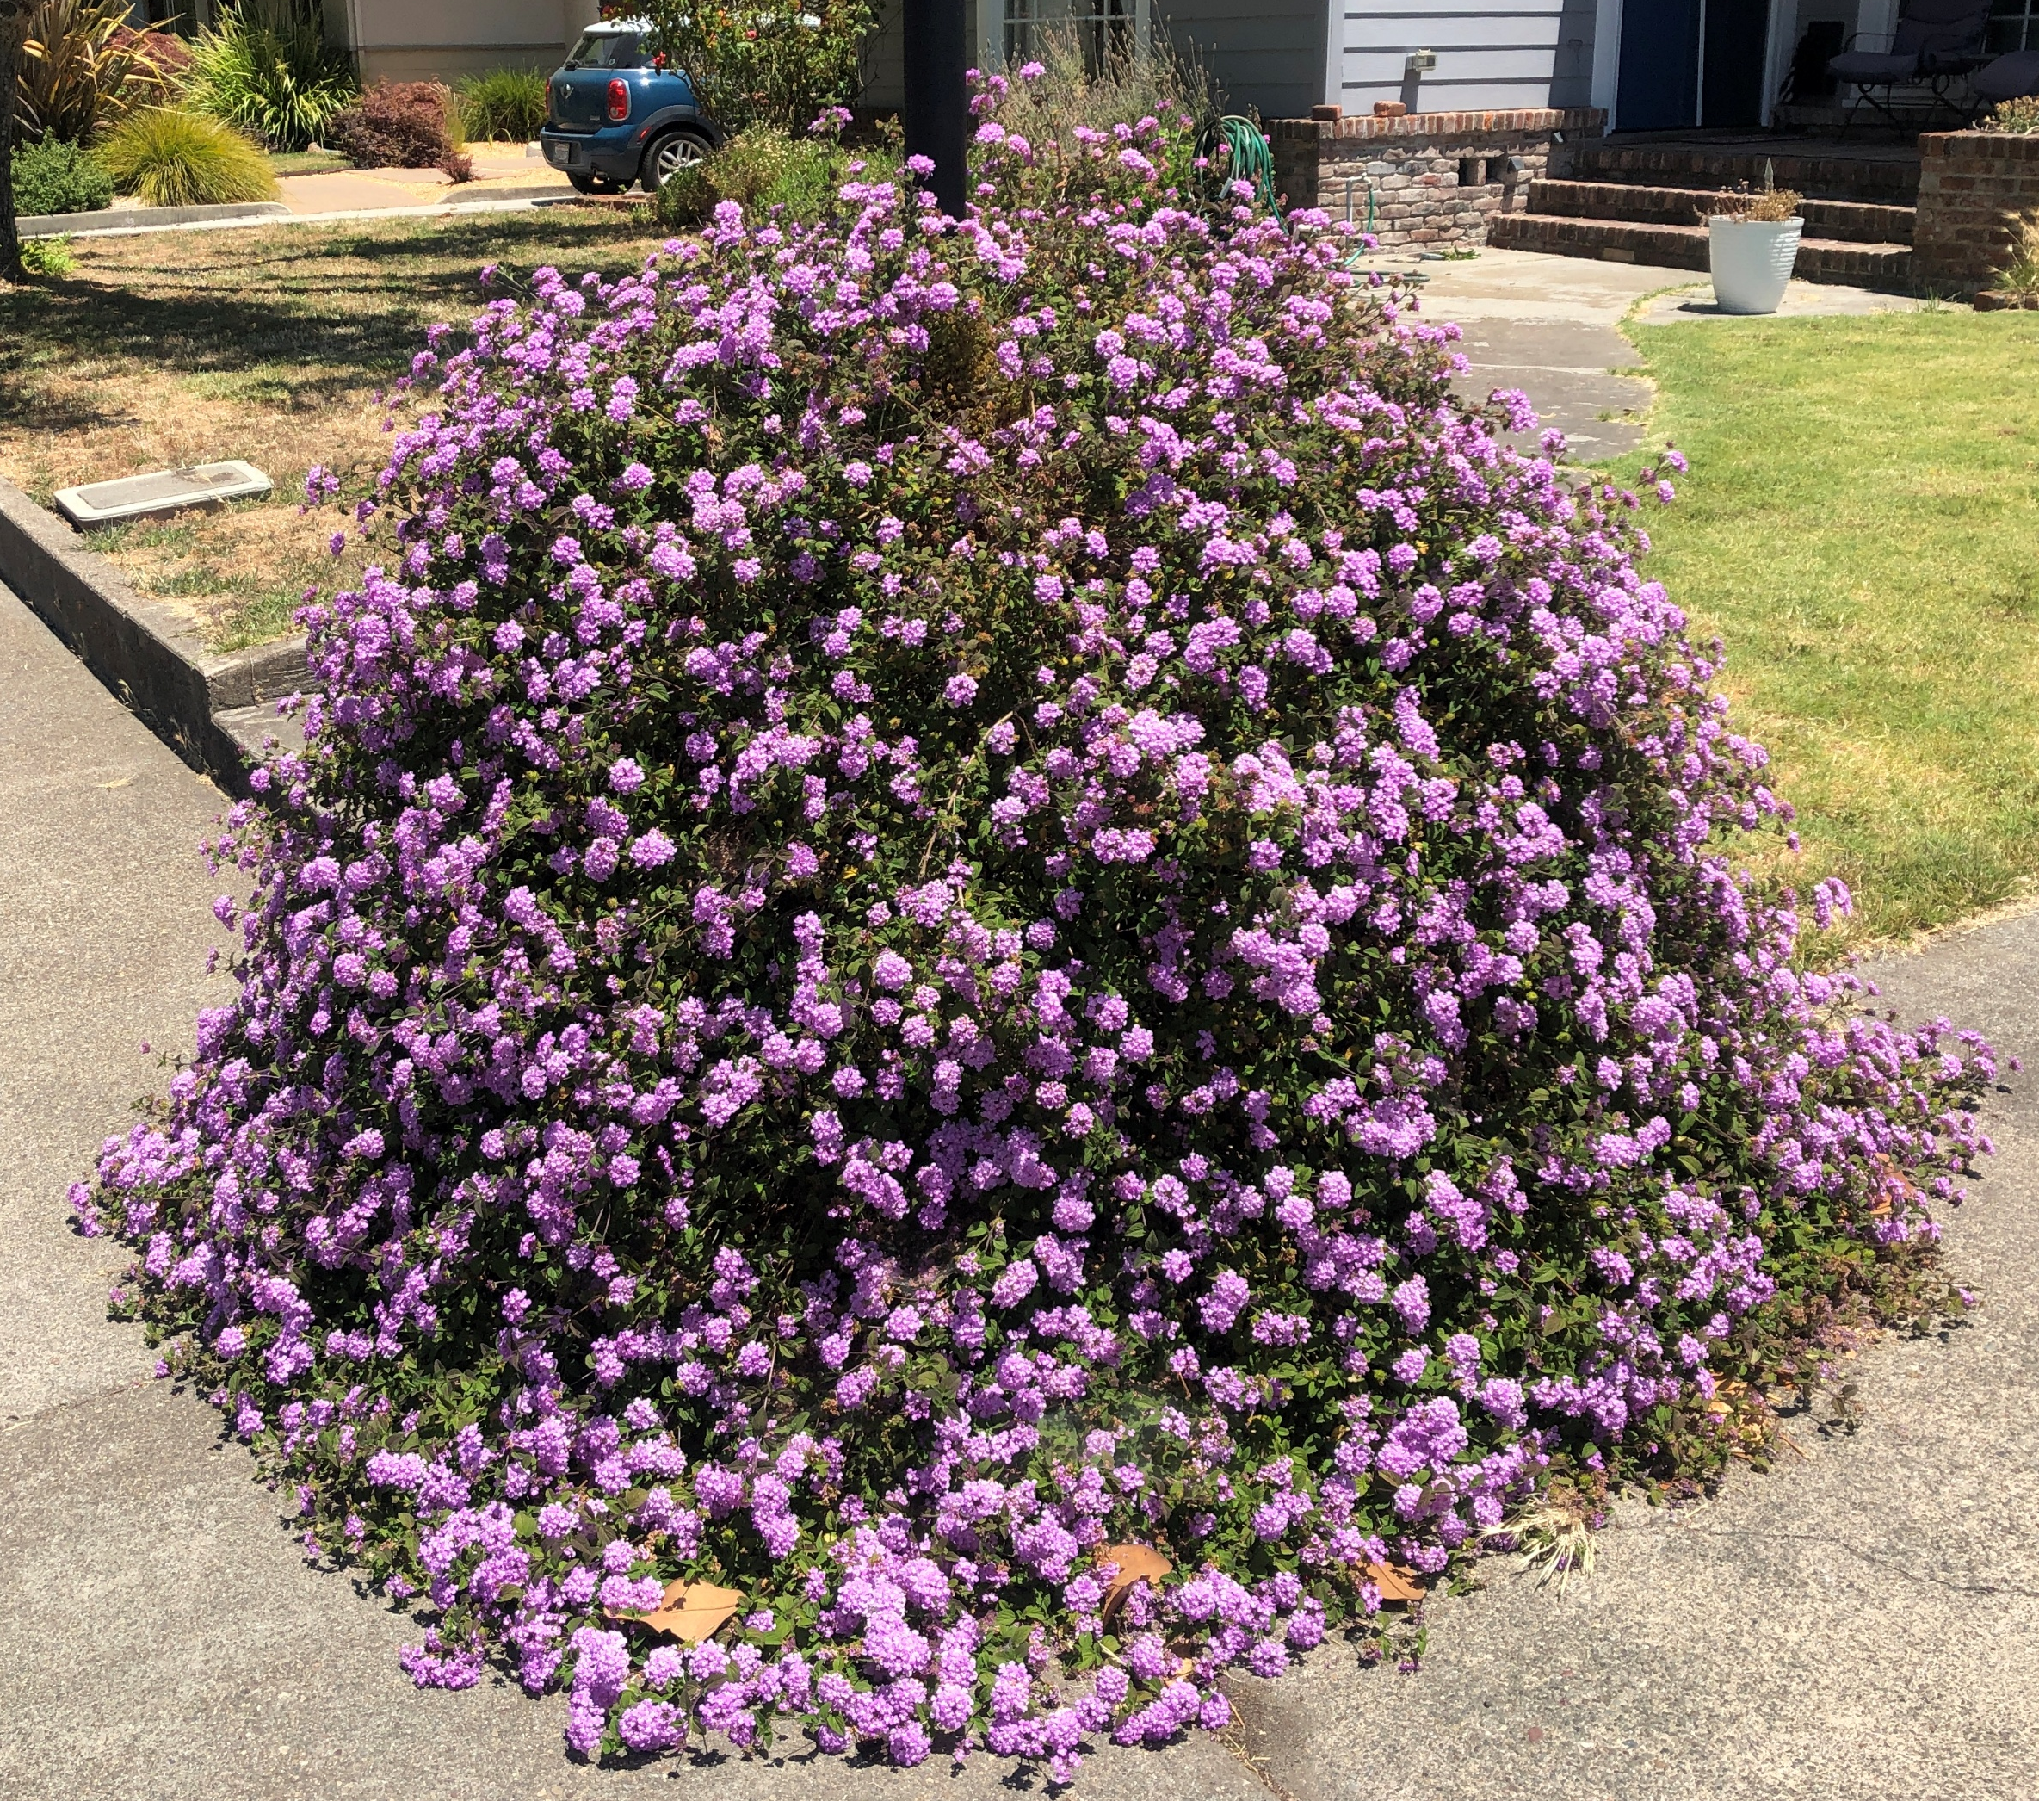
Verbena
Upright varietal up to 6’ tall and 3’ wide
Drought tolerant
Fire resistant
Native to California
Good for pollinators

Slide 15
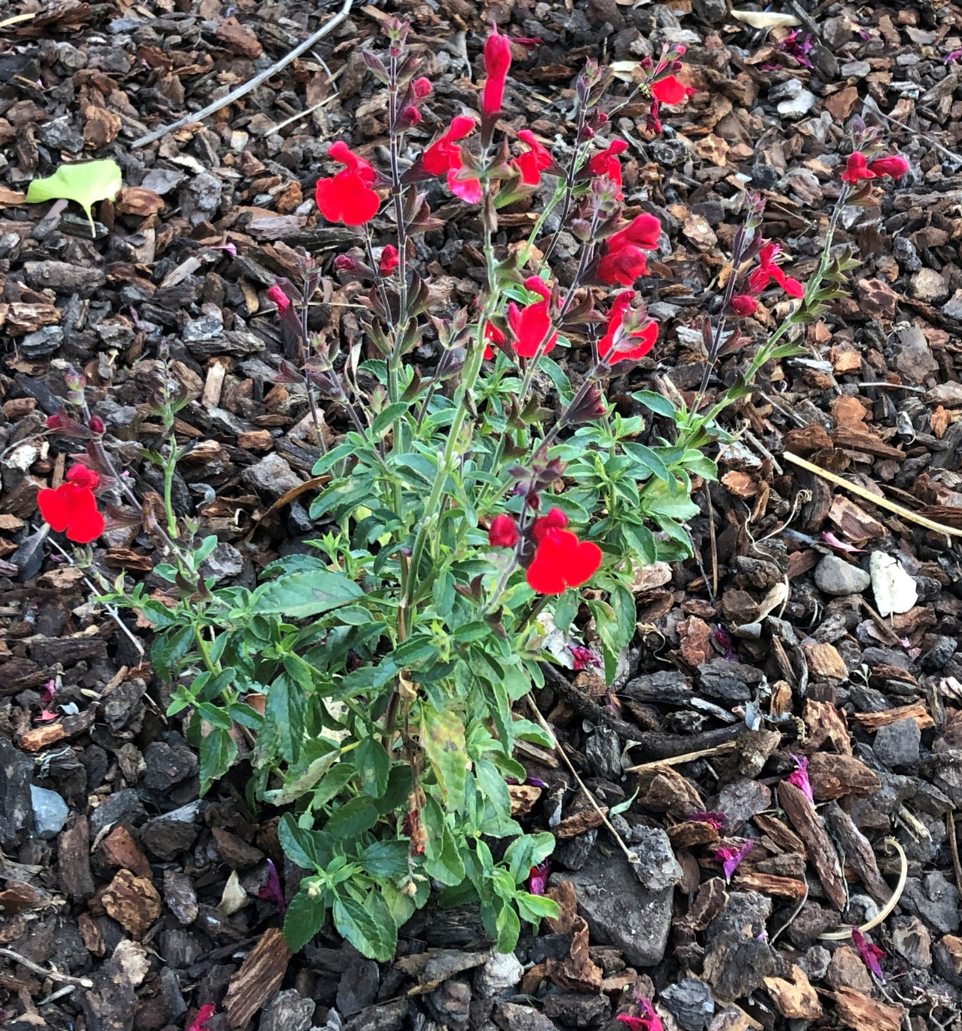
Flowers
Autumn Sage
Up to 3’ tall and wide
Highly drought tolerant
Fire resistant
Native to Texas, Arizona and Mexico

Slide 16
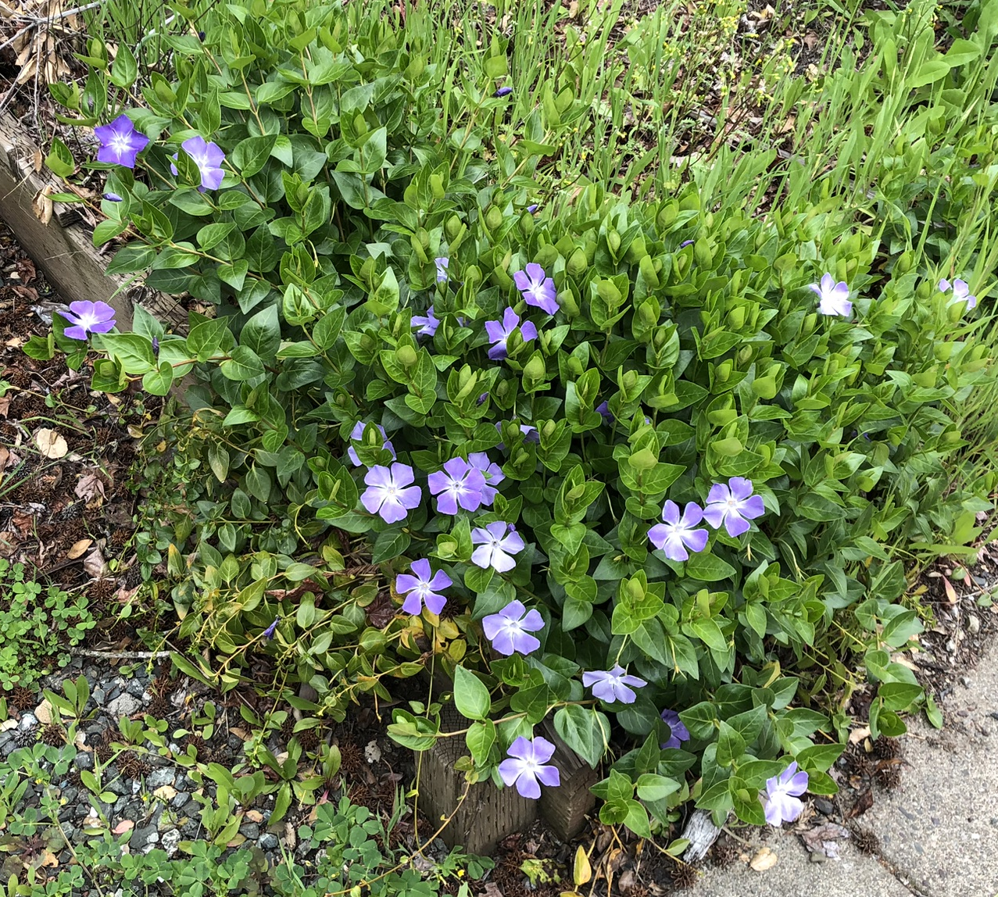
Periwinkle
Up to 2’ high
Highly drought tolerant
Fire resistant
Native to Europe, Africa and Asia

