Slide 1
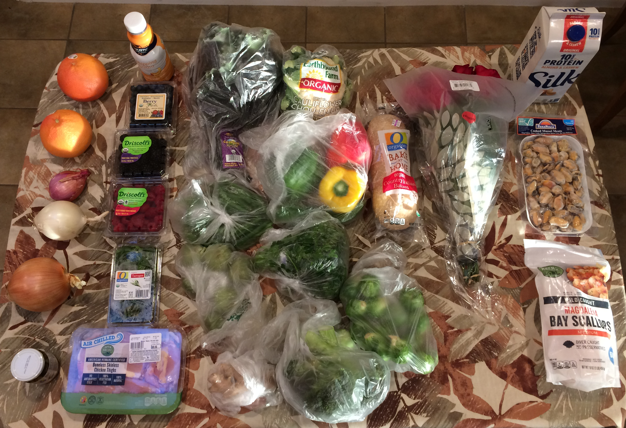
Jones Family Shopping Wrappers 2/13/2022
#1 plastic with
wraparound (2)
thin plastic bags (10)
double thin plastic bags (1)
#1 plastic (4)
carton (1)
None (5)
unknown plastic with
wraparound (1)
Glass jar with steel lid (1)
thick plastic bag (1)

Slide 2
Category | Qty | Items | Notes
None | 5 | 2 grapefruits, shallot, white onion, yellow onion | No need for wrapper, exterior is durable and will be removed
Glass jar with steel lid | 1 | Capers
#1 plastic | 4 | Blueberries, blackberries, raspberries, fresh tarragon
#1 plastic with wraparound | 2 | Cream, chicken
thin plastic bags | 10 | Kale, cauliflower, bell peppers, bread, green beans, Italian parsley, tomatillos, Brussels sprouts, ginger, broccoli
double thin plastic bags | 1 | Roses
carton | 1 | Cashew almond pea milk with calcium | Another brand had #1 plastic with wraparound but was 33% more expensive; non-pea light nut milks with calcium also available in #1 plastic but we want more protein, and heavy nut milk would be too fatty
unknown plastic with wraparound | 1 | Mussels meats
thick plastic bag | 1 | Bay scallops

