Slide 1
Winter Solar Panel Shade Analysis
Chris Jones Santa Rosa, CA 1/13/2022
We have two shade trees in the back yard, a taller deciduous valley oak and a shorter evergreen magnolia, that are critical for not needing air conditioning in summer (as well as cultivating our lawn mushrooms ☺ ). But they are shading our house roof which impacts solar energy production that we want to expand along with adding batteries, and the valley oak is growing into the power lines which is a fire hazard. We need to decide two things:
Whether to remove one or both of the trees and replant one or more shorter trees, or build a shade structure.
How many new solar panels to get, where to put them, and where to put the old ones which are currently in the shade.
Based on the following analysis, it looks like cutting down the valley oak would solve the SE house roof problem where we want to expand in to. By 2 PM in January the magnolia would still shade the existing SW house roof panel installation, but this shade will decrease and should be low for most of the rest of the year. And if we leave the old panels there we can buy 25 American made Solaria panels that would fill the SE roof which would increase our off-grid potential with a 38 kWh battery pack from 64% to 69% for only $3K additional solar panel cost. See if renting local Solmetric Suneye with leaves currently off the valley oak can confirm SW house roof performance will be acceptable with the valley oak removed but not the magnolia; perhaps post-processing software can do this.
Topic | Page
House SW Roof | 2
House SW Roof Shade Trees | 14
House SE Roof | 16
Garage SE Roof | 25

Slide 2
House SW Roof
1/10/2022
Time | Voltage | Power | kWh | Observations with both trees present | Projection if valley oak removed
8 AM |  |  |  | Full shade from roof; remove roof? ☺ | Full shade from roof
9 AM | 277 | 85 | 0 | Partial shade from roof | Partial shade from roof
10 AM | 421 | 470 | .31 | No shade | No shade
11 AM | 276 | 328 | .79 | Partial shade from valley oak | No shade
Noon | 256 | 80 | .99 | Mostly shady from valley oak | No shade
1 PM | 381 | 33 | .99 | Mostly shady from valley oak | No shade
2 PM | 379 | 0 | .99 | Half shade from magnolia, partial shade from valley oak | Half shade from magnolia
3 PM | 365 | 0 | .99 | Half shade from Magnolia | Half shade from Magnolia
4 PM | 337 | 0 | .99 | Almost all shade from neighborhood trees, but production would be low anyway due to angle | Almost all shade from neighborhood trees, but production would be low anyway due to angle
5 PM | 329 | 0 | .99 | Sunset

Slide 3
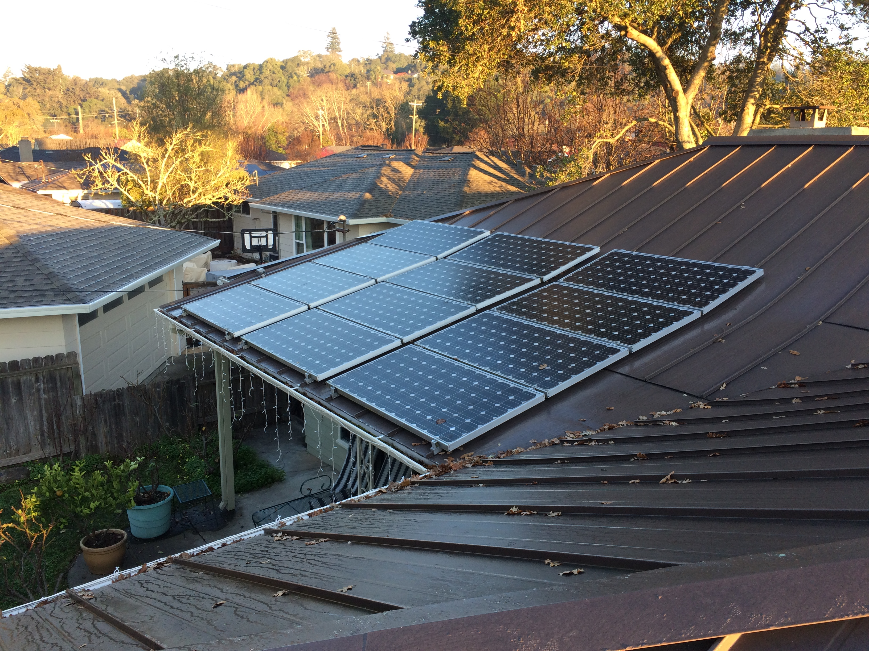
House
SW roof
8 AM
Full shade from roof

Slide 4
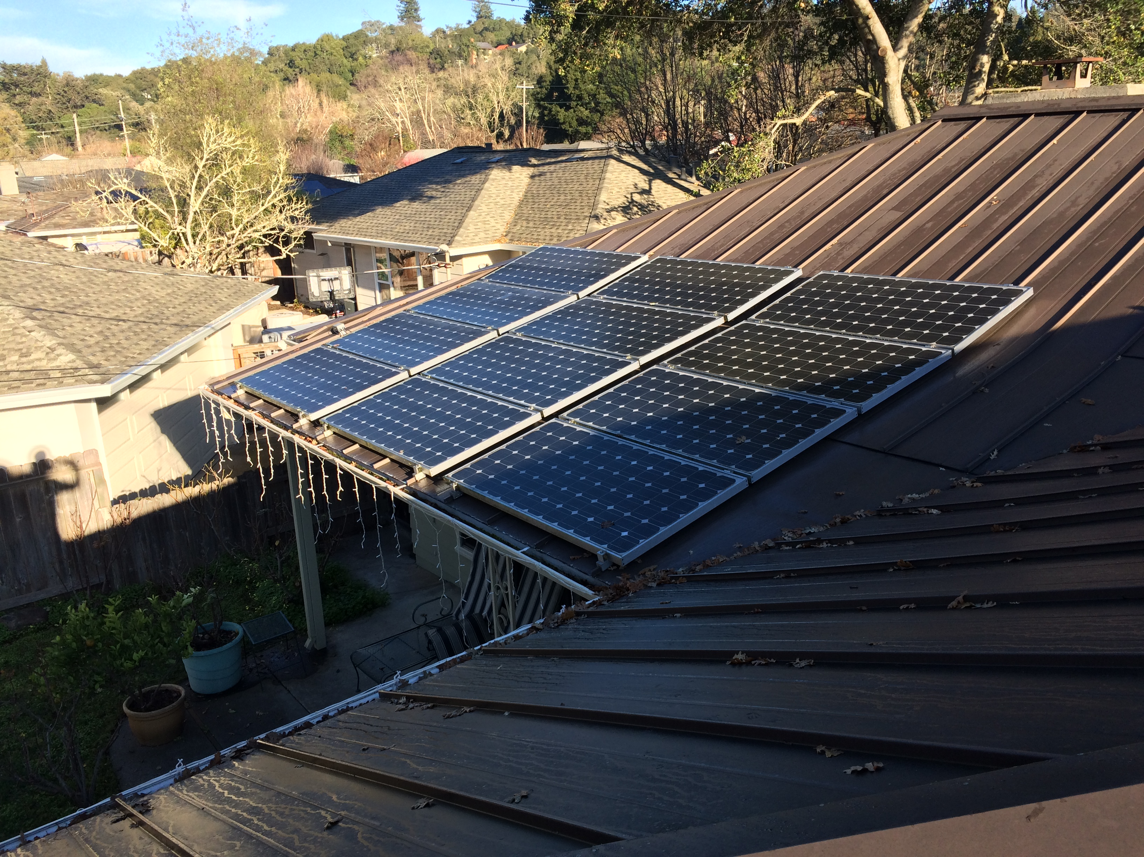
House
SW roof
9 AM
277V
85W
0 kWh
Partial shade from roof

Slide 5
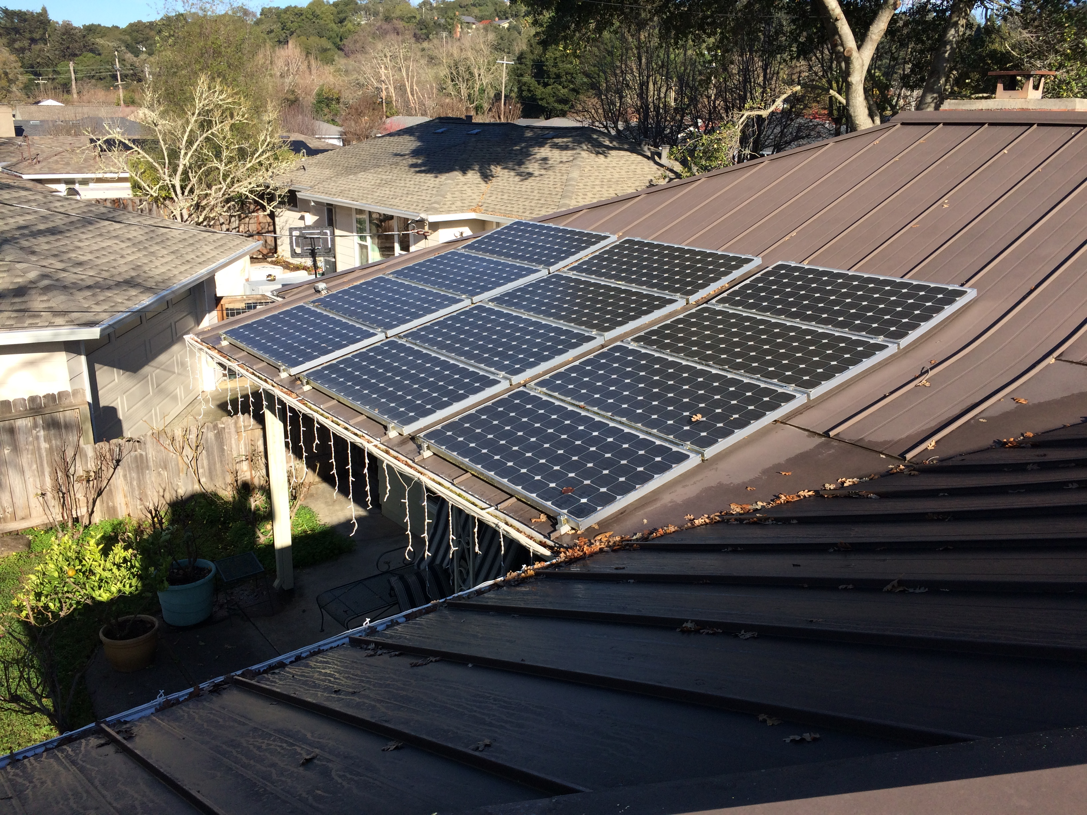
House
SW roof
10 AM
421V
470W
0.31 kWh

Slide 6
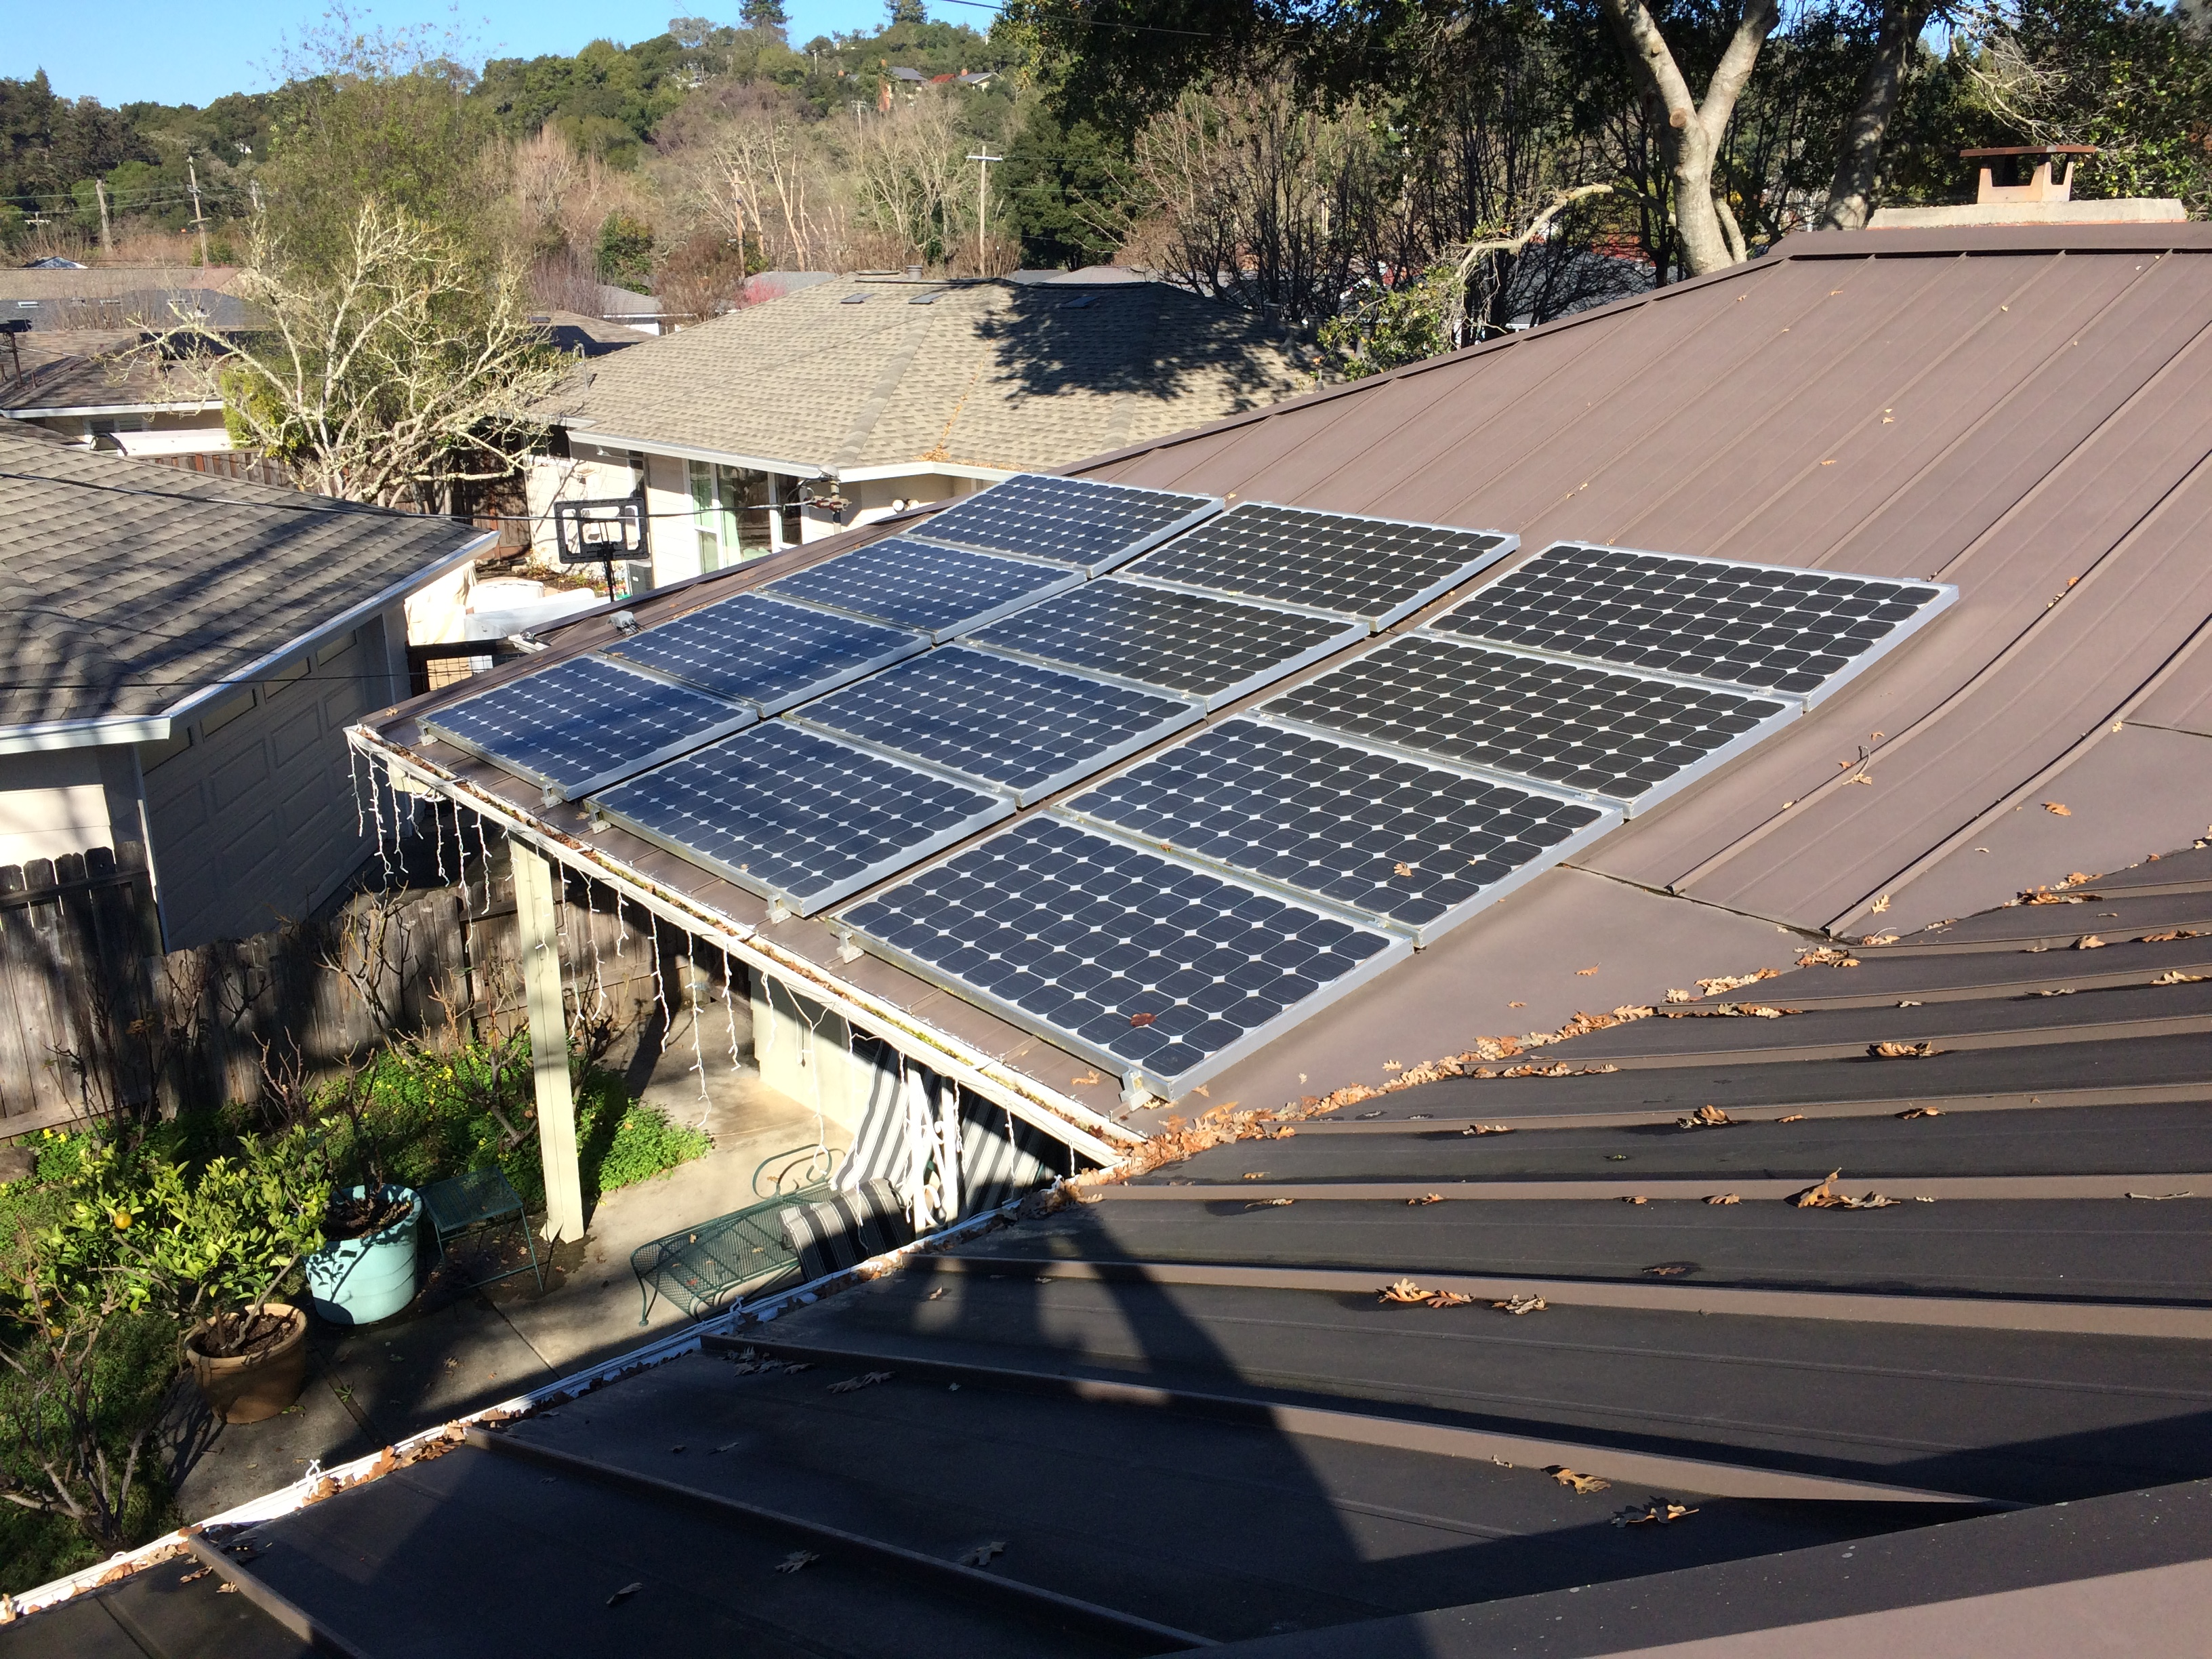
House
SW roof
11 AM
276V
328W
0.79 kWh
Partial shade from valley oak

Slide 7
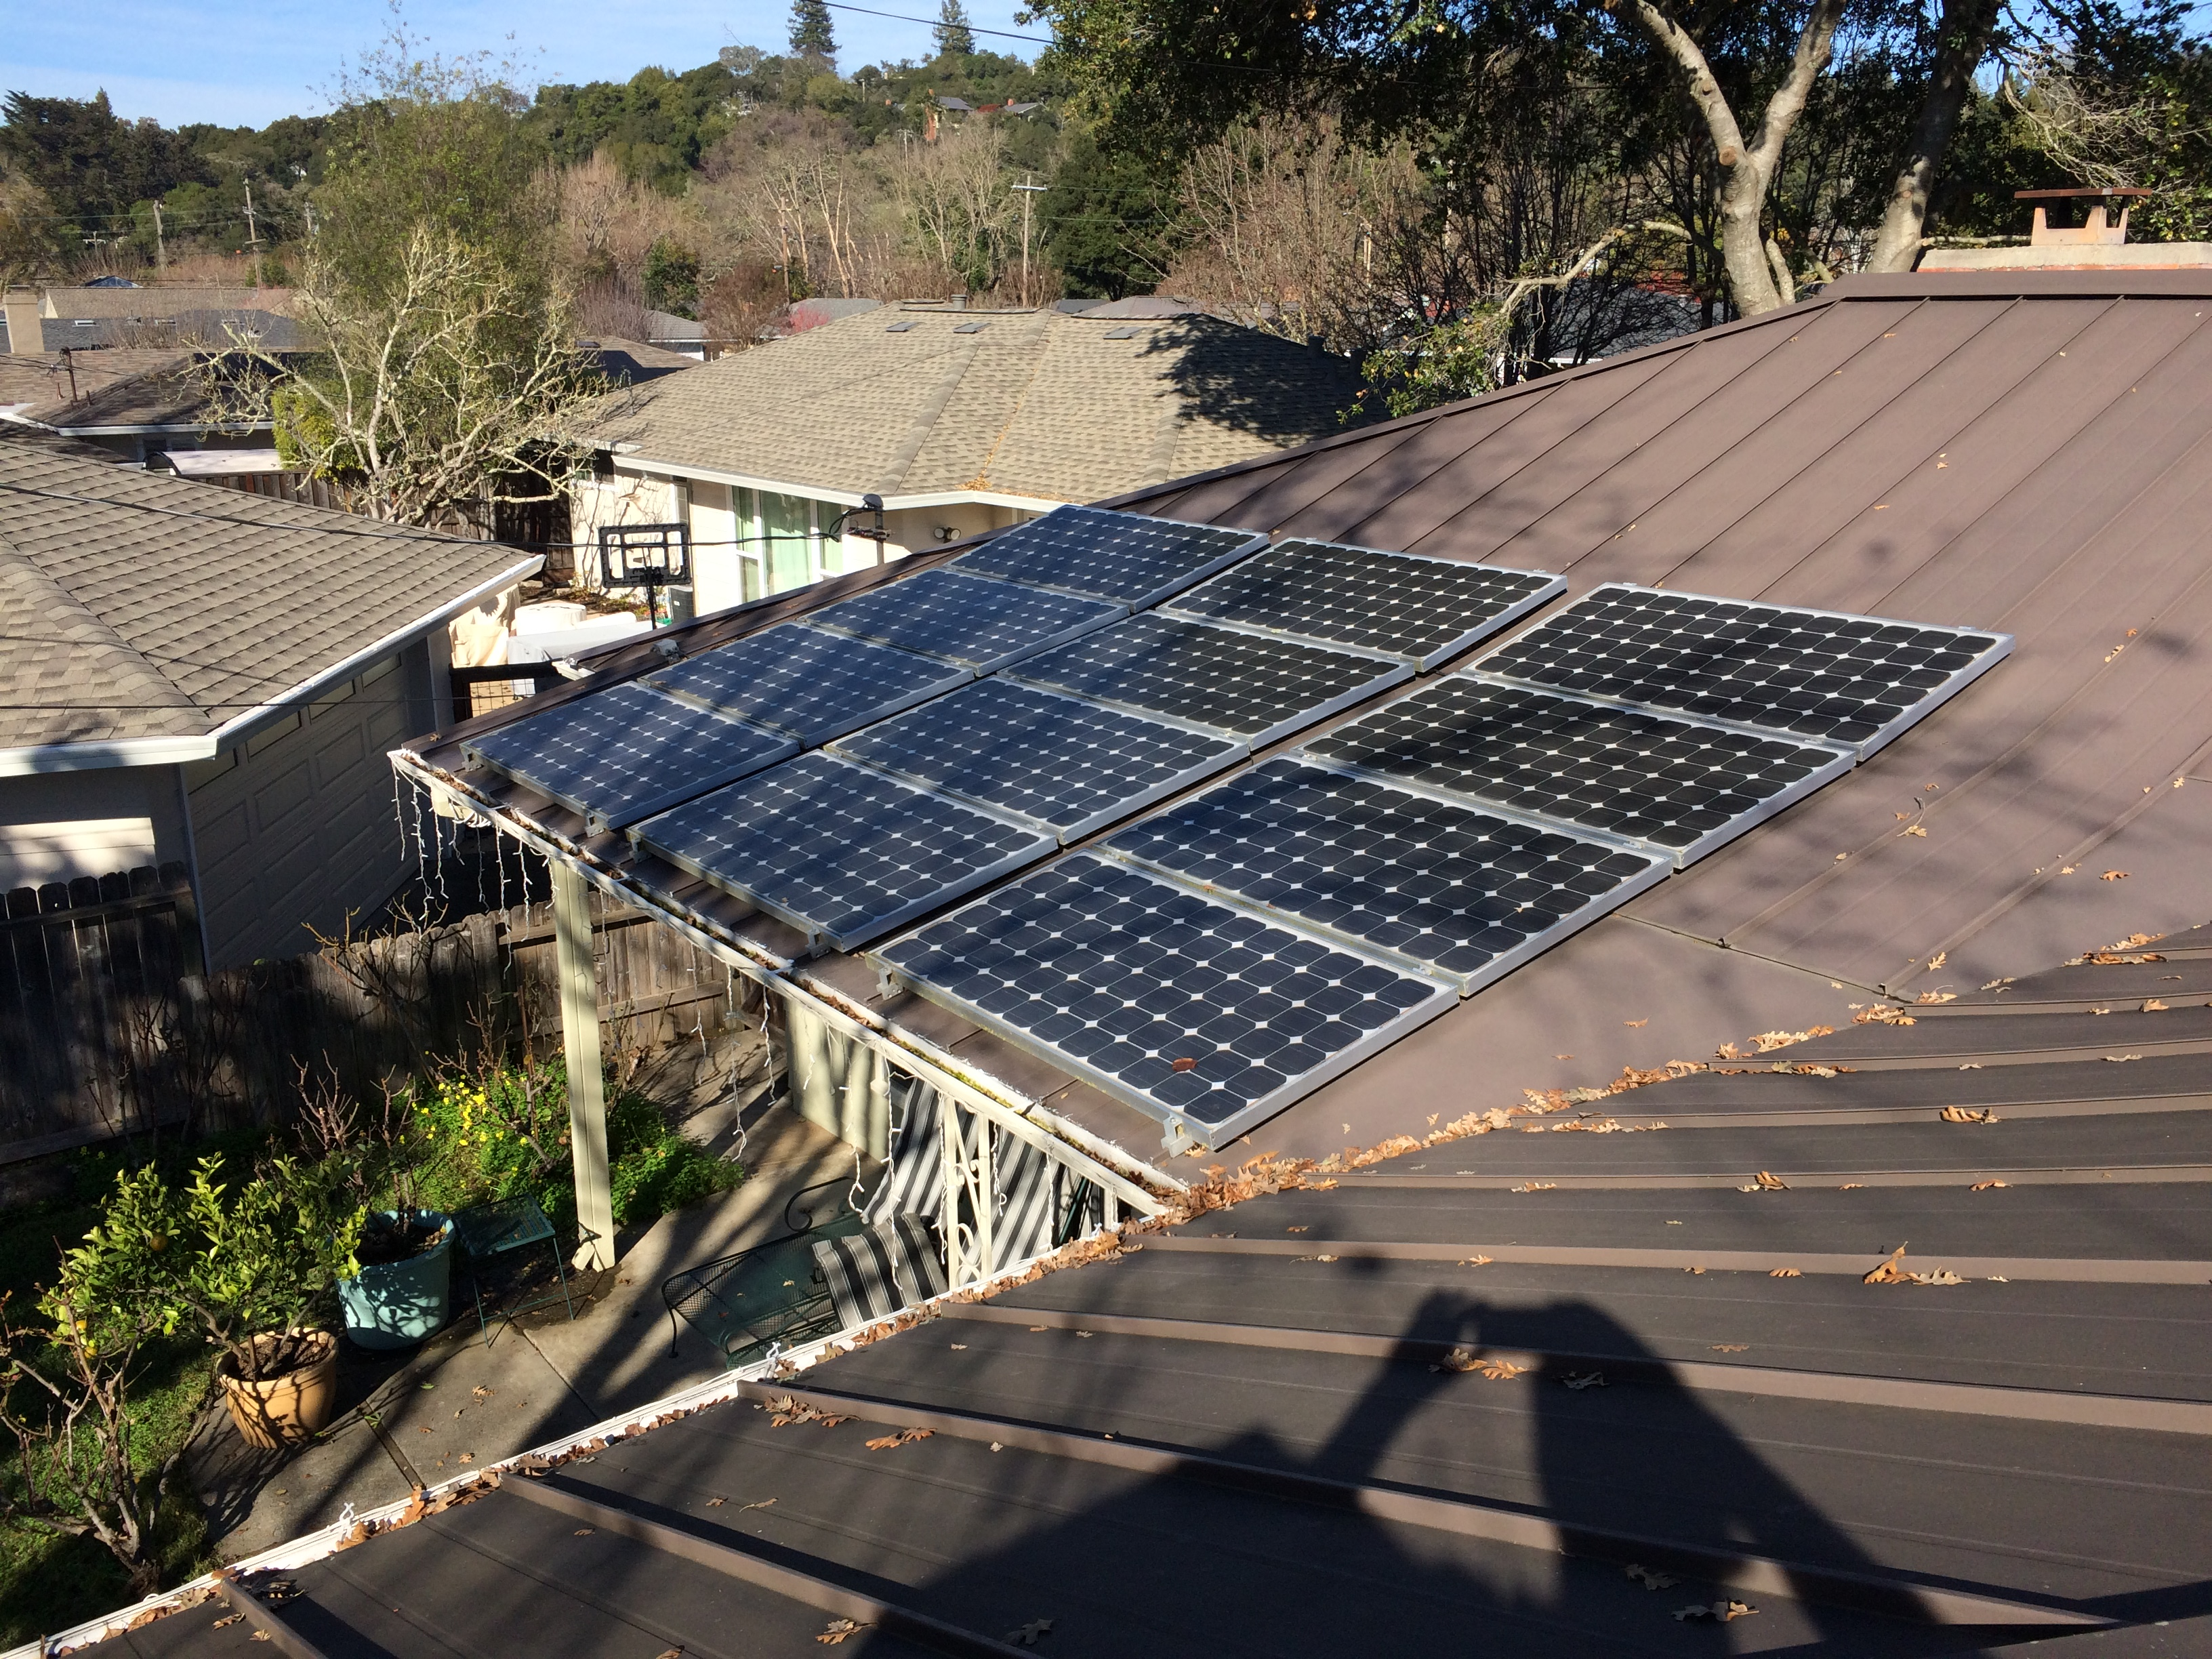
House
SW roof
Noon
256V
80W
0.99 kWh
Mostly shady from valley oak

Slide 8
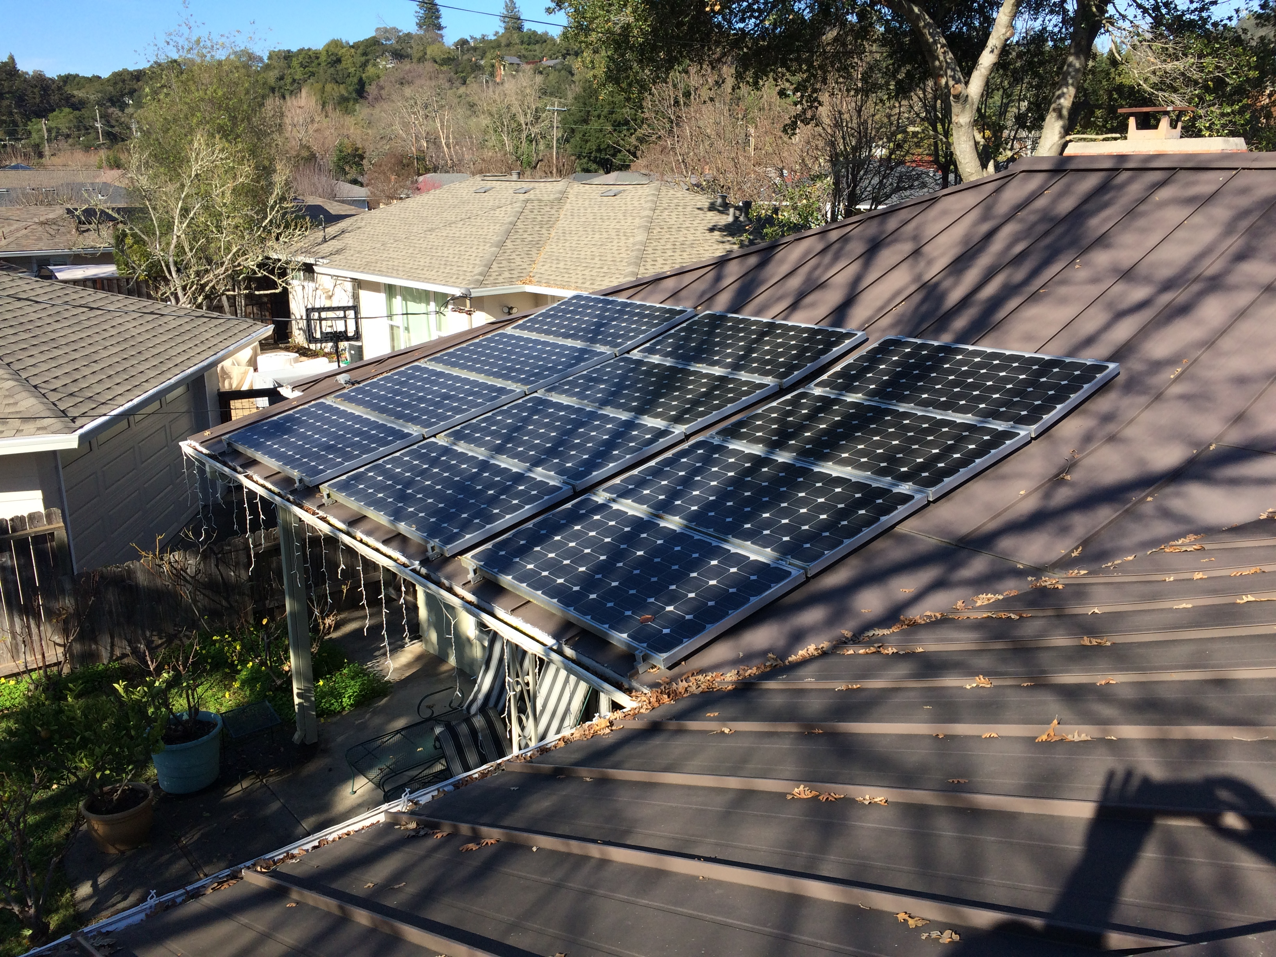
House
SW roof
1 PM
381V
33W
0.99 kWh
Mostly shady from valley oak

Slide 9
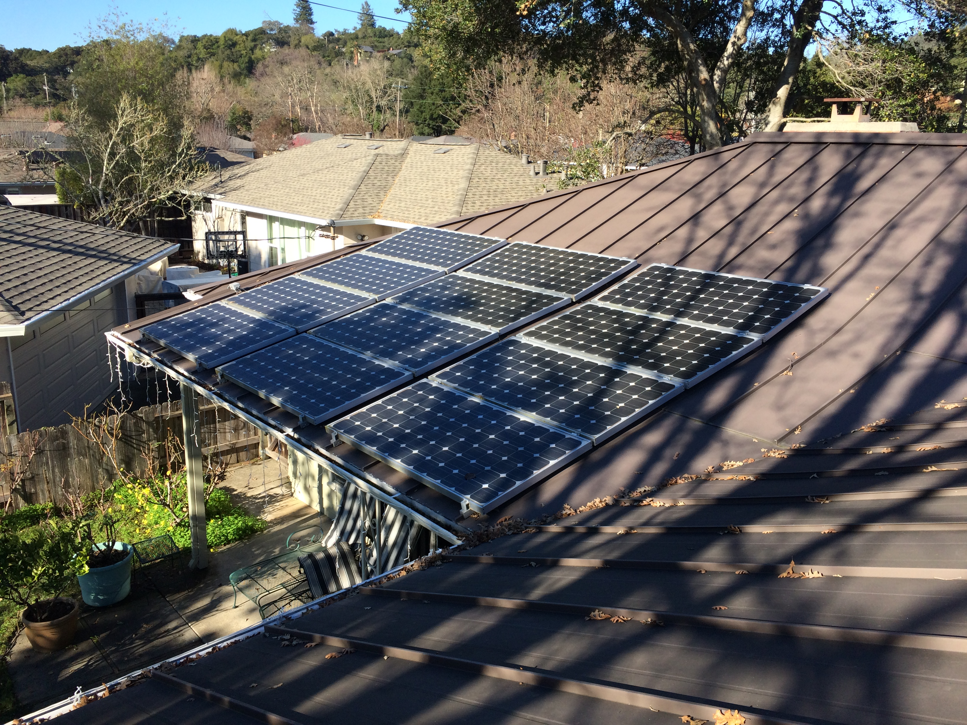
House
SW roof
2 PM
379V
0W
0.99 kWh
Half shade from magnolia, partial shade from valley oak

Slide 10
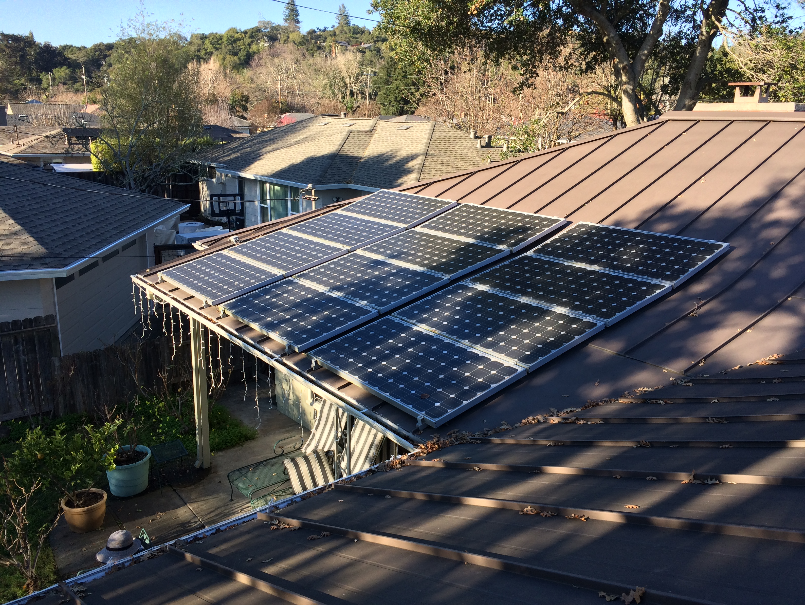
House
SW roof
3 PM
365V
0W
0.99 kWh
Half shade from magnolia

Slide 11
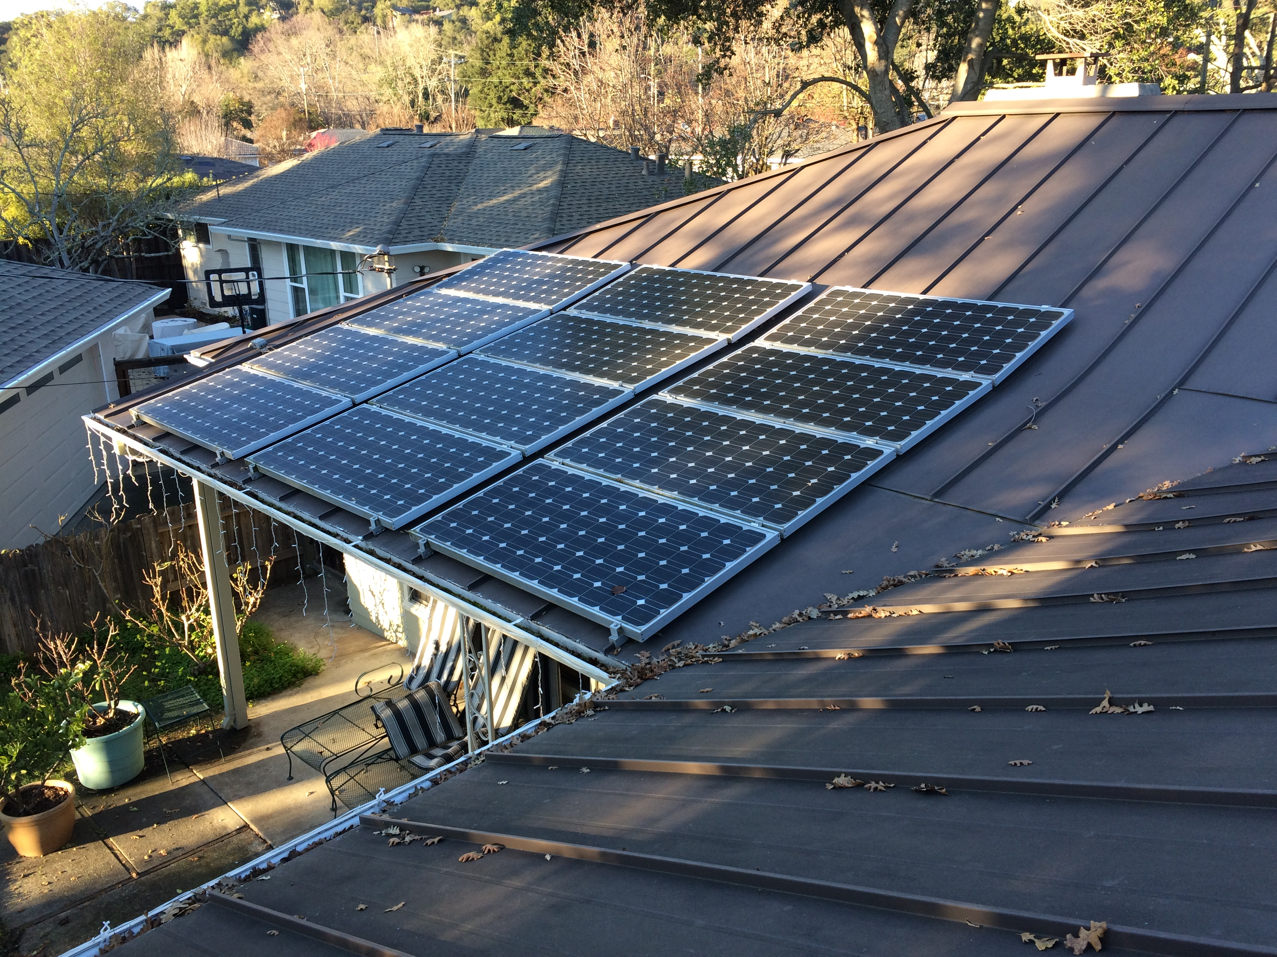
House
SW roof
4 PM
329V
0W
0.99 kWh
Almost all shade from neighbor-hood trees, but production would be low anyway due to angle

Slide 12
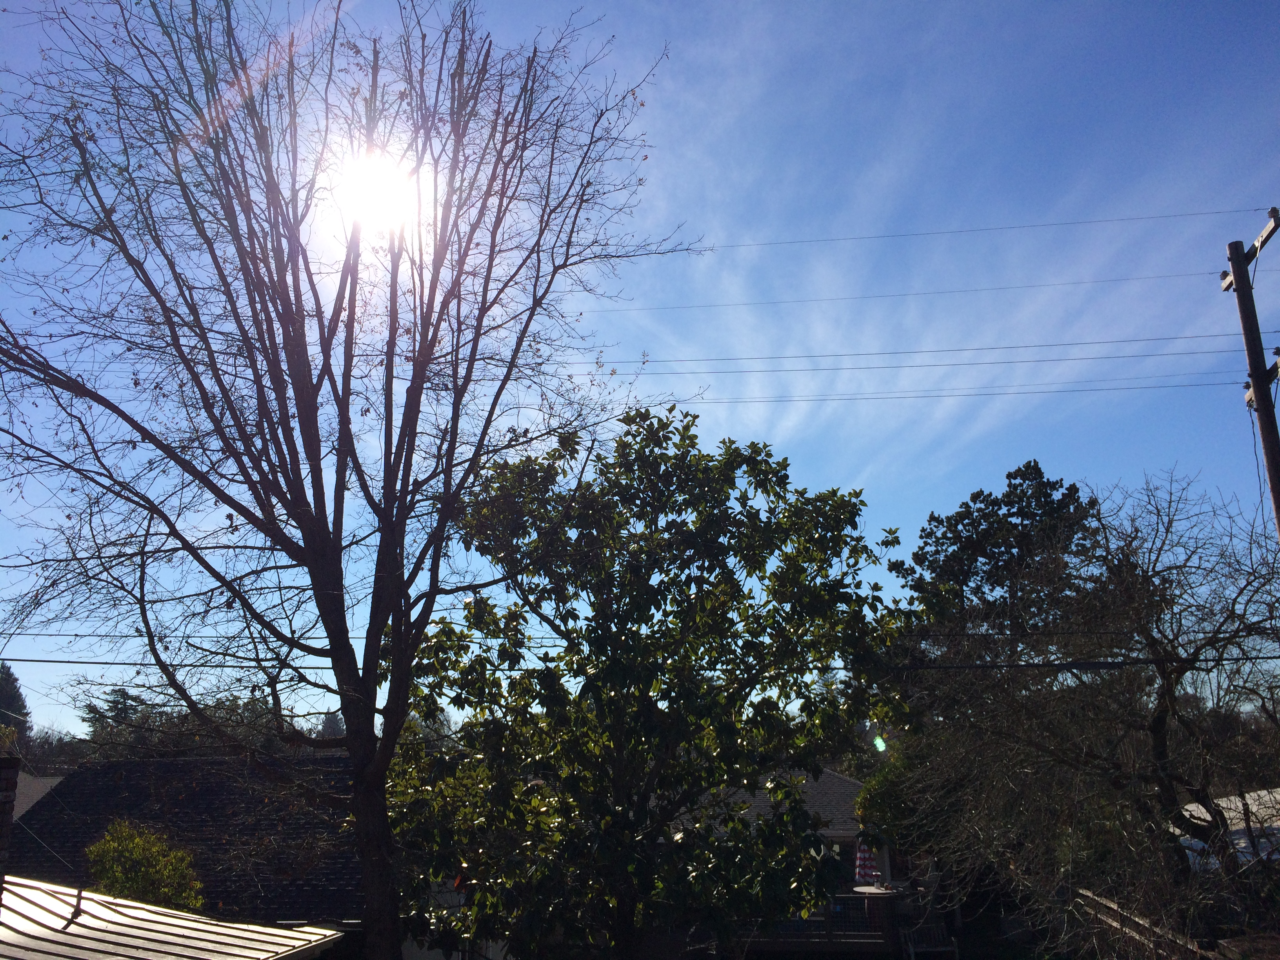
House
SW roof shade trees
1 PM
from top
of panels:
Blocked only by valley oak

Slide 13
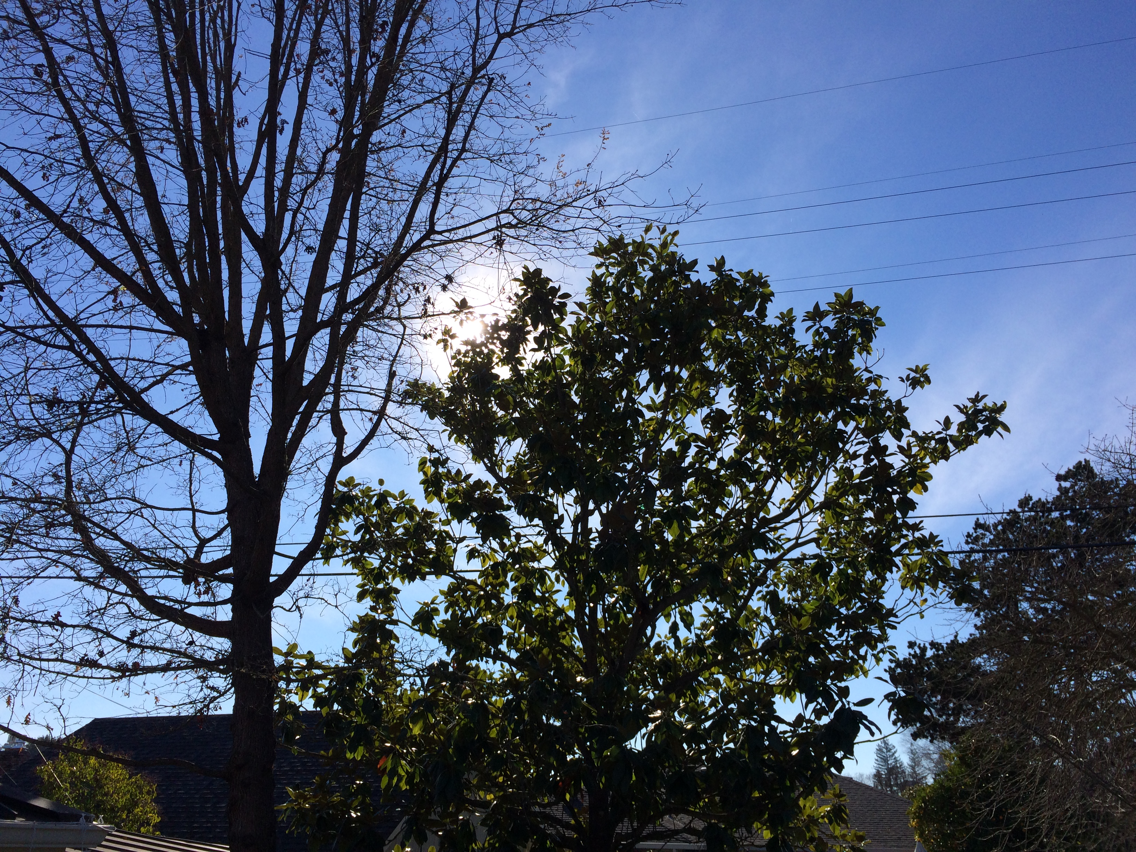
House
SW roof shade trees
1 PM
from
bottom
of panels:
Blocked by valley oak, and barely by magnolia

Slide 14
House SE Roof
1/10/2022
Time | Observations with both trees present | Projection if valley oak removed
8 AM | Partial shade on far surface from neighbor’s house | Partial shade on far surface from neighbor’s house
9 AM | No shade | No shade
10 AM | No shade | No shade
11 AM | No shade | No shade
Noon | No shade | No shade
1 PM | Telephone pole shade; remove telephone pole? ☺ | Telephone pole shade
2 PM | Valley oak starting to shade | No shade
3 PM | Valley oak shading most of near surface over family room and part of far surface | No shade
4 PM | Almost complete shade from valley oak, and partial shade from magnolia; but SE panel angle sub-optimized by this point | Partial shade from magnolia; but SE panel angle sub-optimized by this point
5 PM | Sunset | Sunset

Slide 15
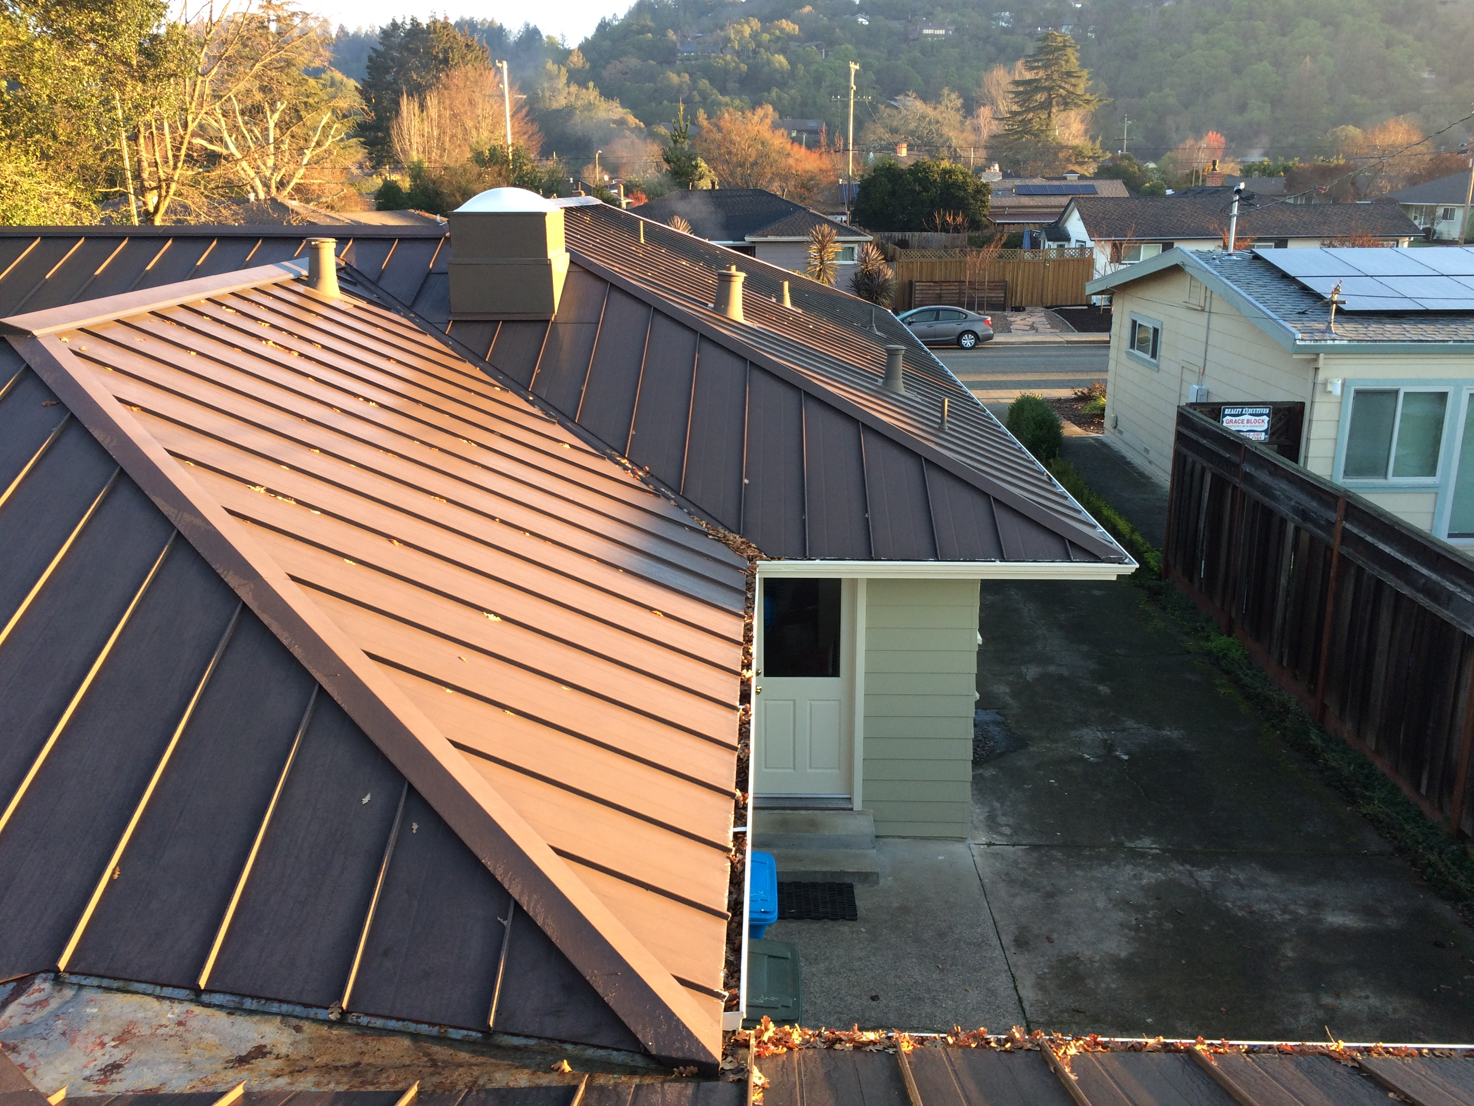
House
SE roof
8 AM
Partial shade on far surface from neighbor’s house

Slide 16
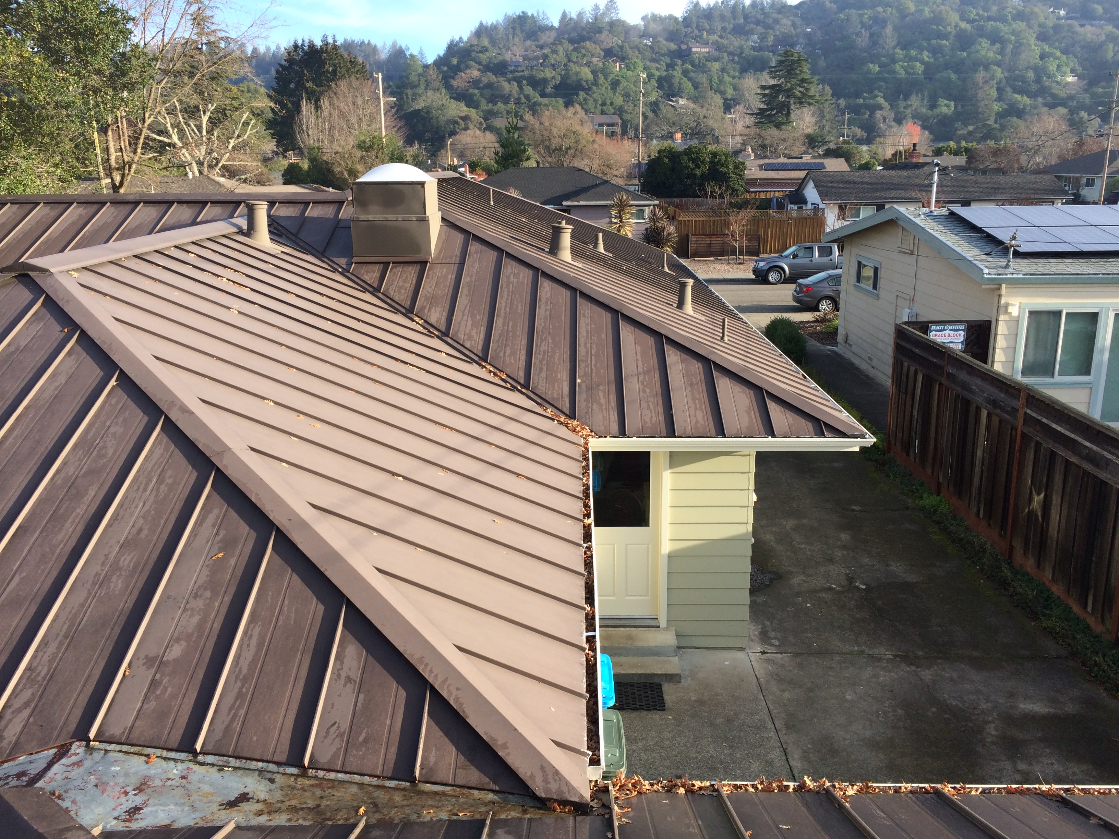
House
SE roof
9 AM

Slide 17
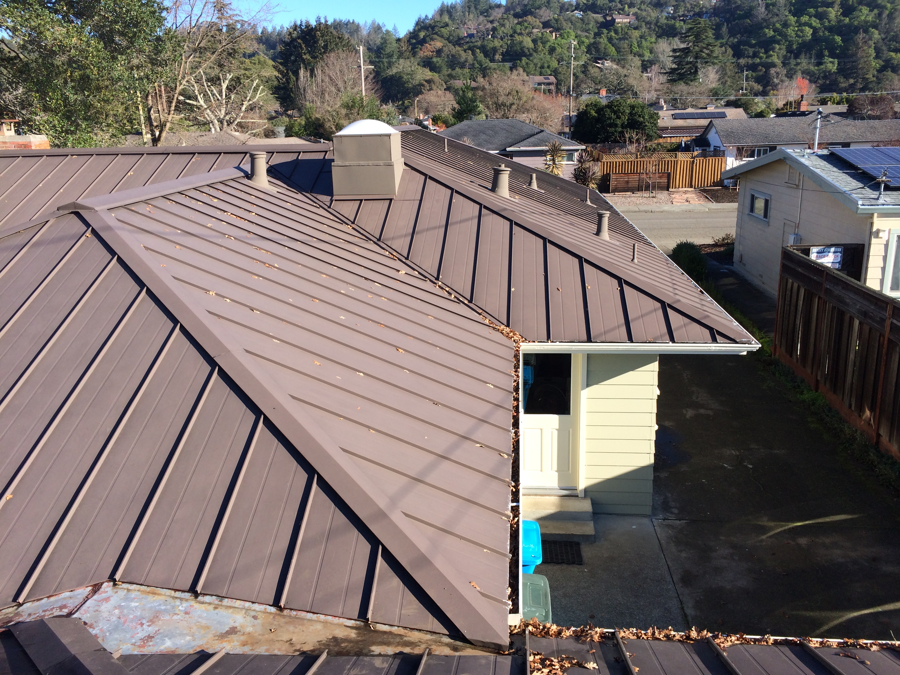
House
SE roof
10 AM

Slide 18
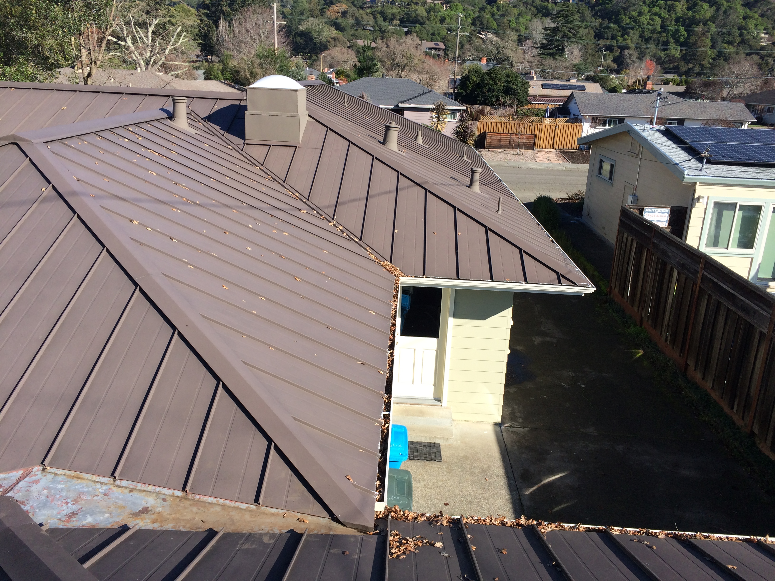
House
SE roof
11 AM

Slide 19
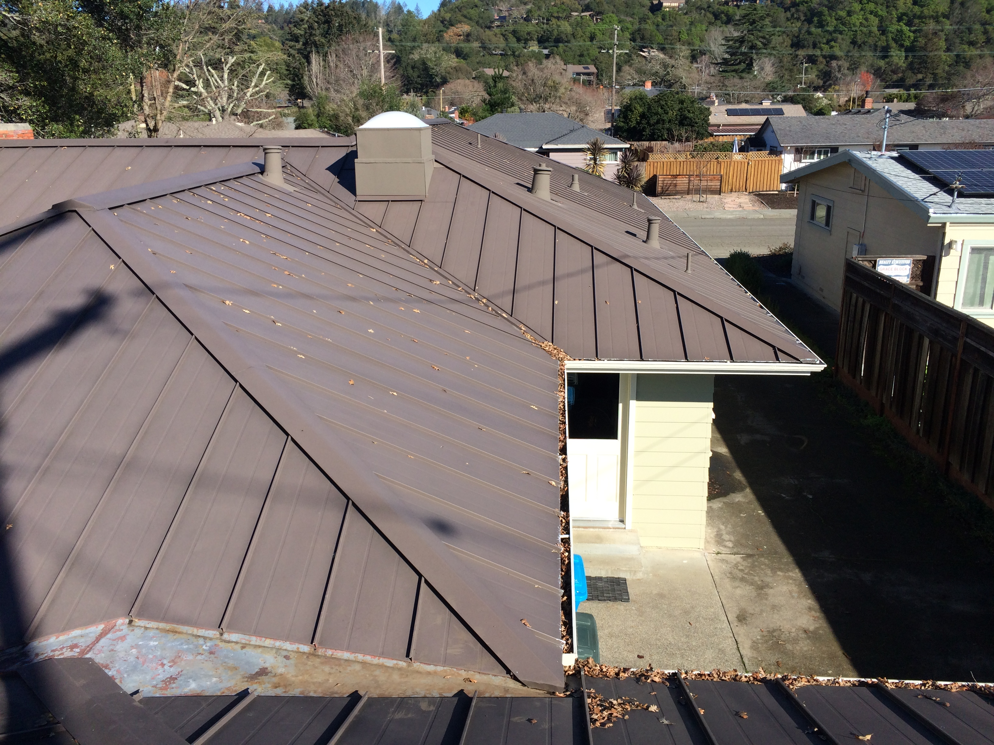
House
SE roof
Noon

Slide 20
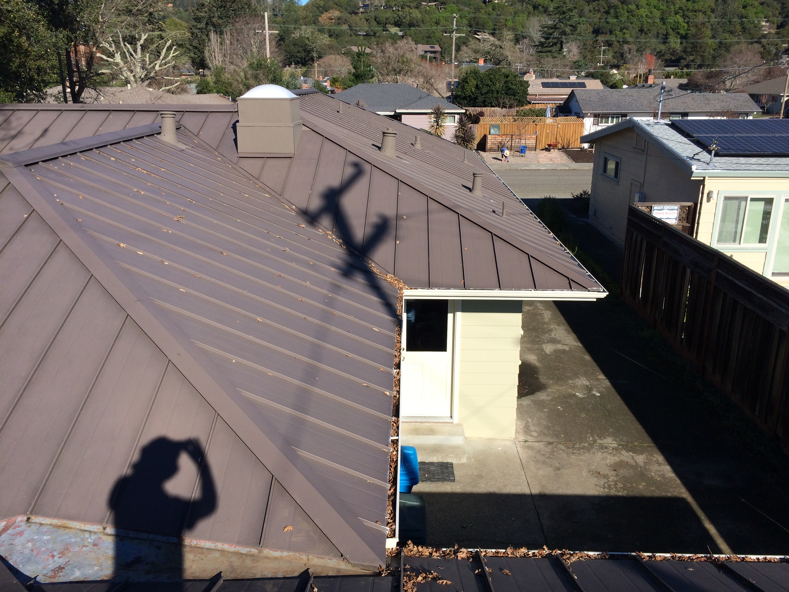
House
SE roof
1 PM
Telephone pole shade

Slide 21
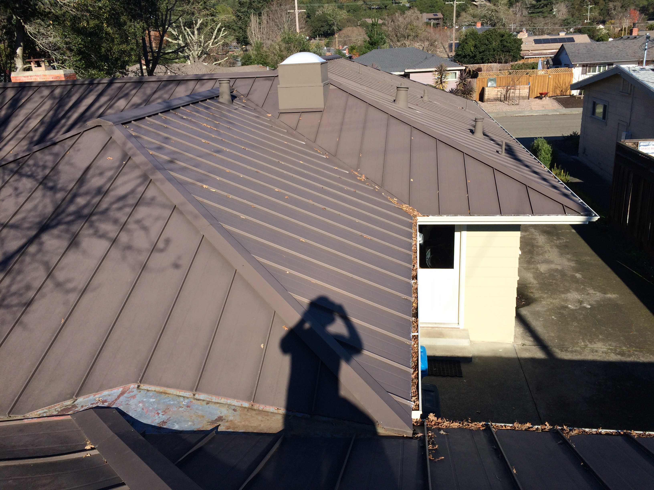
House
SE roof
2 PM
Valley oak starting to shade

Slide 22
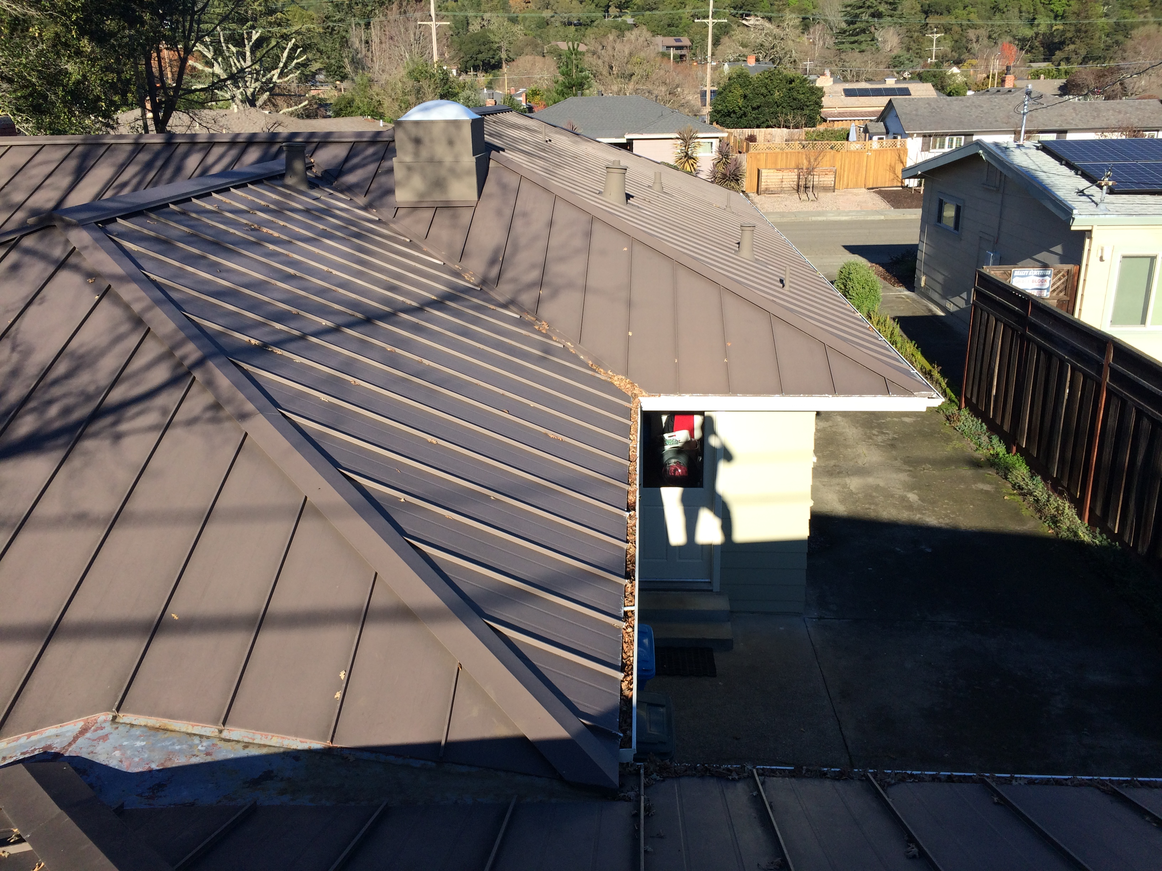
House
SE roof
3 PM
Valley oak shading most of near surface over family room and part of far surface

Slide 23
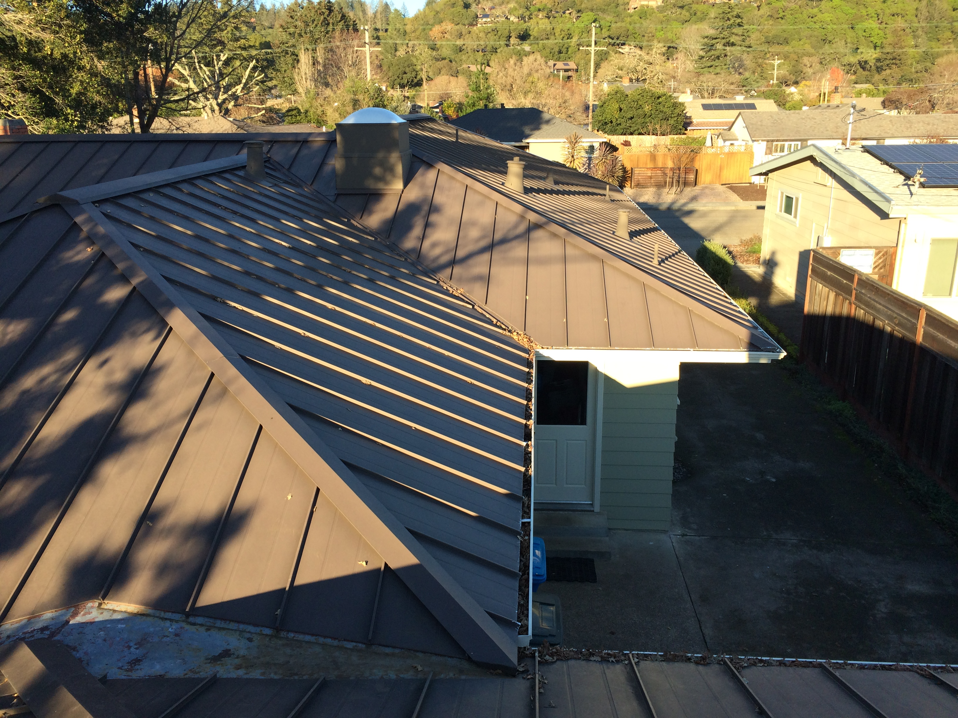
House
SE roof
4 PM
Almost complete shade from valley oak, and partial shade from magnolia; but SE panel angle sub-optimized by this point

Slide 24
Garage SE Roof
1/10/2022
Time | Observations
8 AM | No shade
9 AM | No shade
10 AM | No shade
11 AM | No shade
Noon | No shade
1 PM | Telephone pole shade
2 PM | Telephone pole shade
3 PM | No shade
4 PM | No shade
5 PM | Sunset

Slide 25
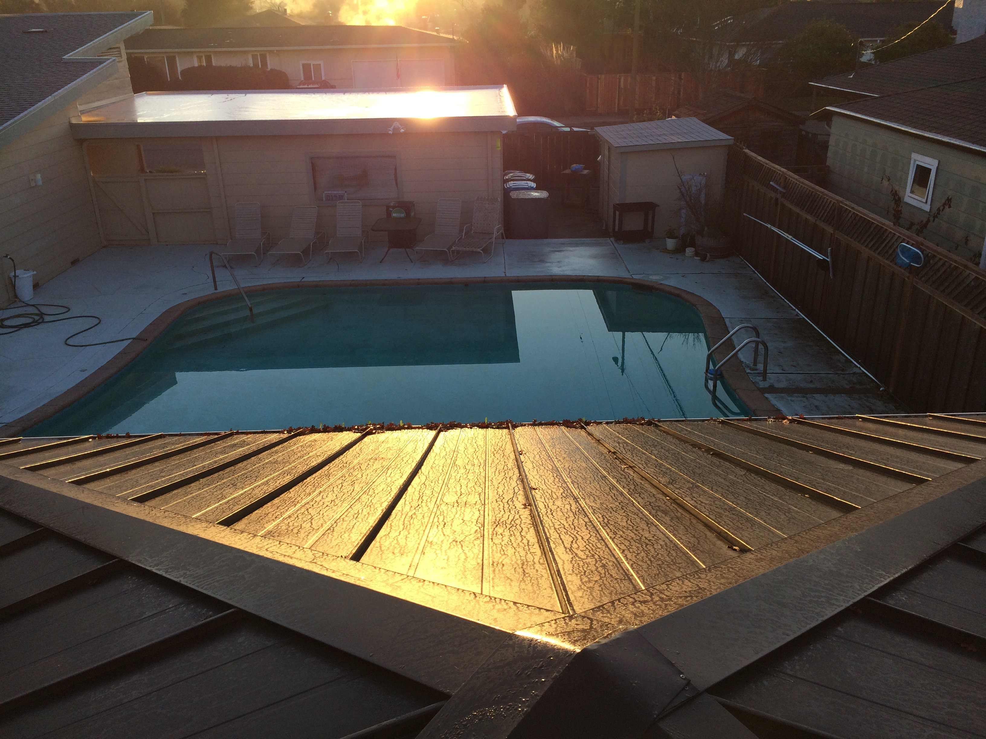
Garage
SE roof
8 AM

Slide 26
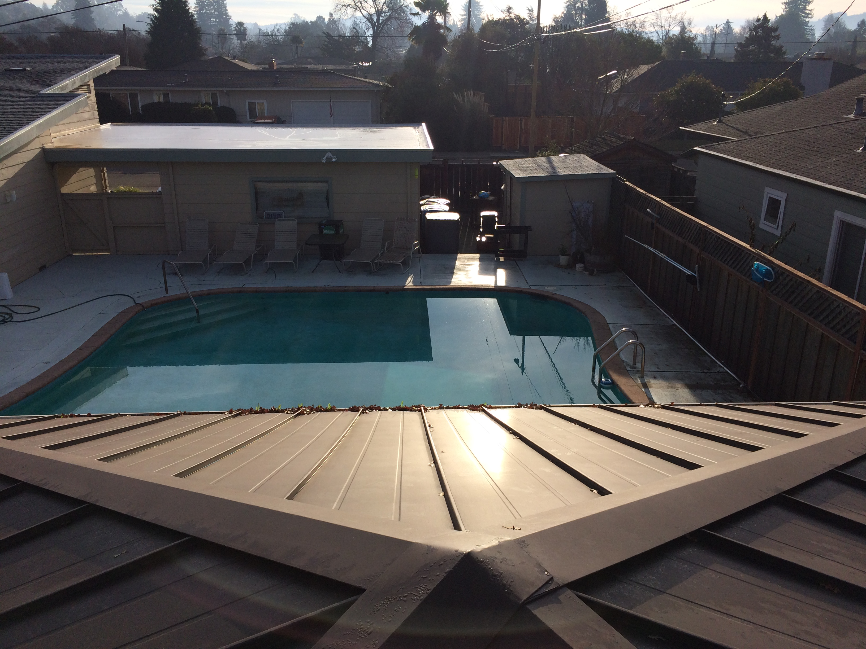
Garage
SE roof
9 AM

Slide 27
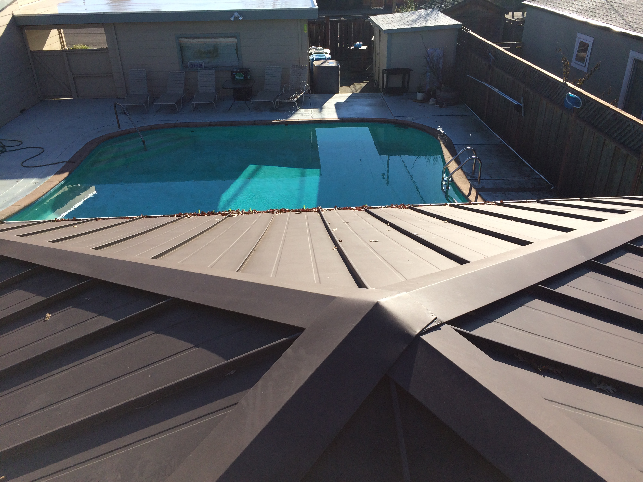
Garage
SE roof
10 AM

Slide 28
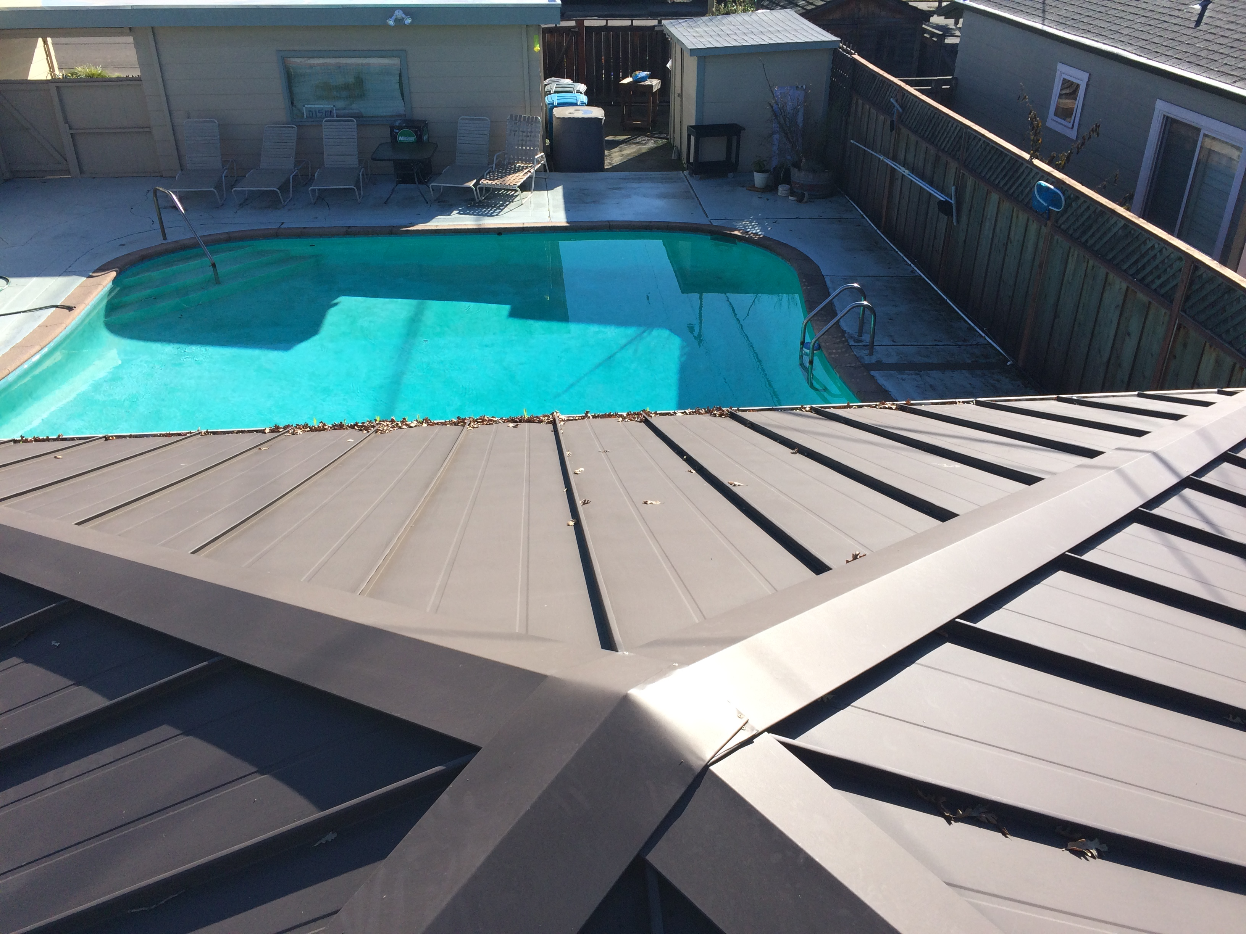
Garage
SE roof
11 AM

Slide 29
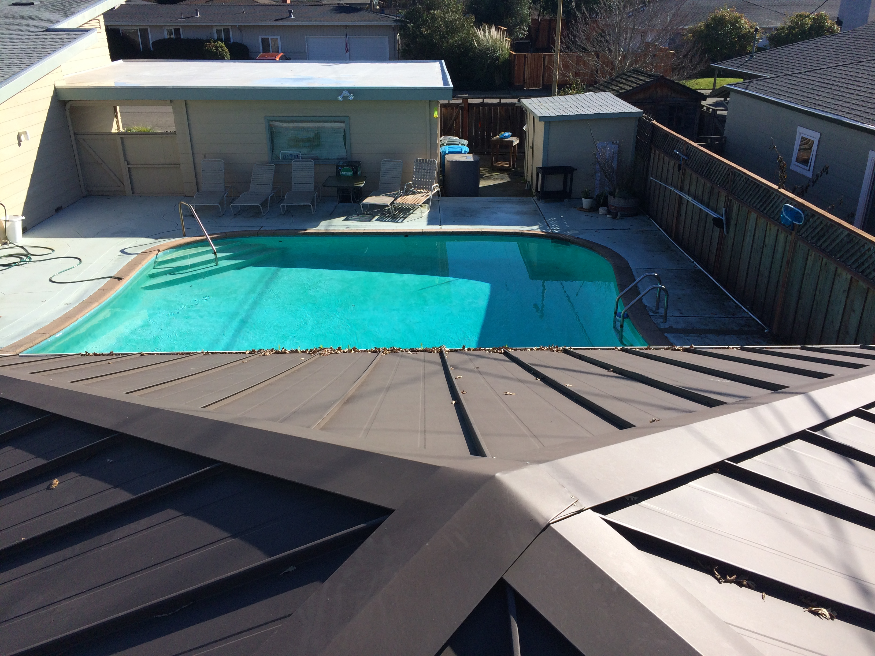
Garage
SE roof
Noon

Slide 30
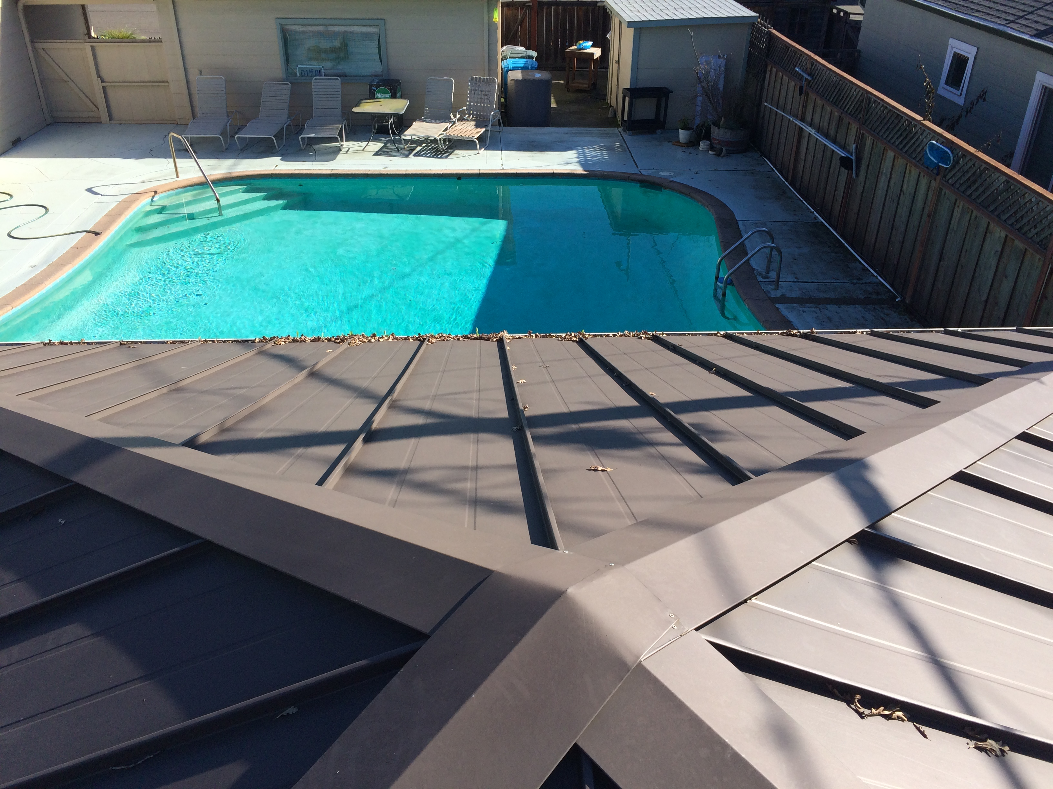
Garage
SE roof
1 PM
Telephone pole shade

Slide 31
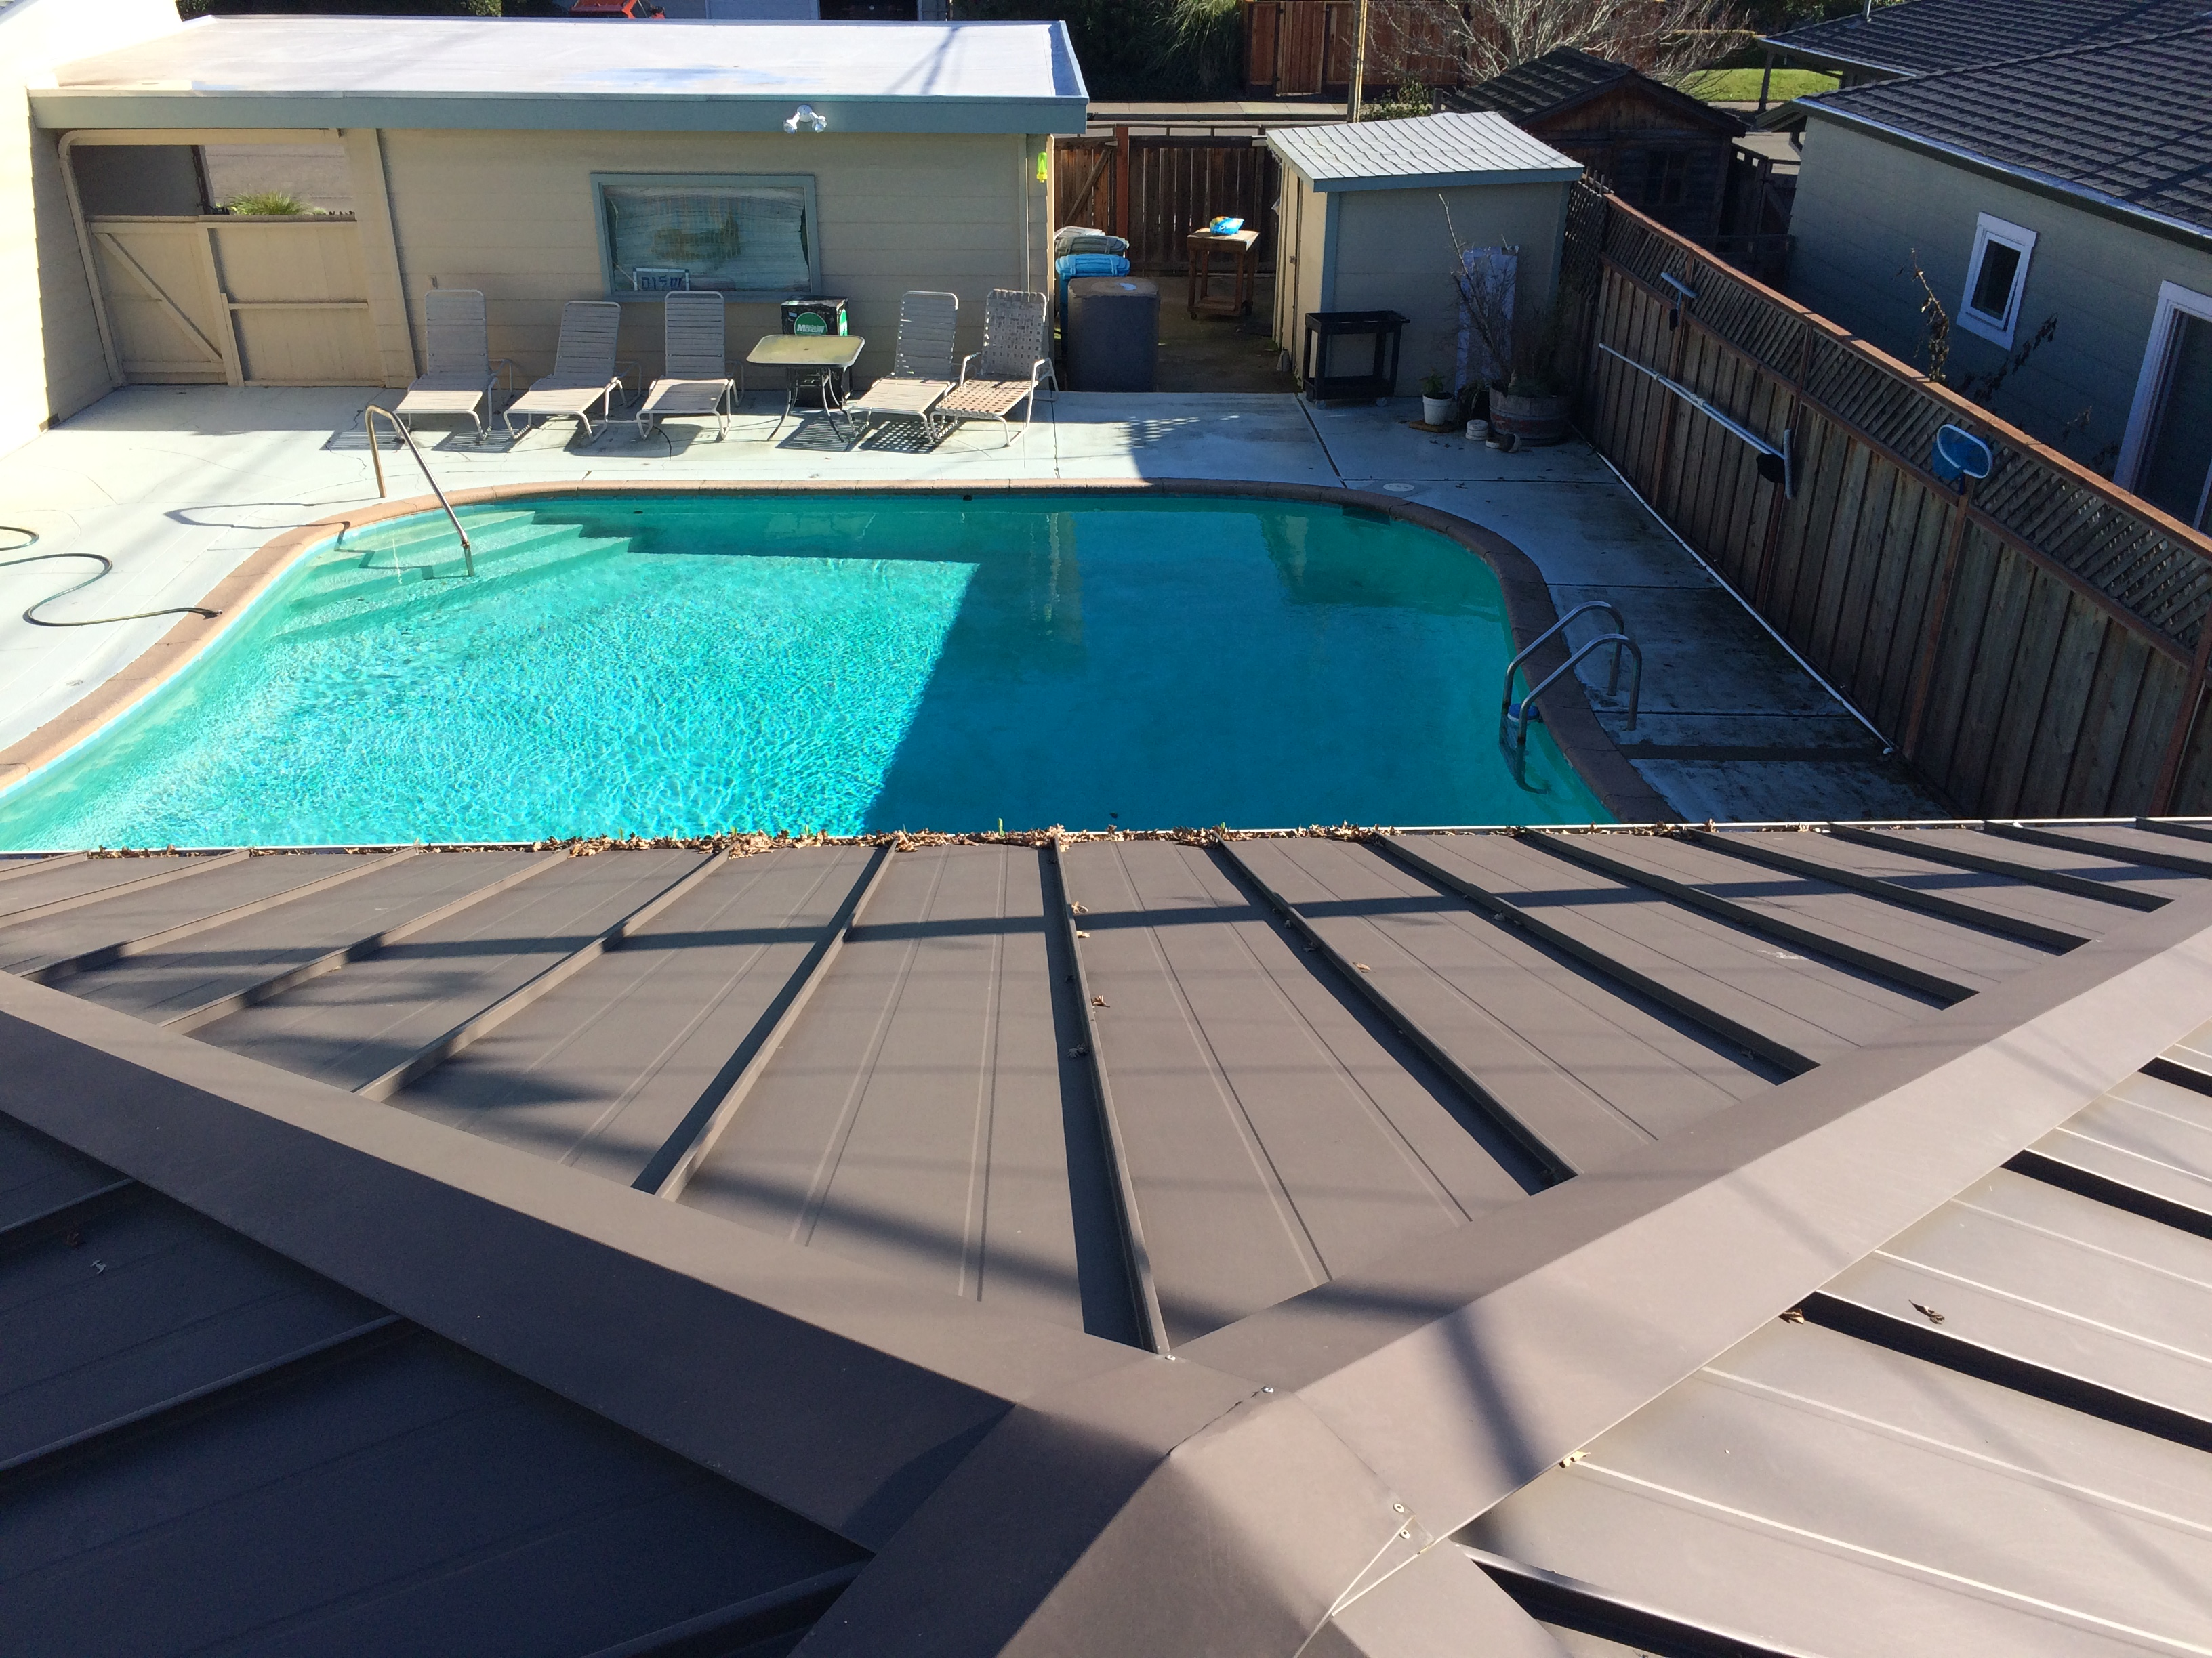
Garage
SE roof
2 PM
Telephone pole shade

Slide 32
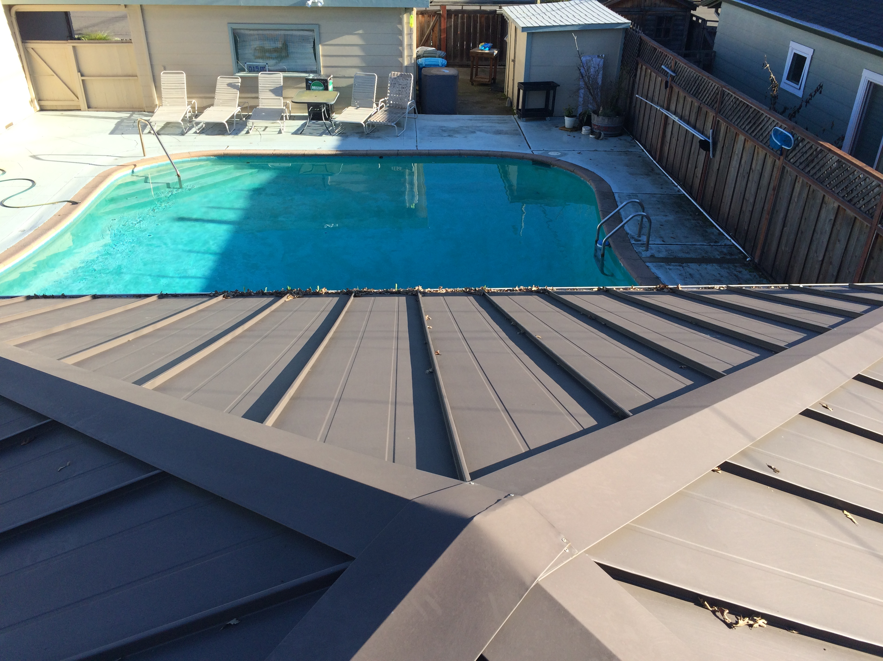
Garage
SE roof
3 PM

Slide 33
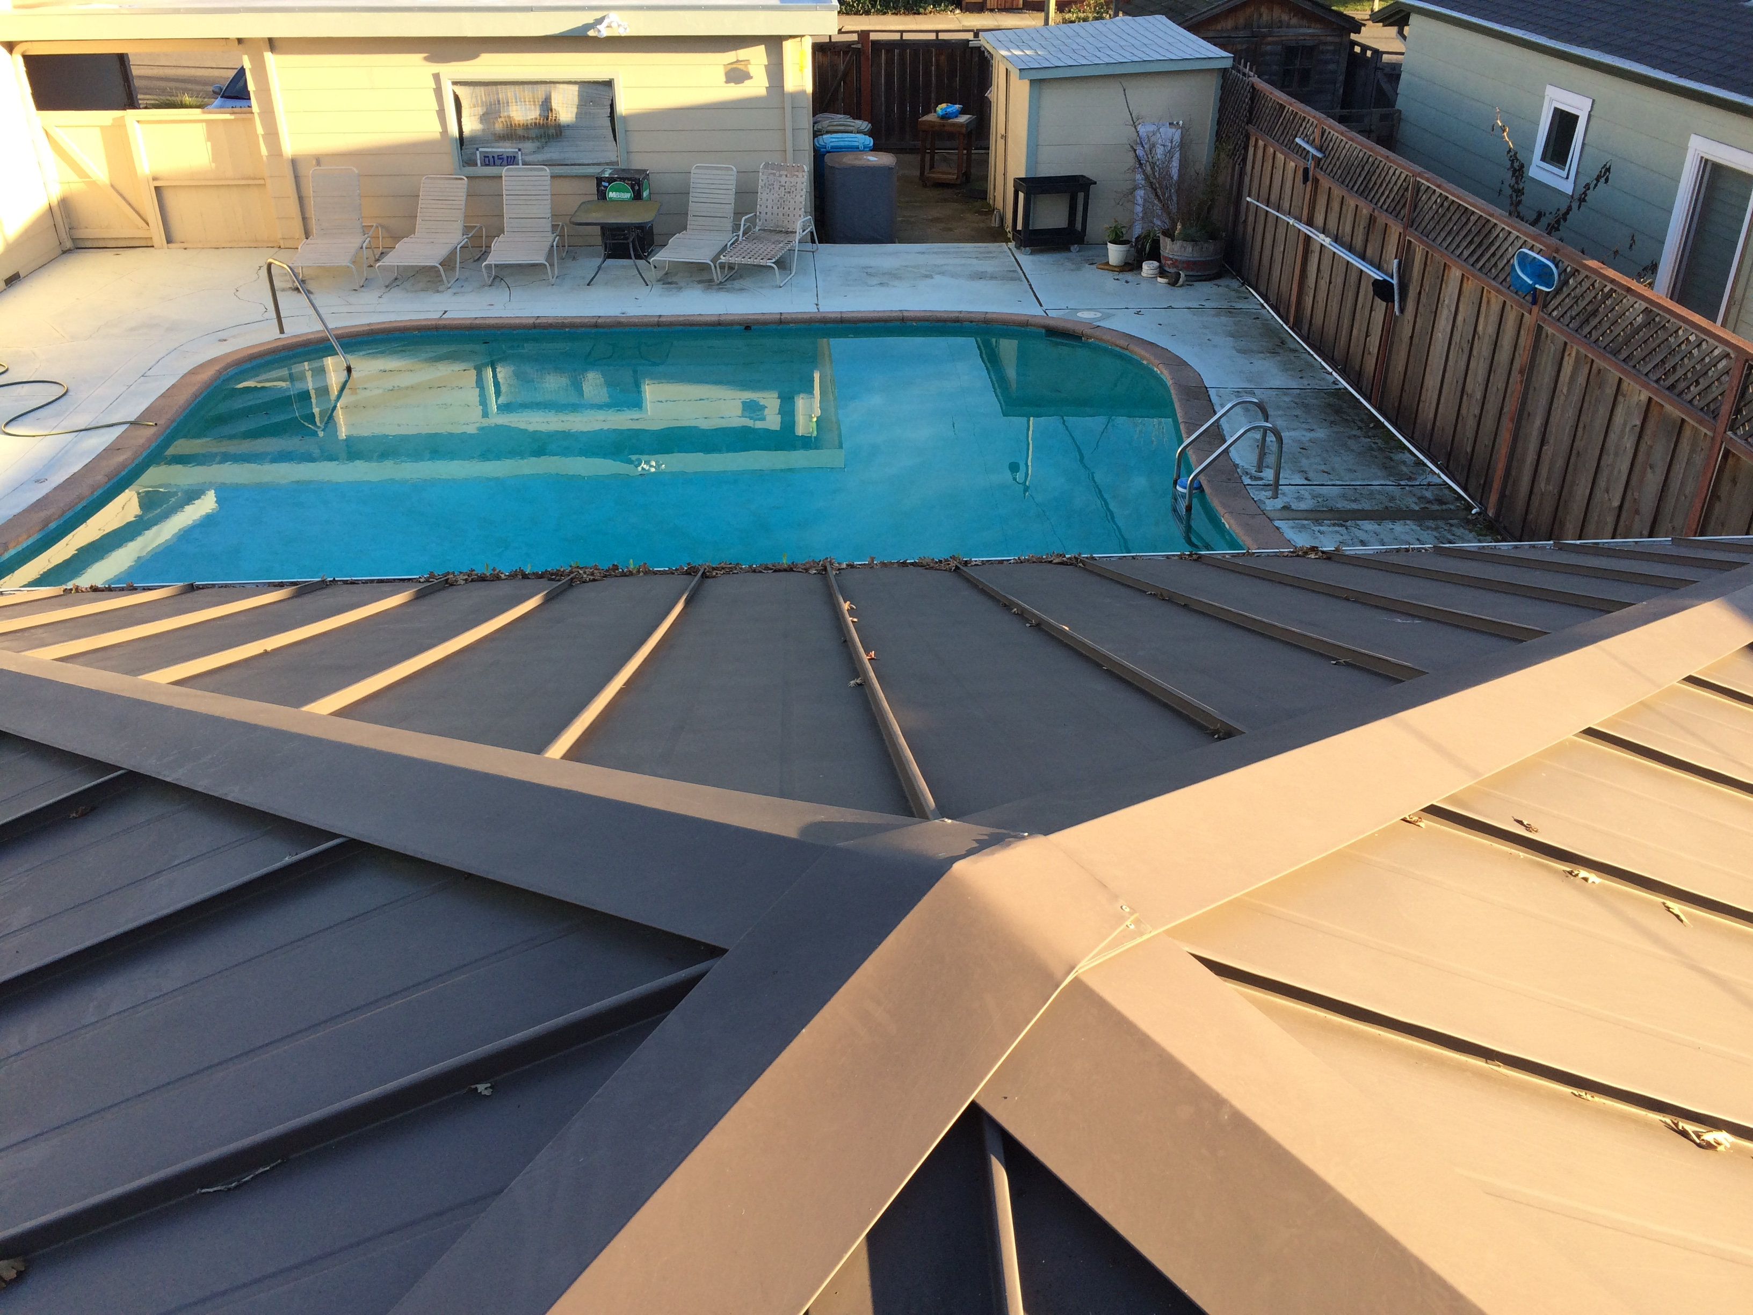
Garage
SE roof
4 PM

