Slide 1
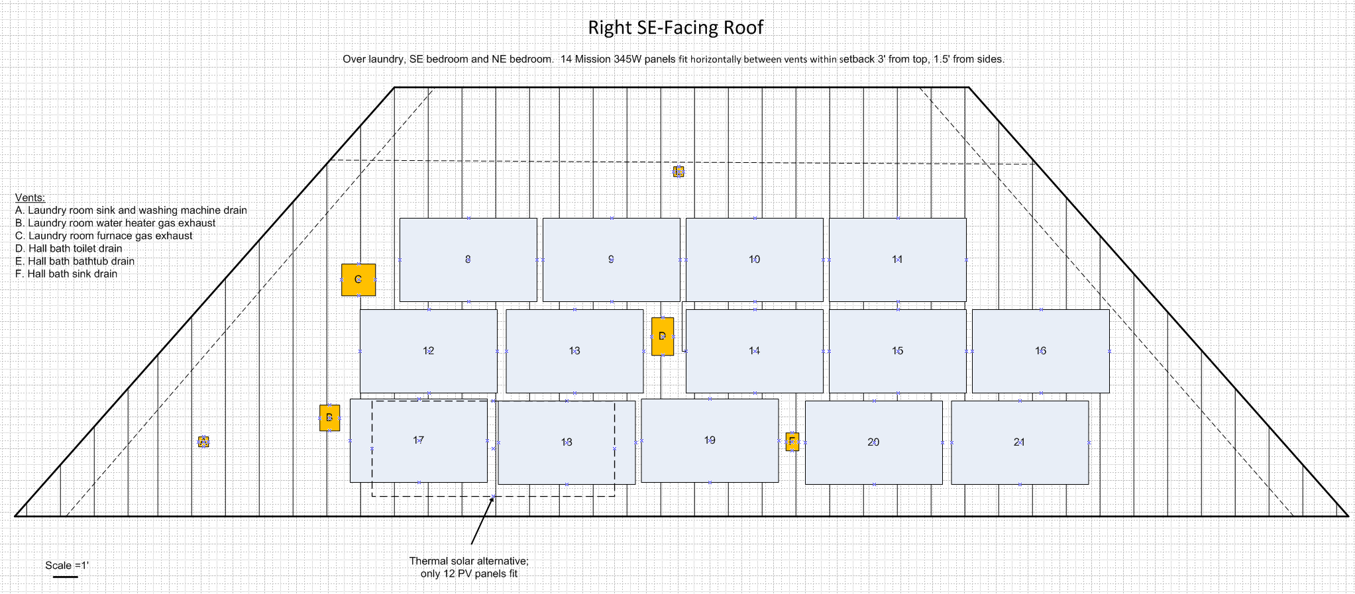
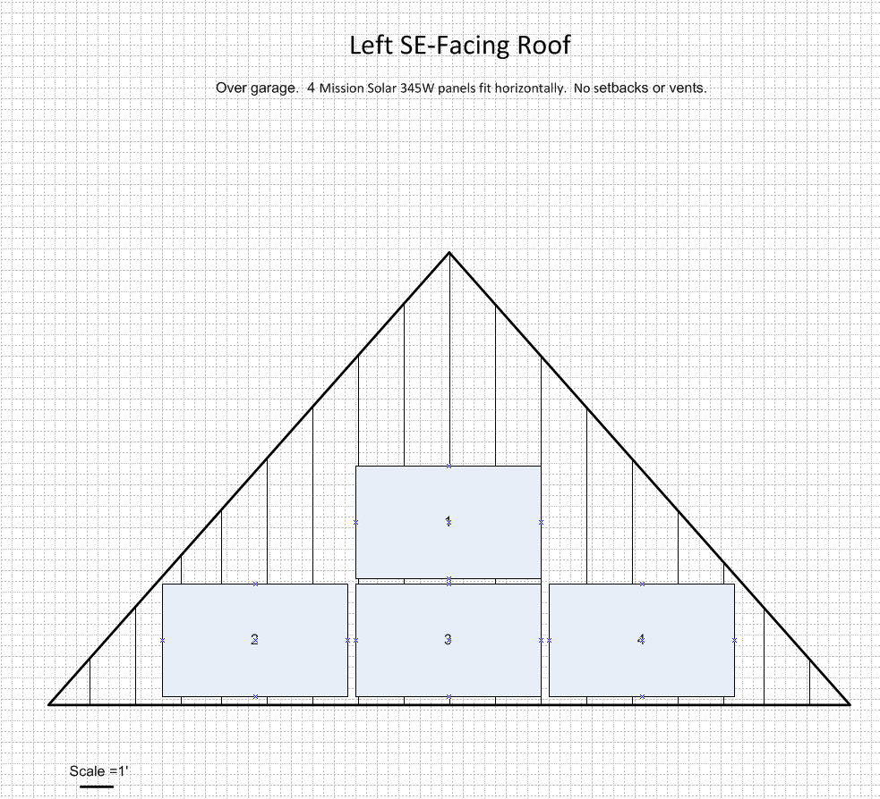
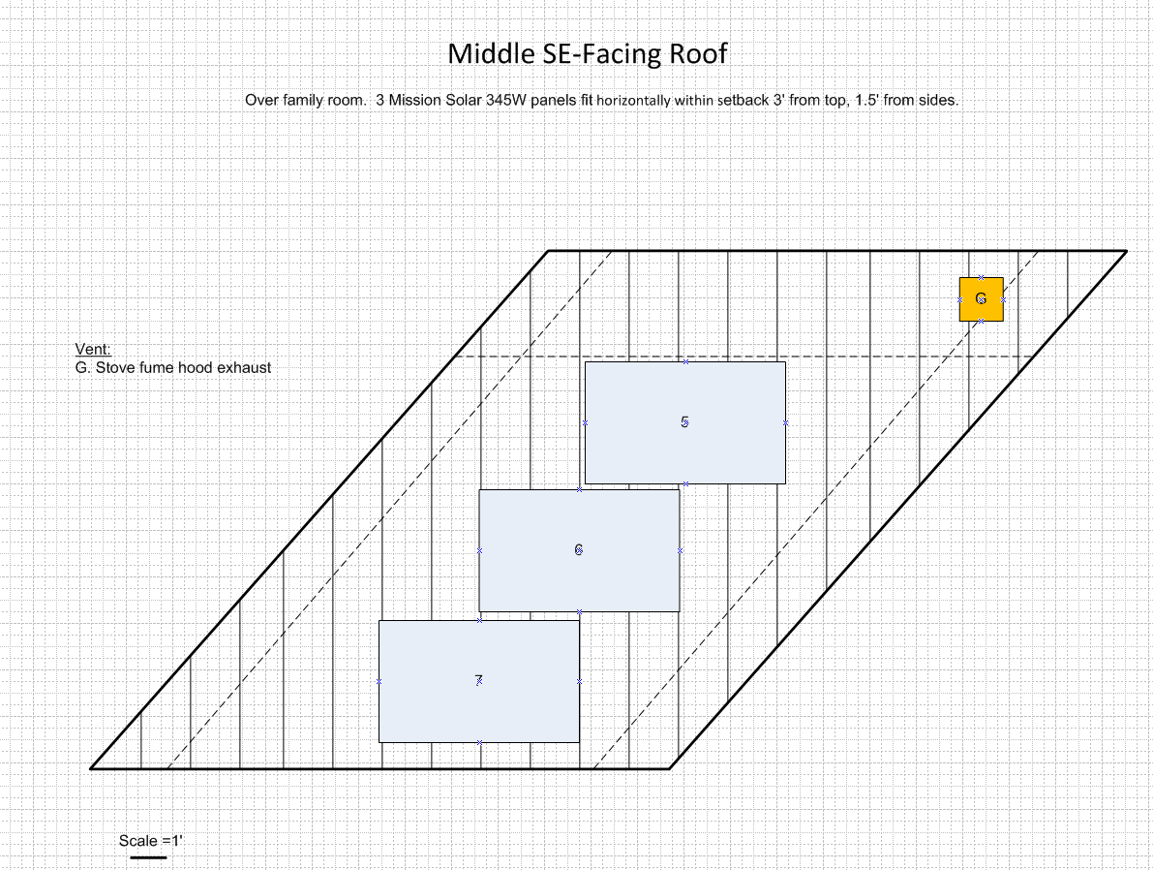
PV Panel Fit Analysis
Scenario C, 345 Watt Mission panels all horizontal: 21 without thermal solar, 19 with thermal solar

Slide 2
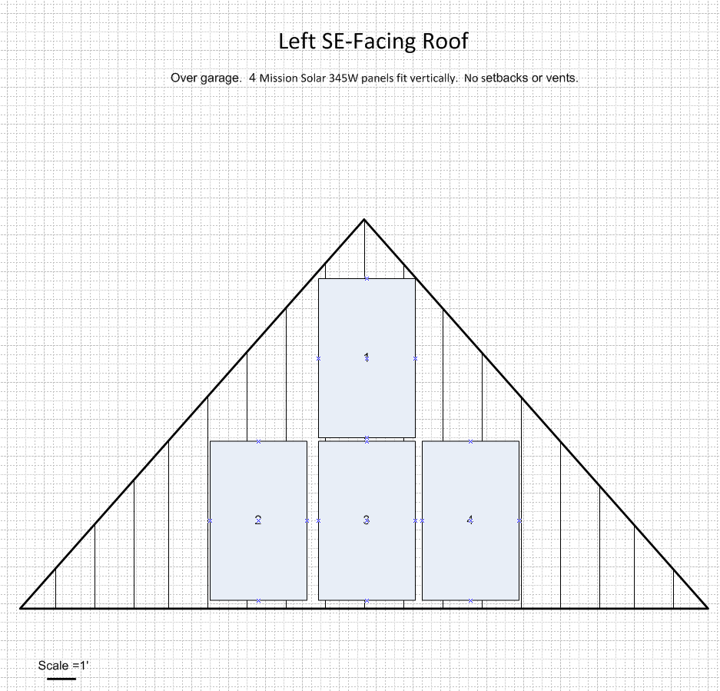
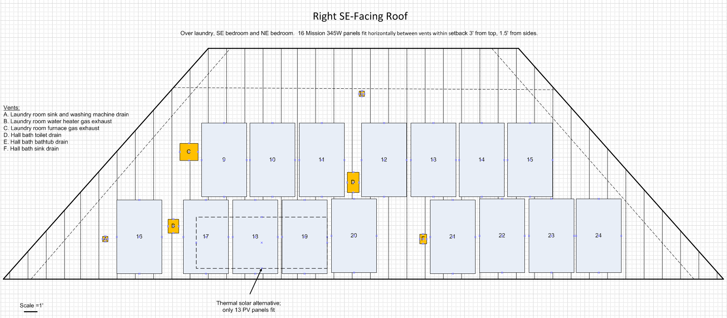
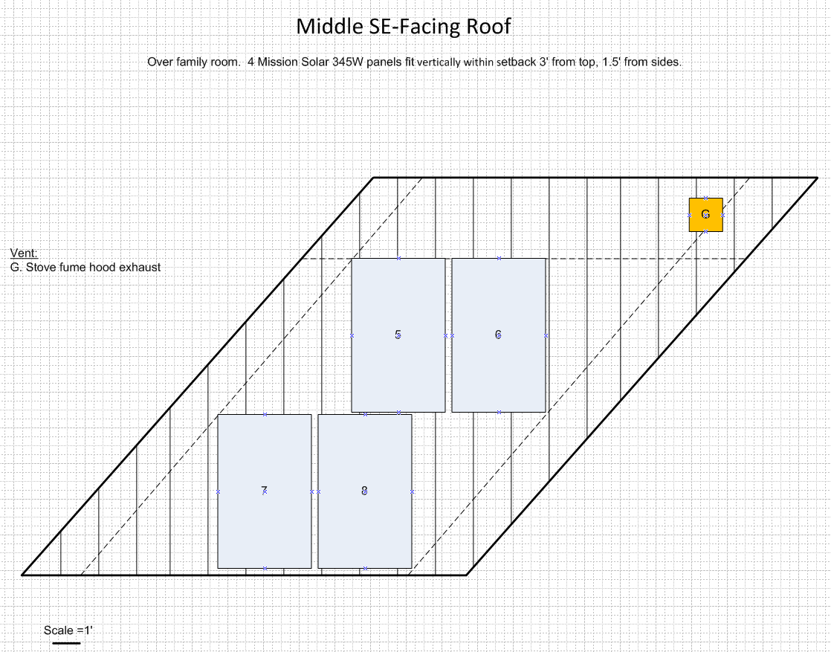
PV Panel Fit Analysis
Scenario D, 345 Watt Mission panels all vertical: 24 without thermal solar, 21 with thermal solar

Slide 3
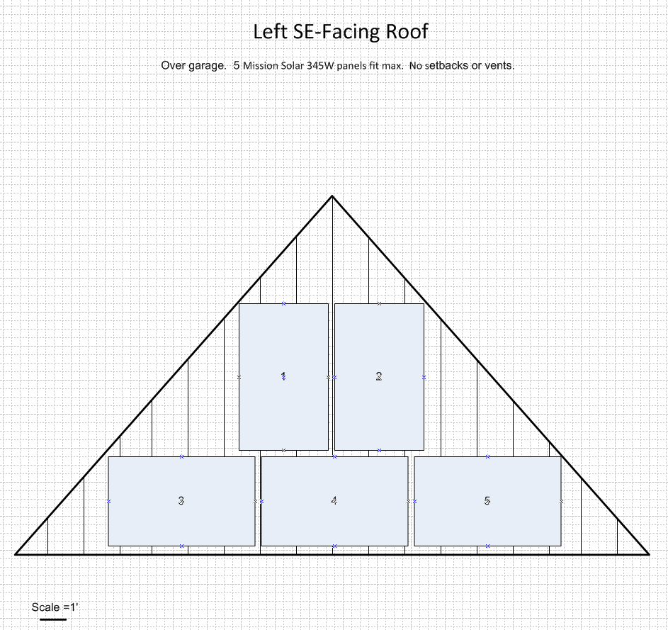
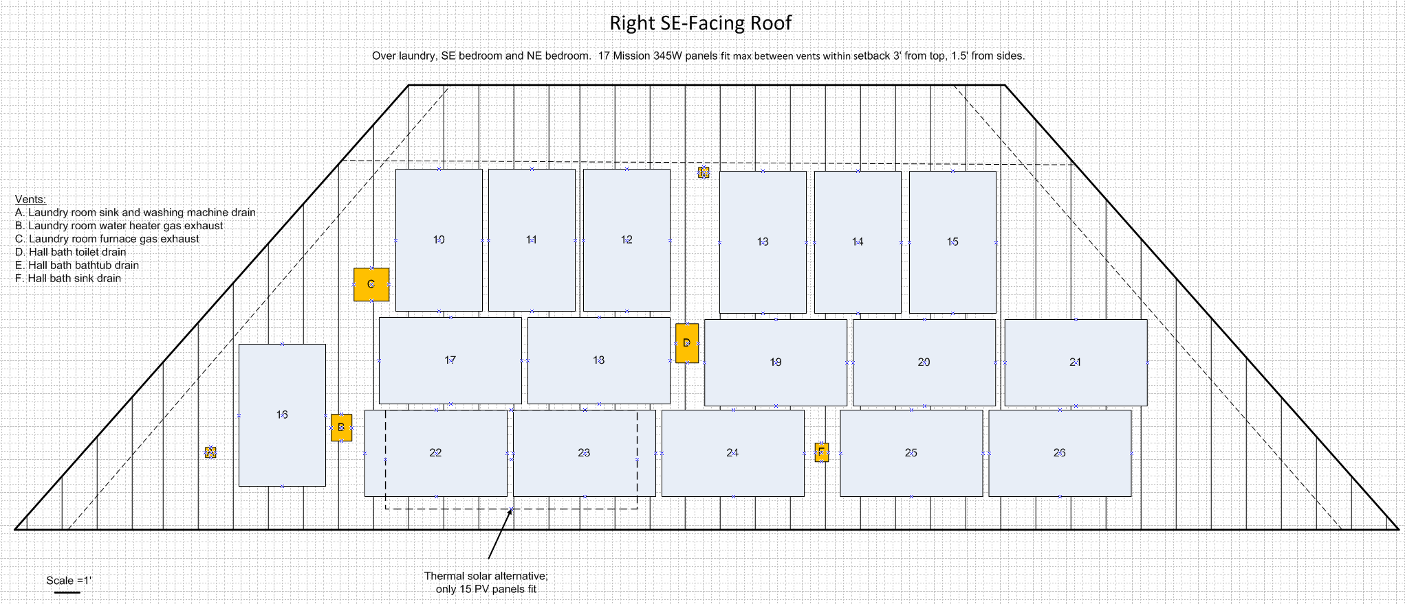
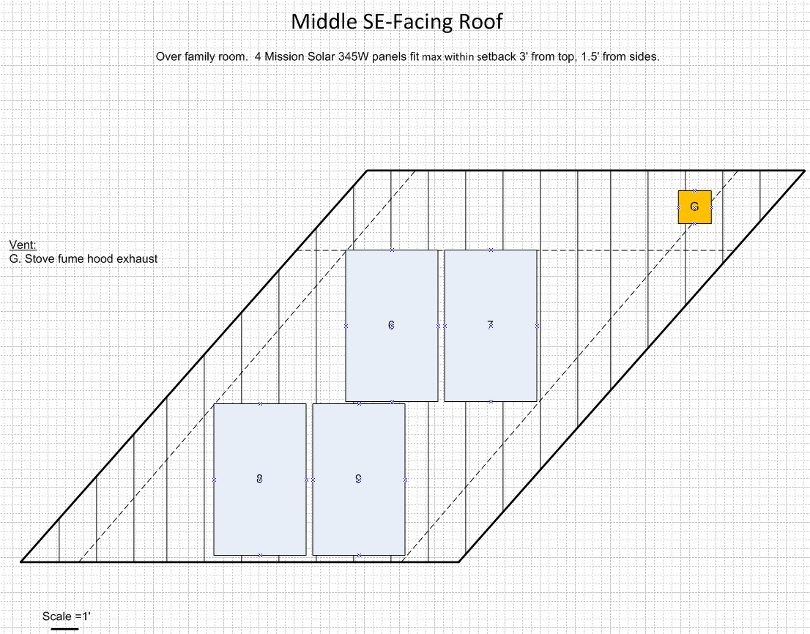
PV Panel Fit Analysis
Scenario E, 345 Watt Mission panels mixed orientation: 26 without thermal solar, 24 with thermal solar

